Slide 1

The role of climate legacies in shaping extinction risk throughout Earth's history
University of Bayreuth
Gregor Mathes
PhD Defense
02.02.2023

Slide 2

One of the defining features of the Anthropocene is that the world is changing in ways that compel species to move
Elizabeth Kolbert, The Sixth Extinction: An Unnatural History

Slide 3
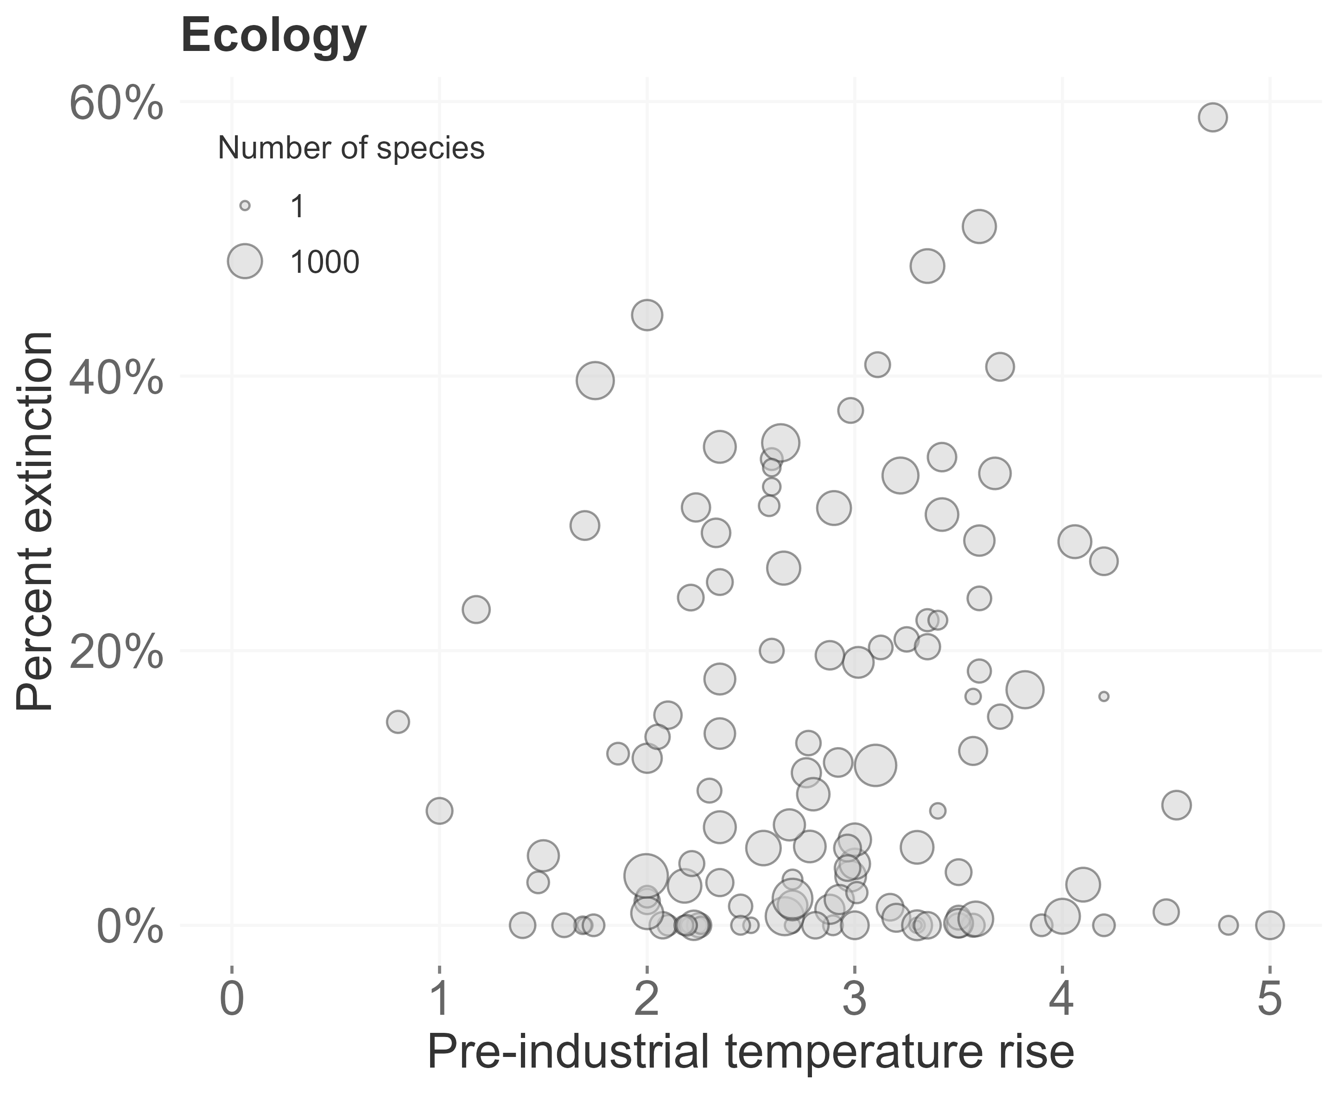
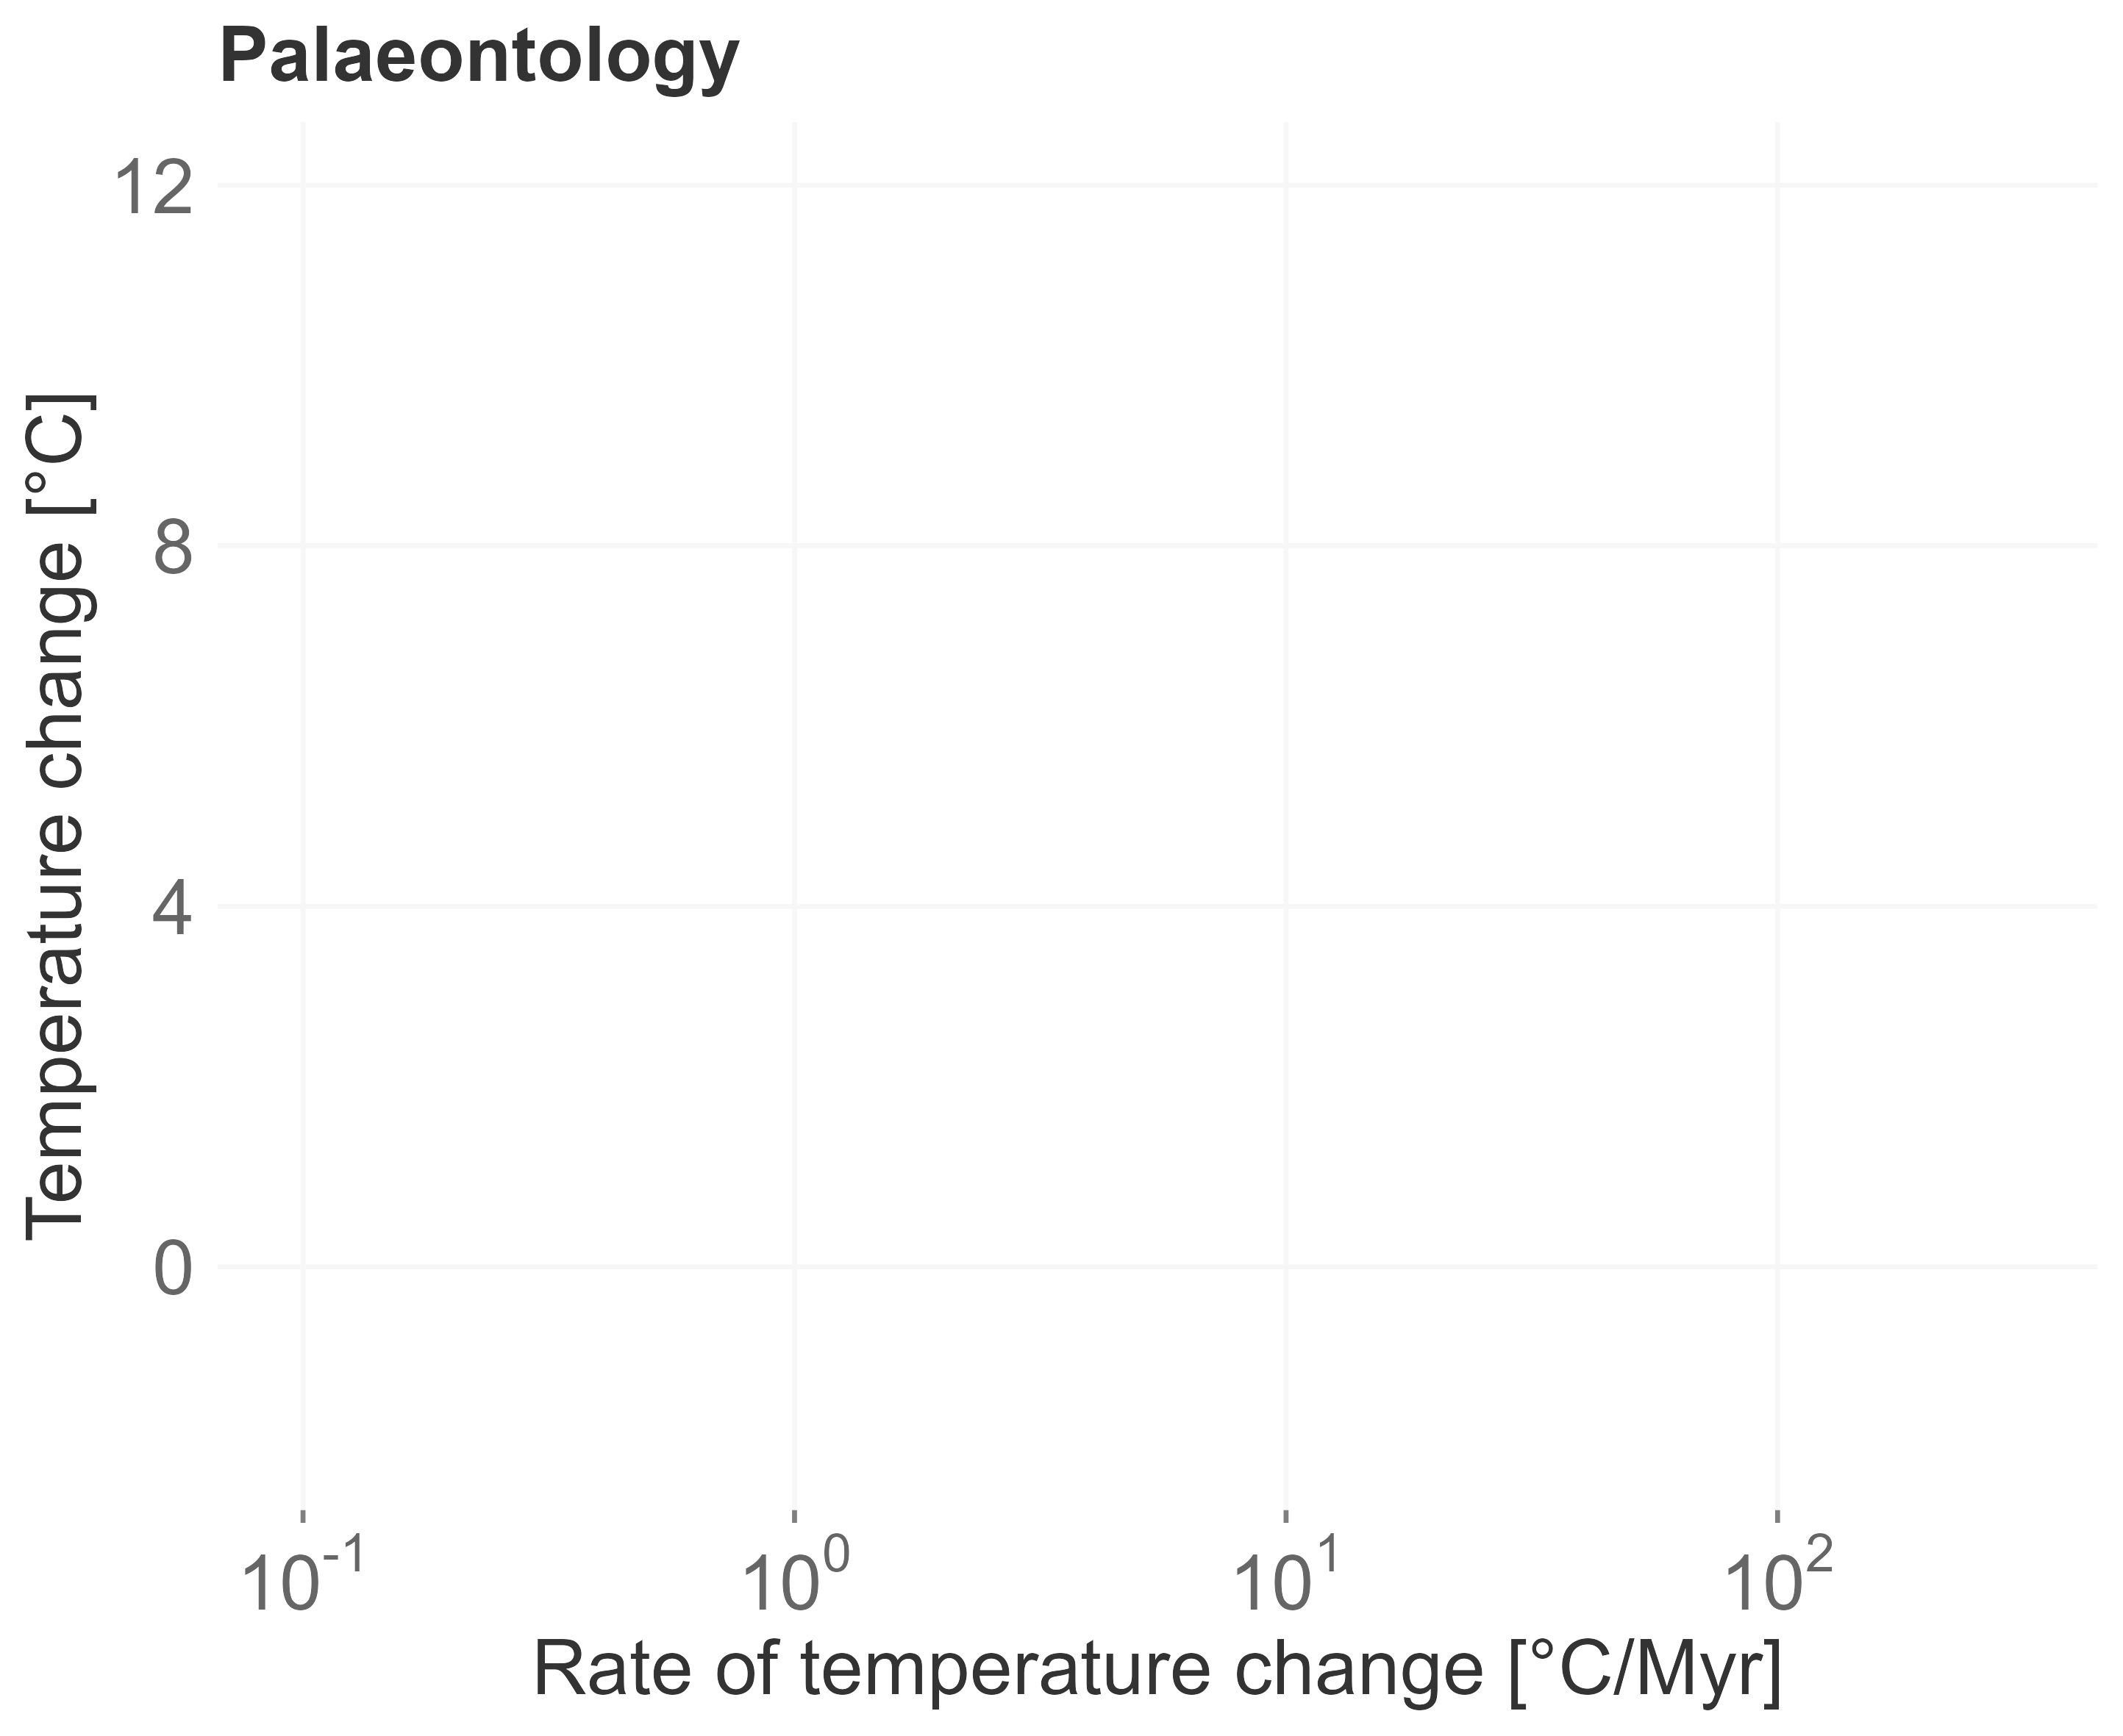
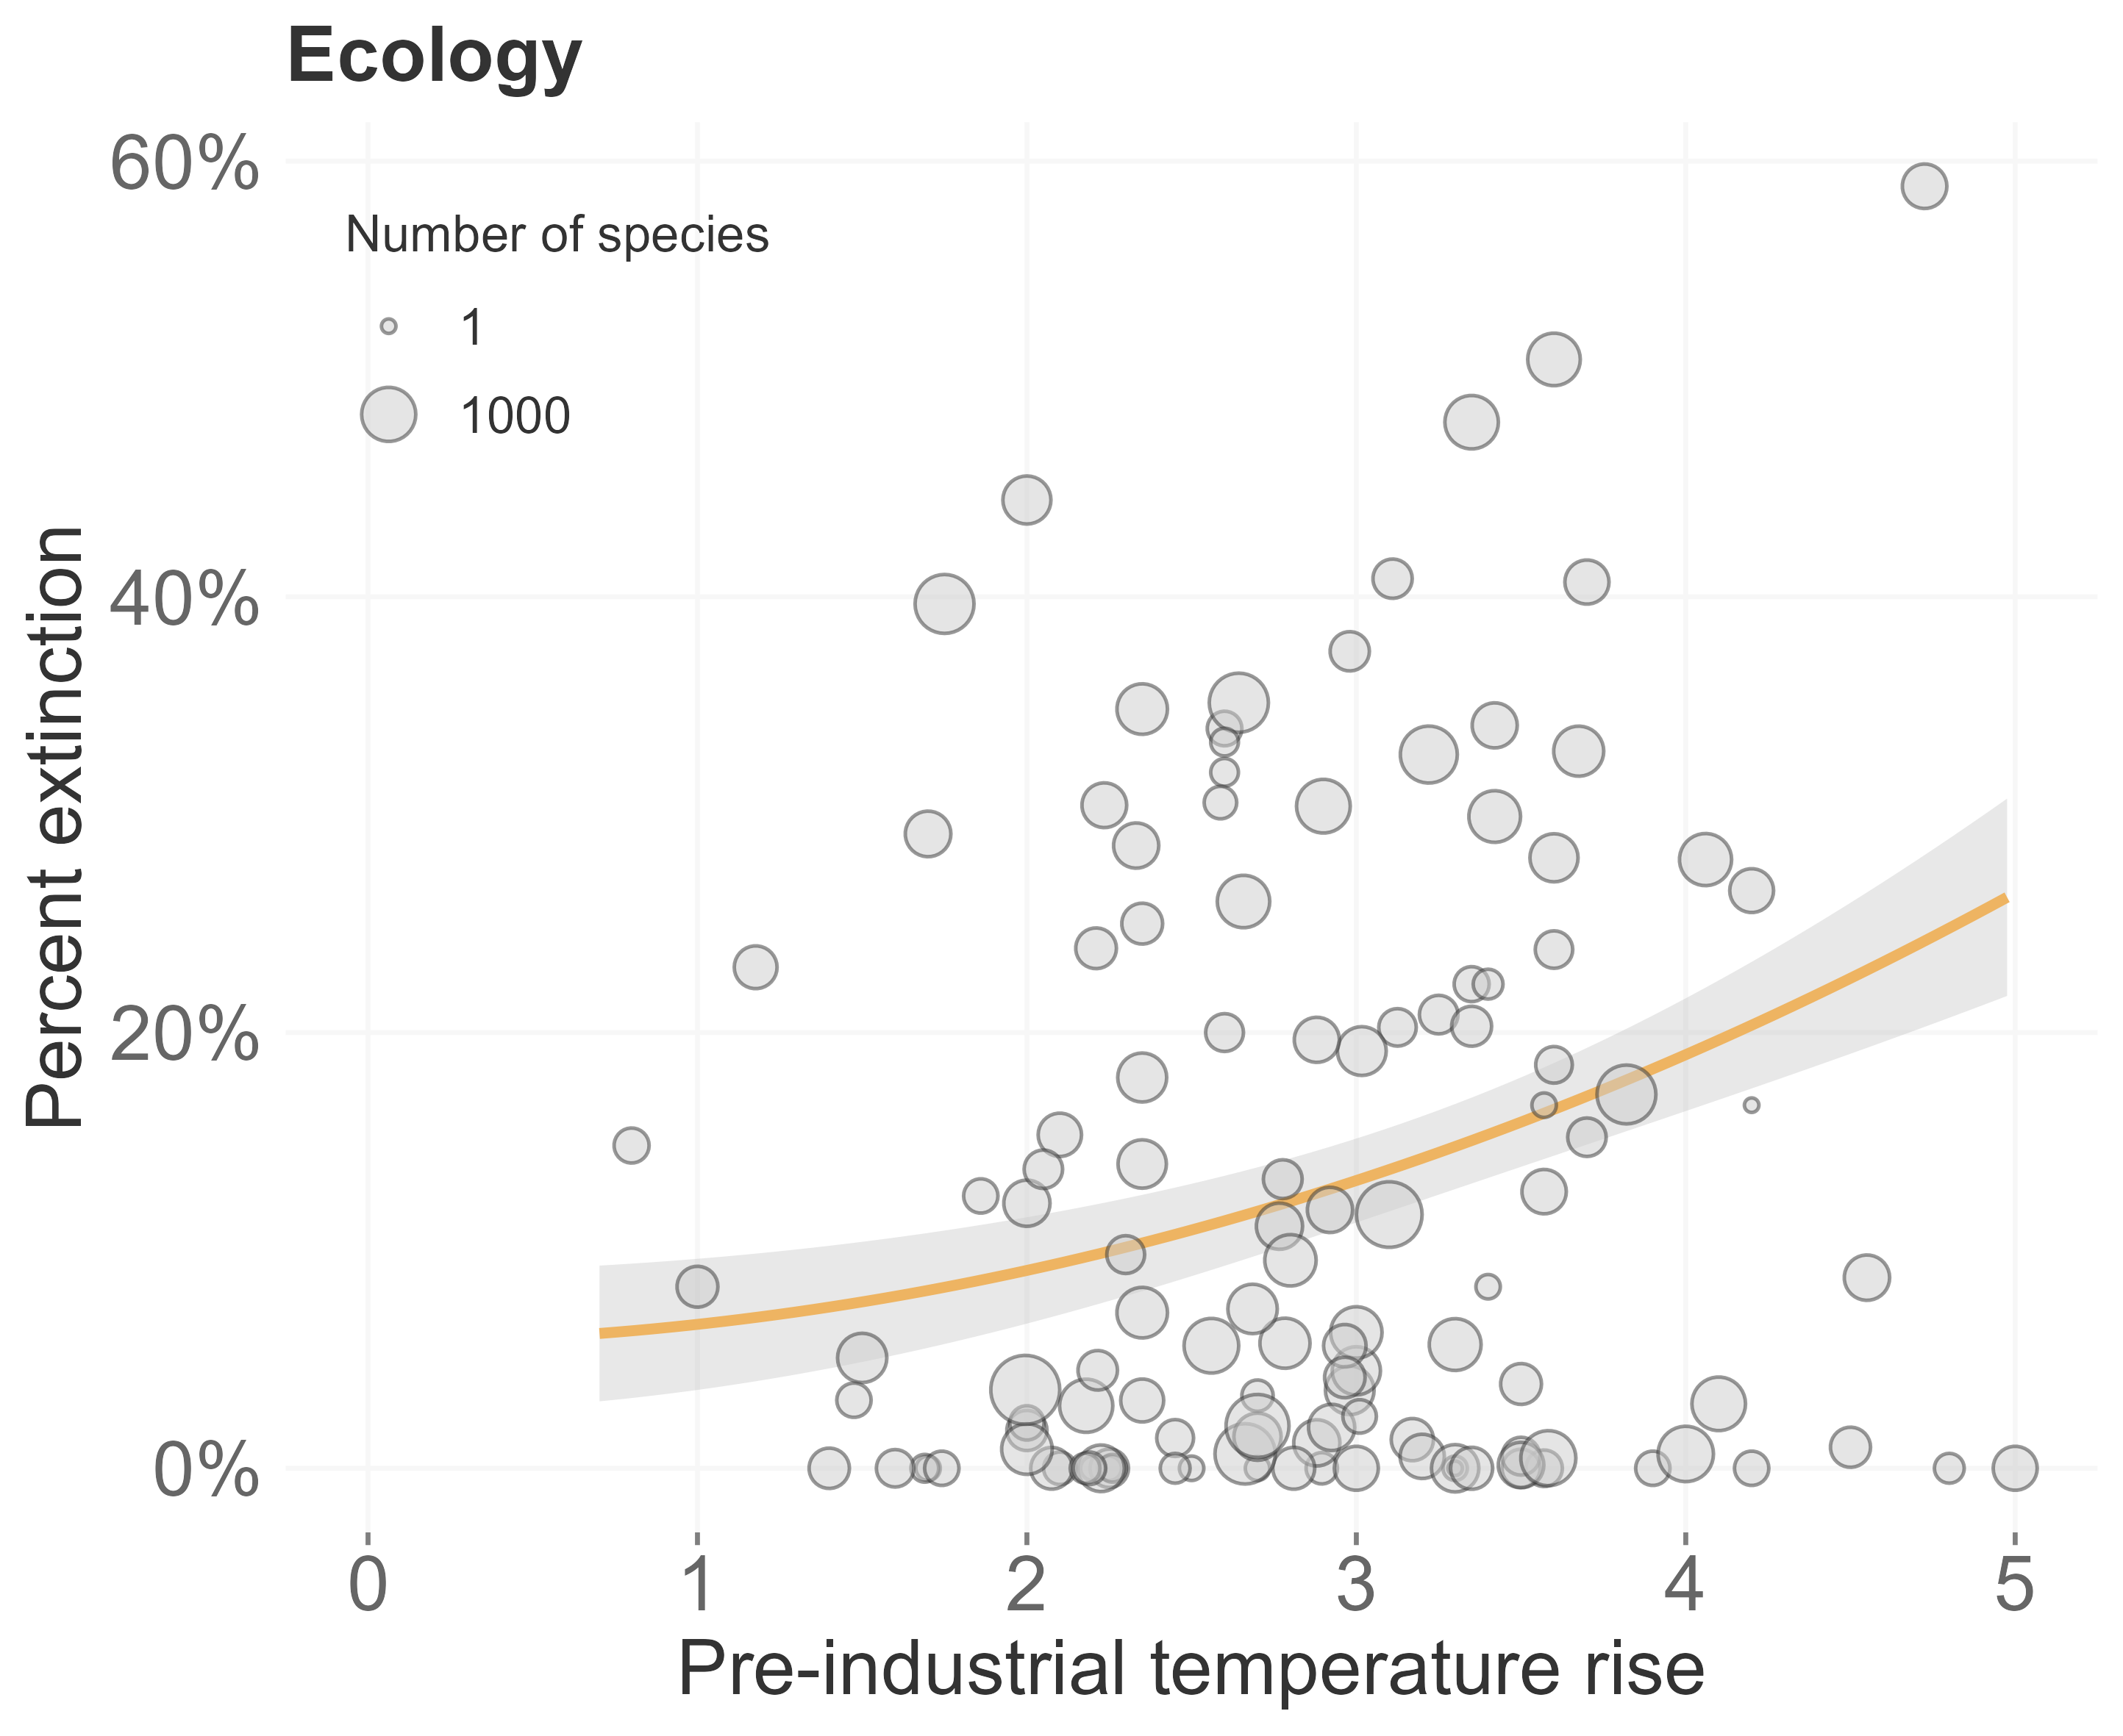
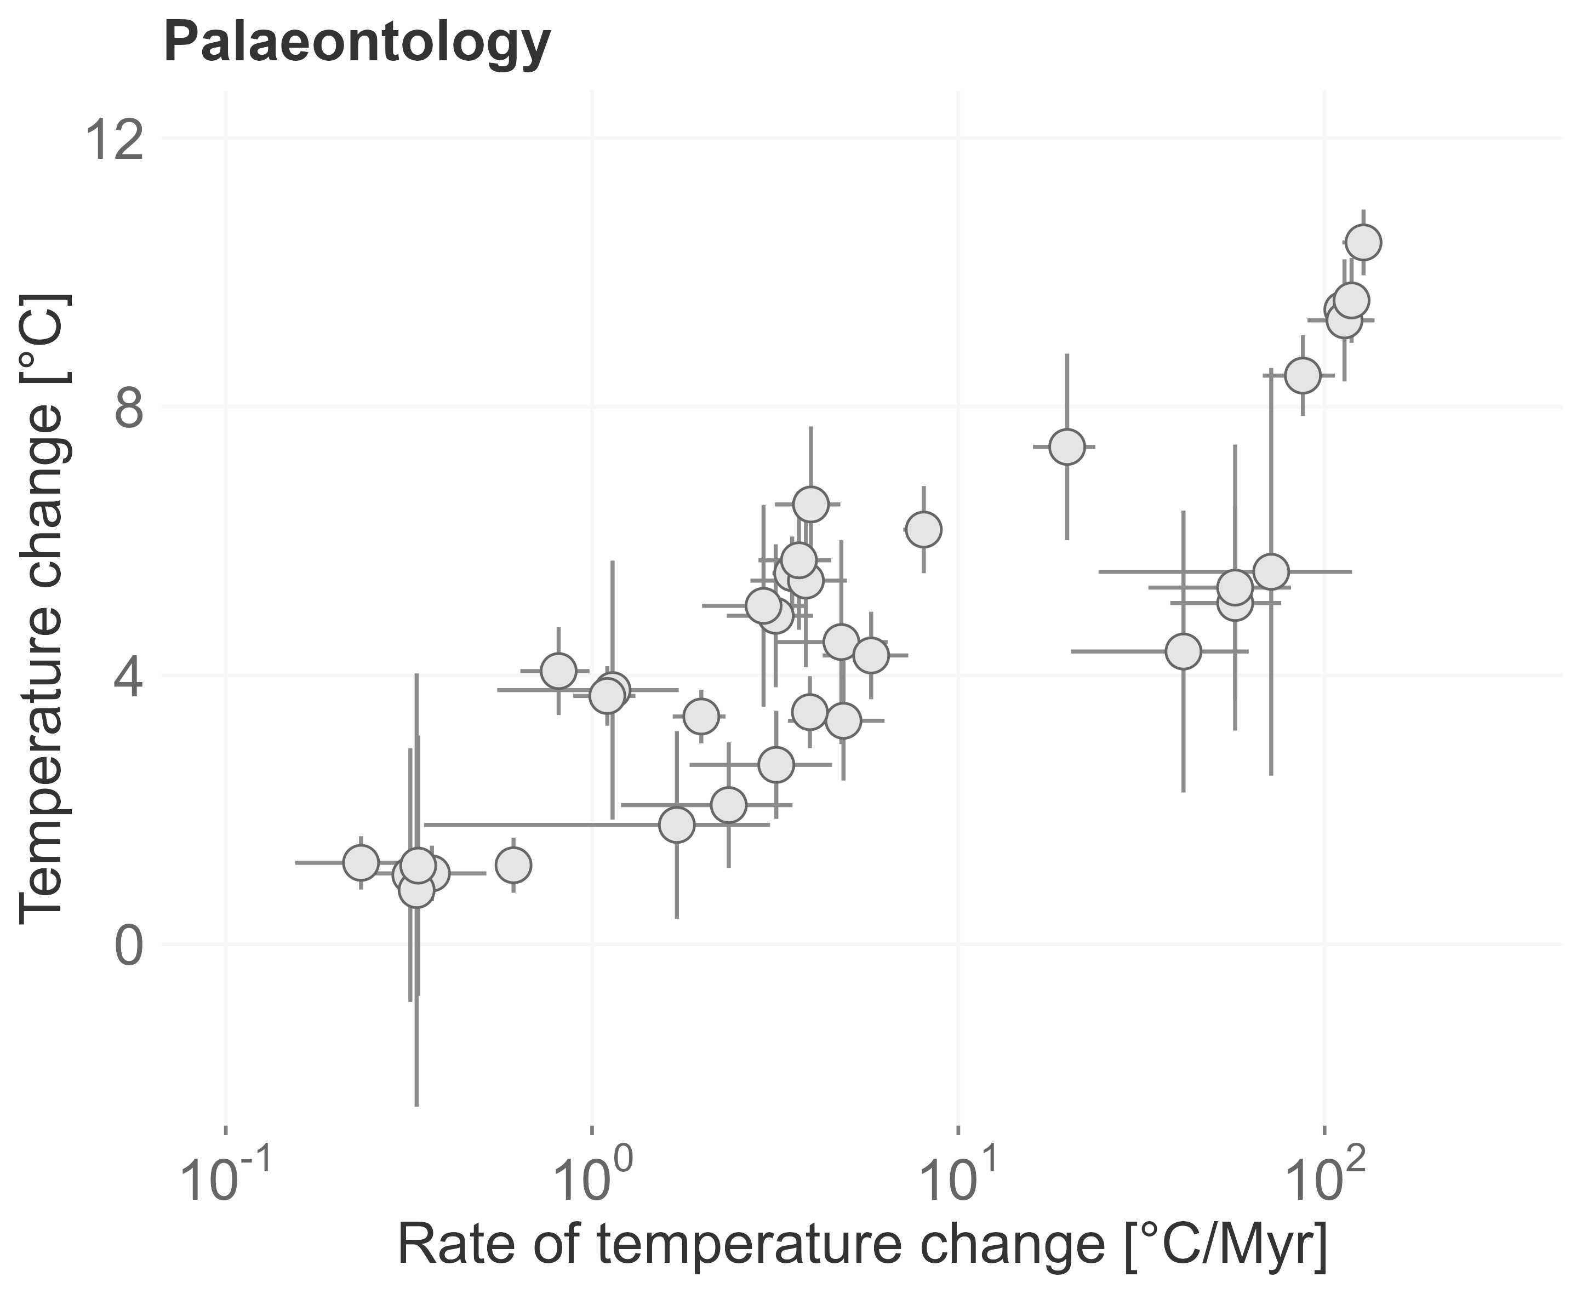
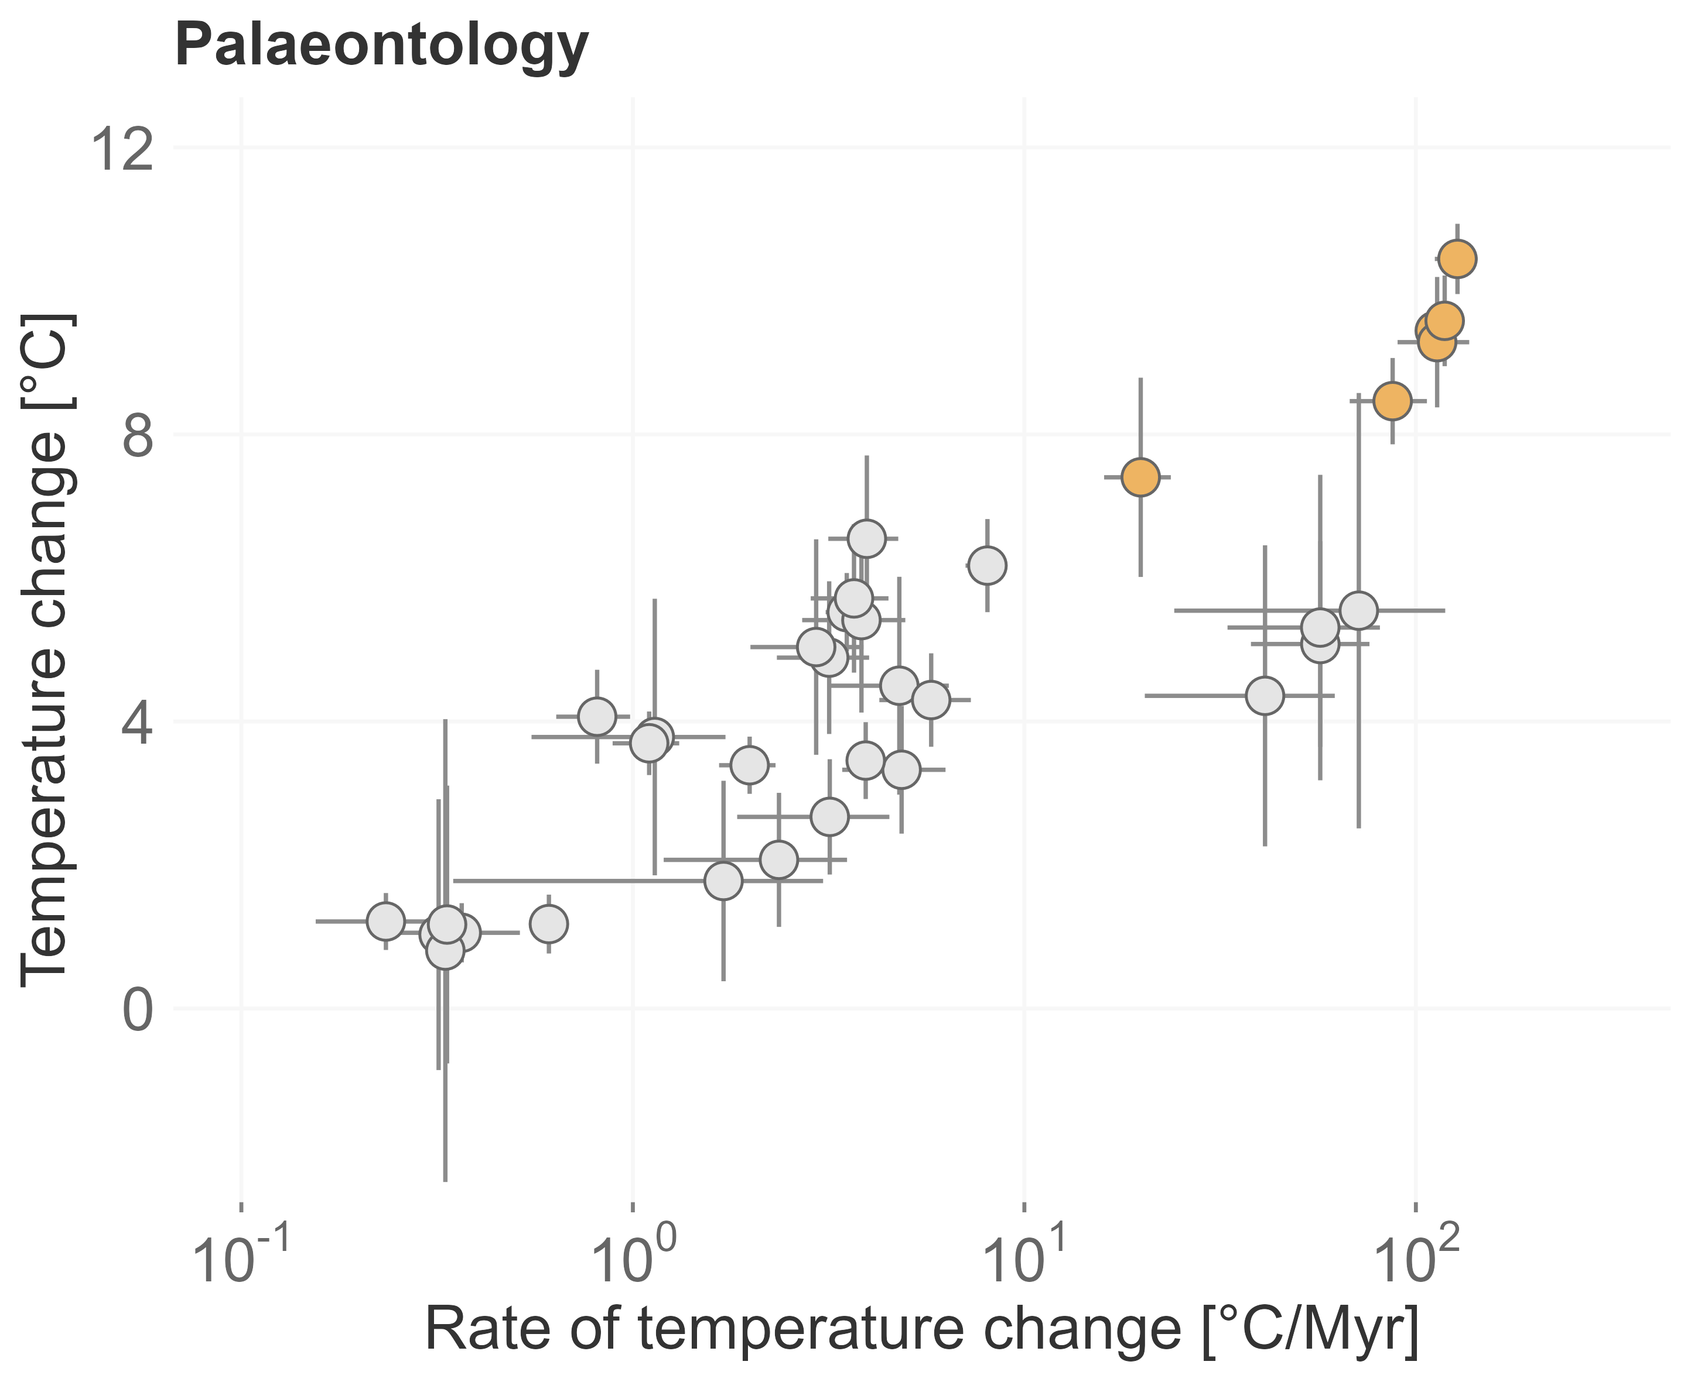

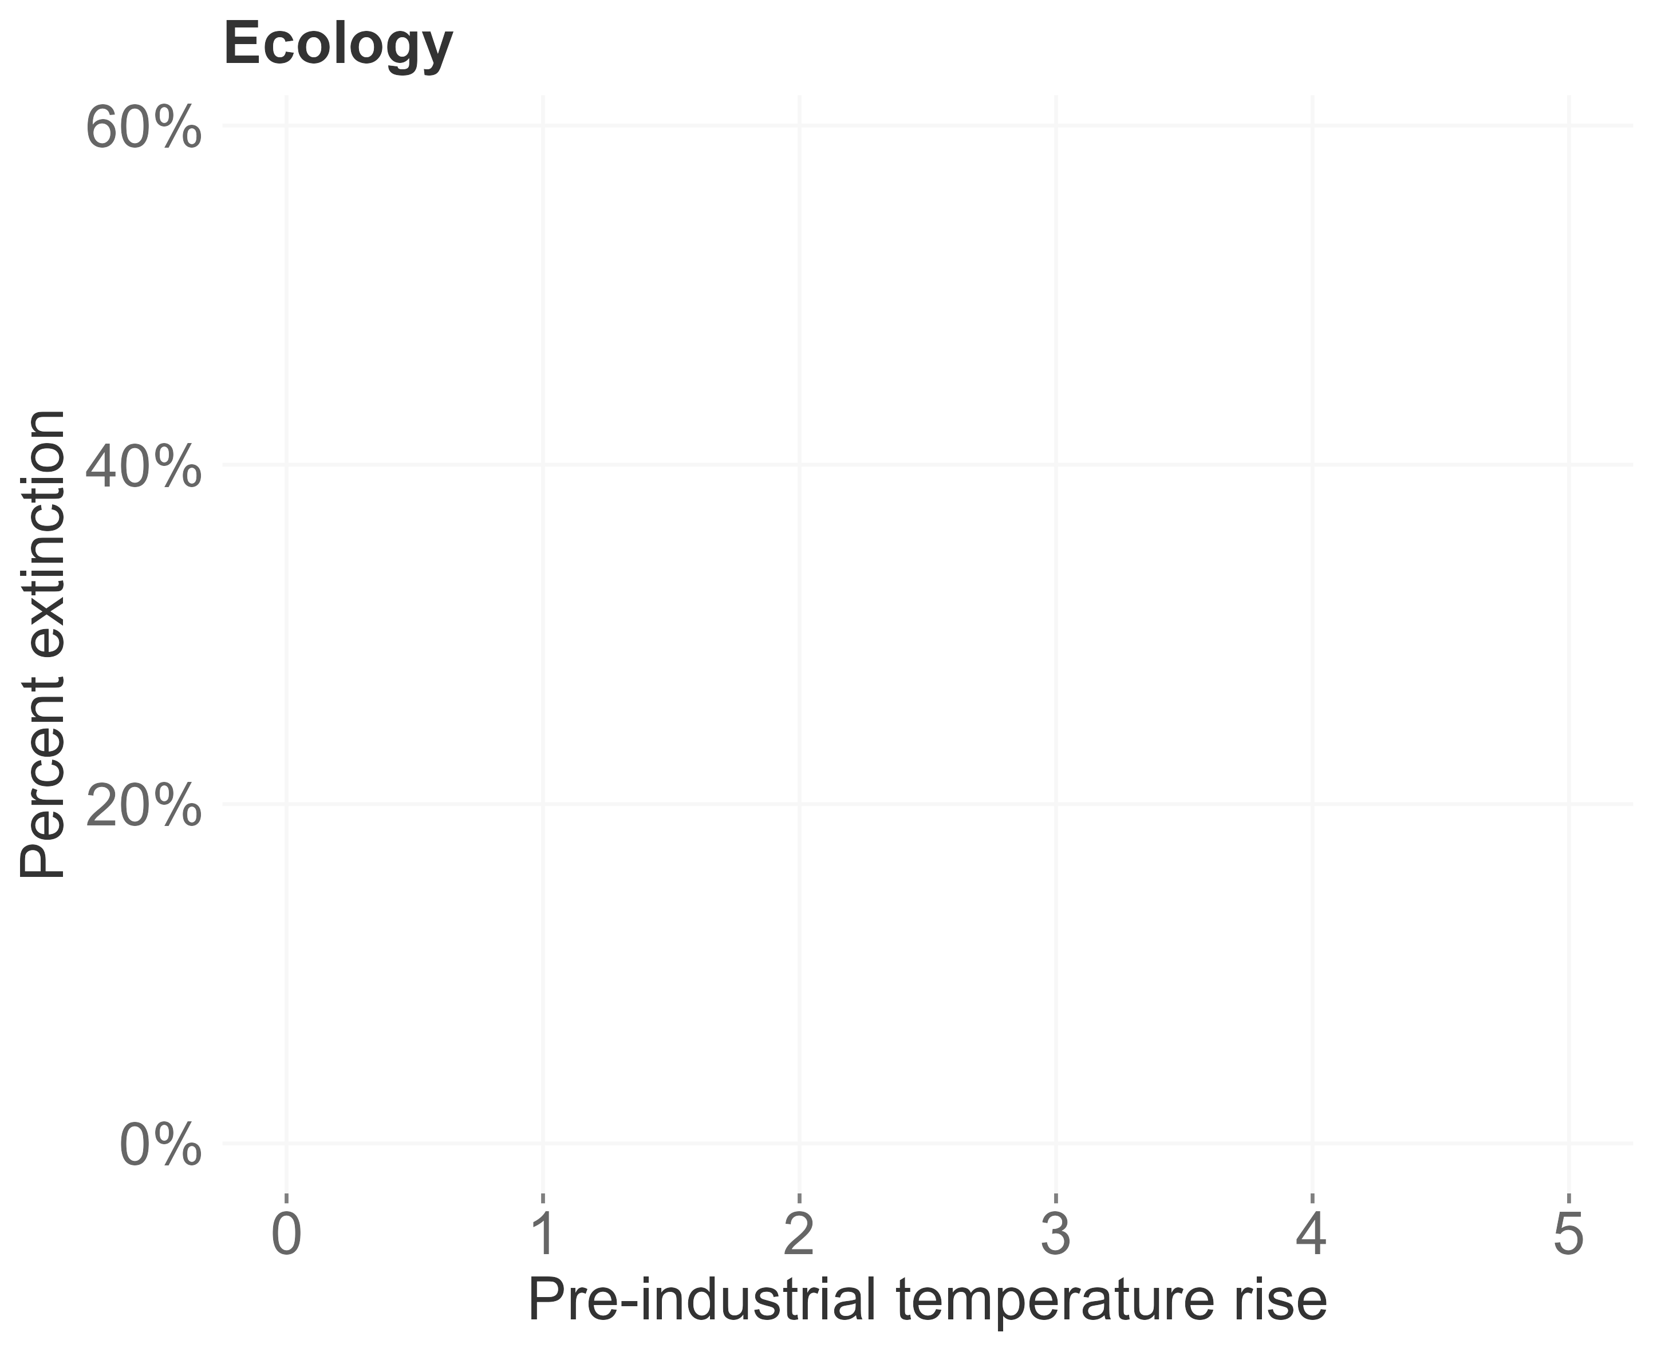
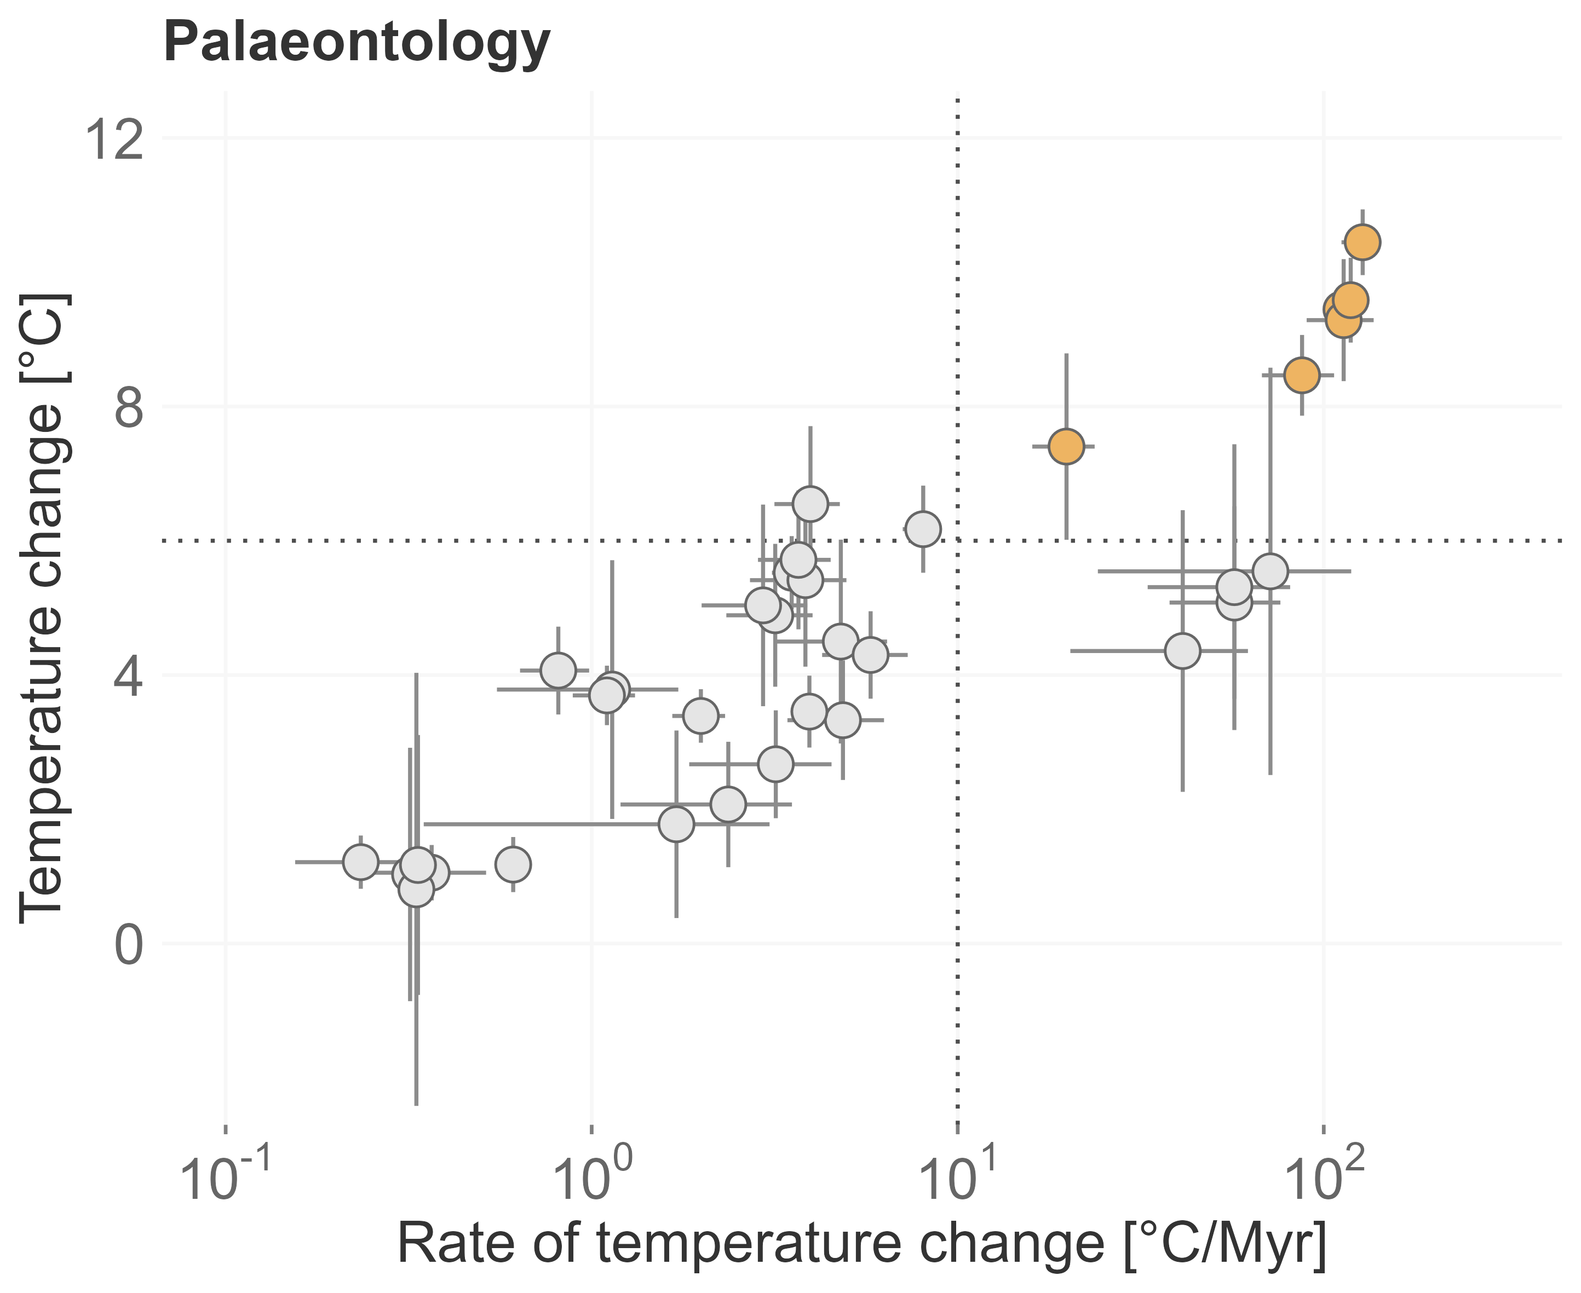
Two approaches
modified after Urban 2015
modified after Song et al. 2022

Slide 4






Temporal context matters
Deep-Time
Extinction risk of fossils
Origination probability of fossils
Environmental data during extinction events
Near-Time
Rate of change in terrestrial plants
Assemblage turnover in planktonic foraminifera
Implementation in conservation science
Meta-analysis and review

Slide 5
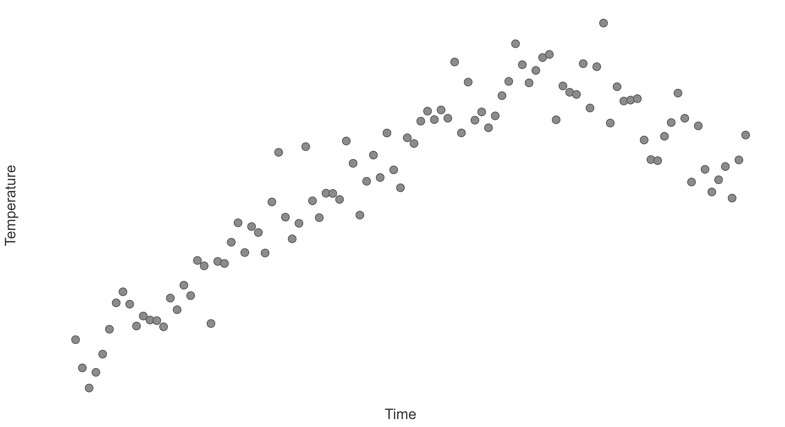
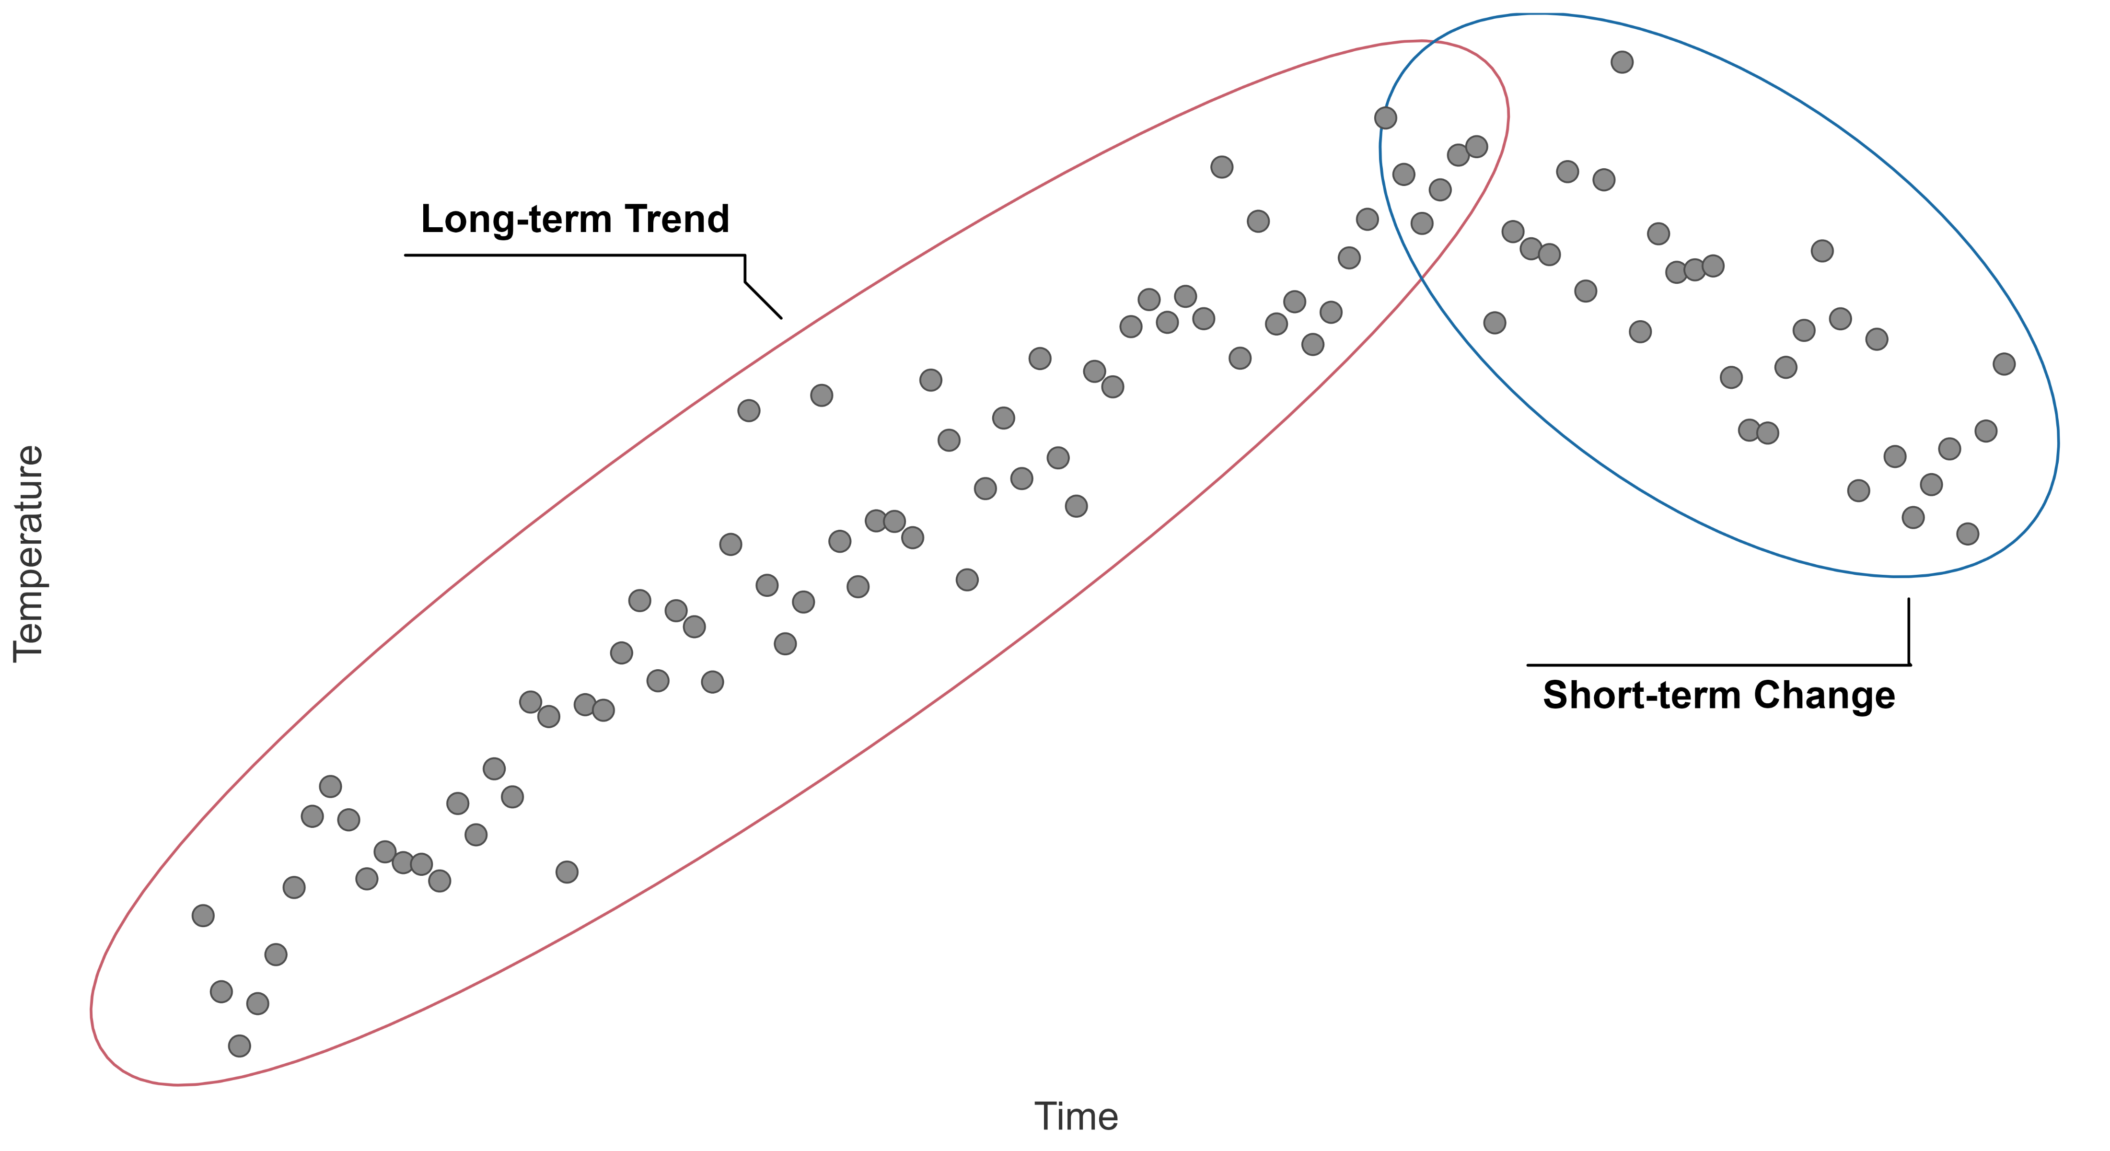
Temporal context

Slide 6
Niche stability
- Temperature +
Topt
Time
Performance
Tmin
Tmax
Temperature
Wiens and Graham 2005
Lieberman and Saupe 2016
Steinbauer et al. 2016

Slide 7
Niche stability
- Temperature +
Topt
Time
Performance
Tmin
Tmax
Temperature
Wiens and Graham 2005
Lieberman and Saupe 2016
Steinbauer et al. 2016

Slide 8
Climate interaction
- Temperature +
- Temperature +
Time
Time
- Temperature +
- Temperature +
Time
Time

Slide 9
Methodology
ΔTtrend₁
ΔTtrend₂
- Temperature +
ΔTchange
ΔTtrend₃
Time
Ecological data
X
X
X
X
X
X
X
X
X
X
X
Extinction
∫_{Time}
Extinction/survival(1,0,1,0)
Model
Extinction ~ ΔTchange : ΔTtrend + (random structure)
Mathes et al. 2021, Nature Ecology and Evolution

Slide 10






Extinction risk
δ¹⁸O
Genera
PaleoBioDB
Extinction events
Marine and terrestrial
6 million years / 6 to 24 million years

Slide 11
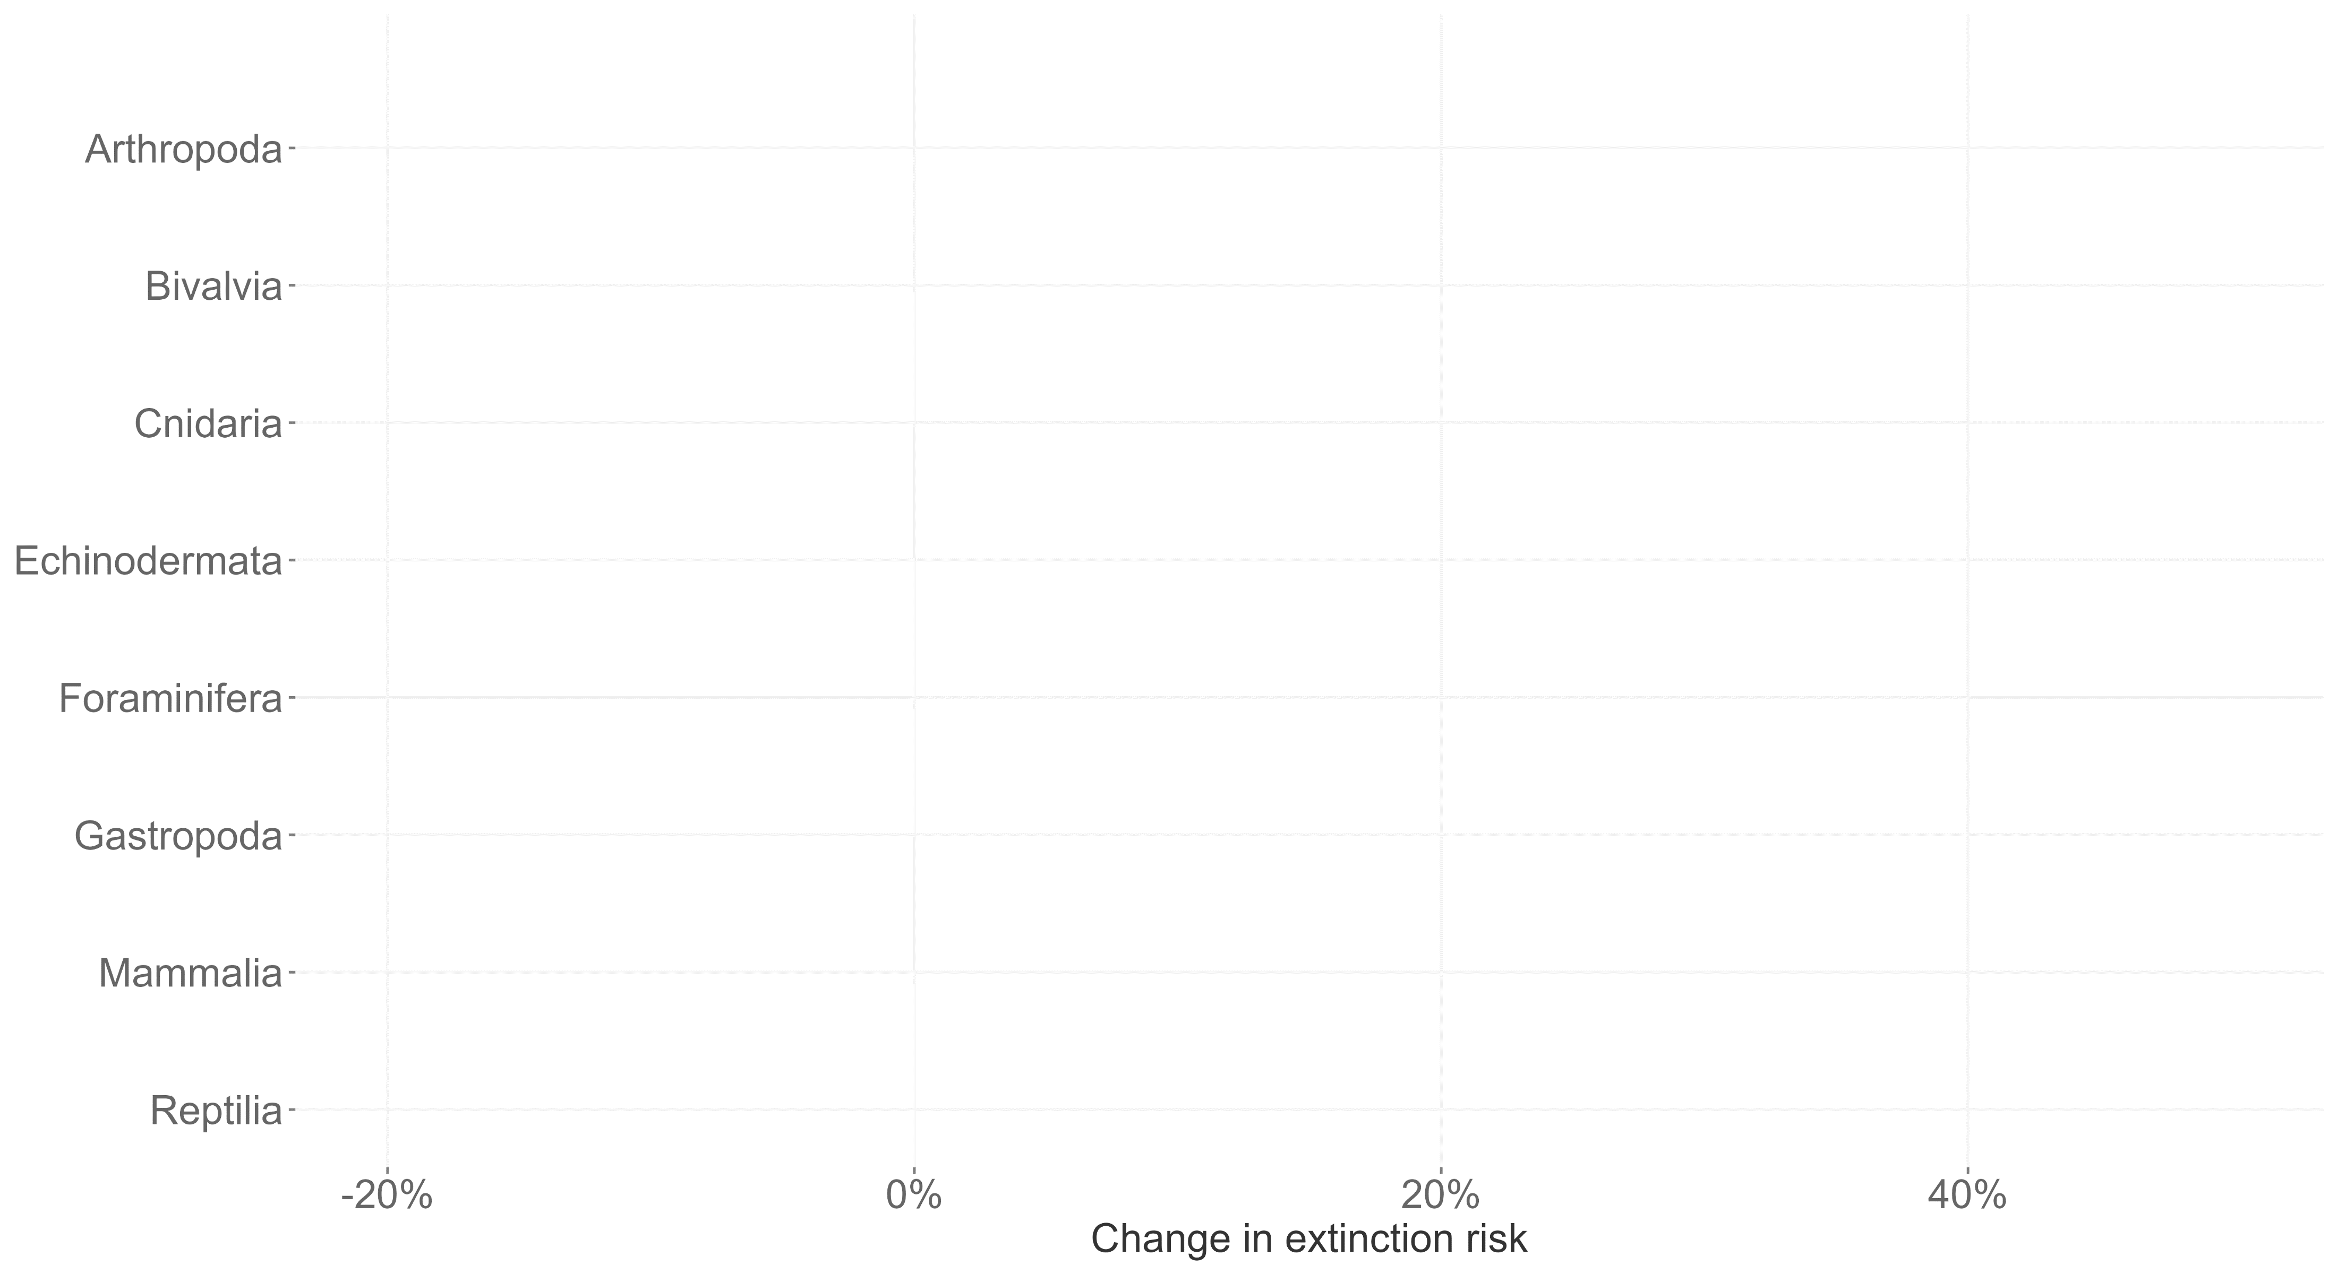
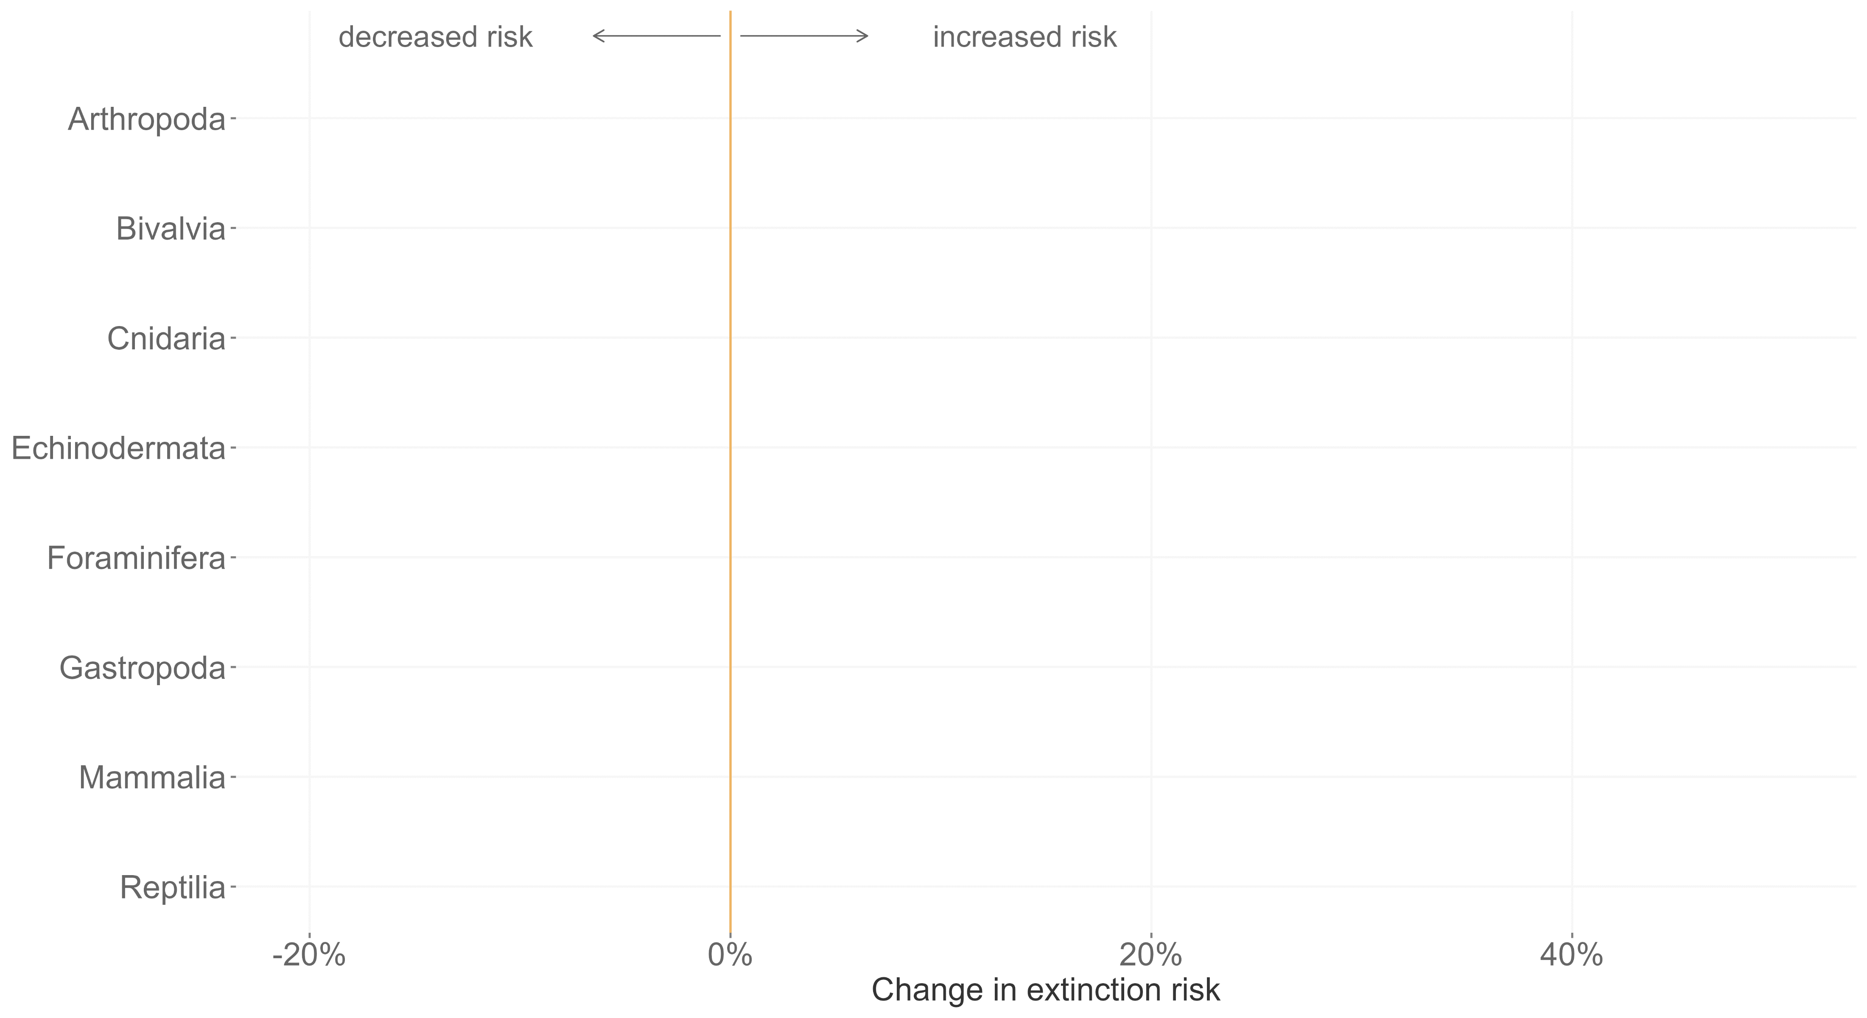
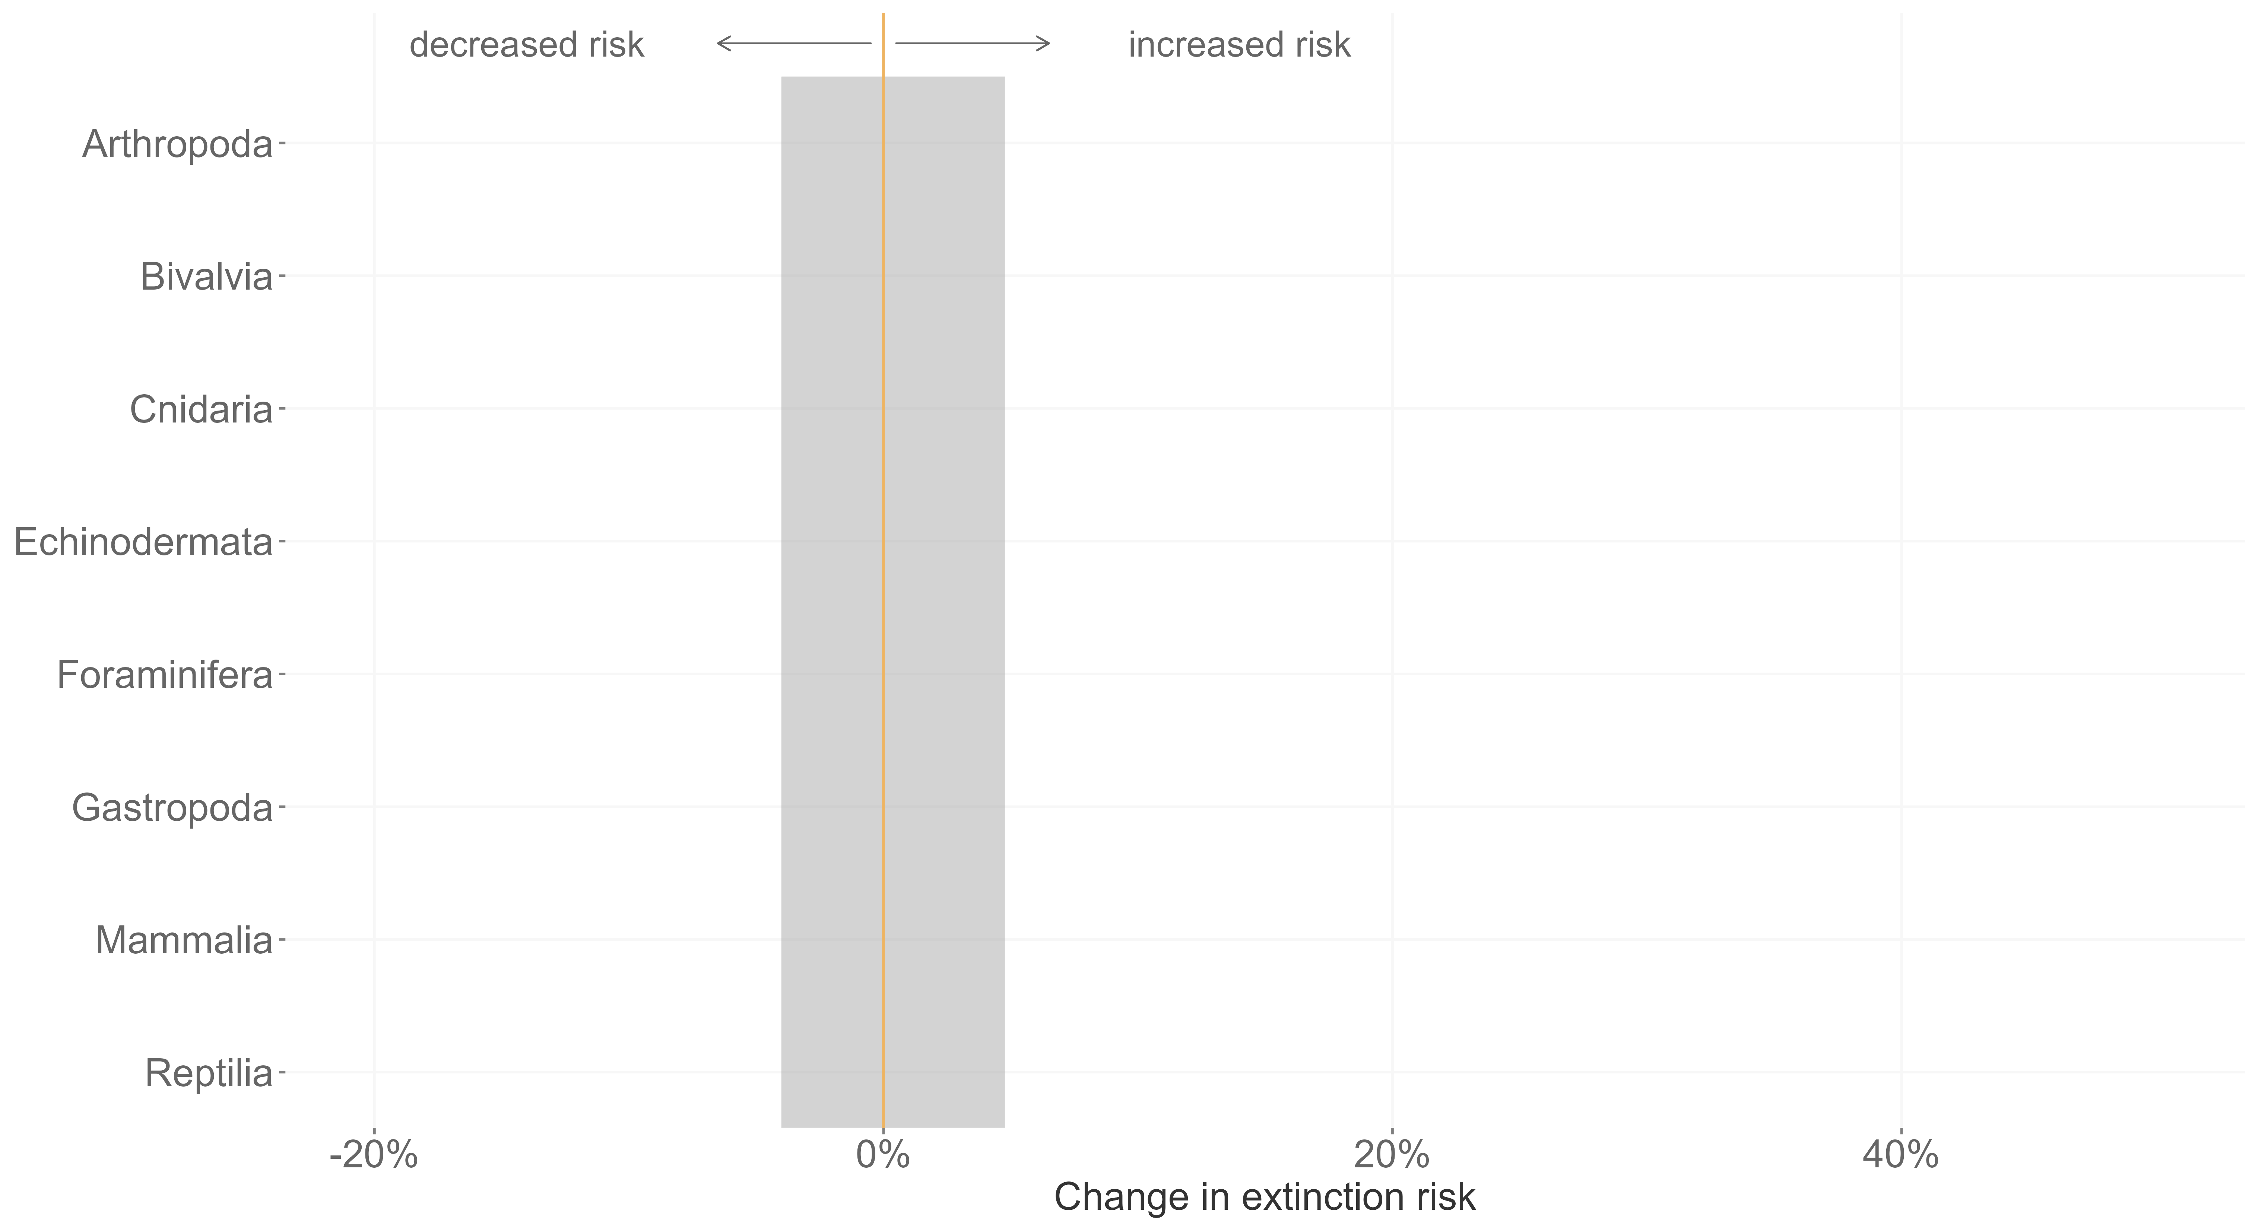
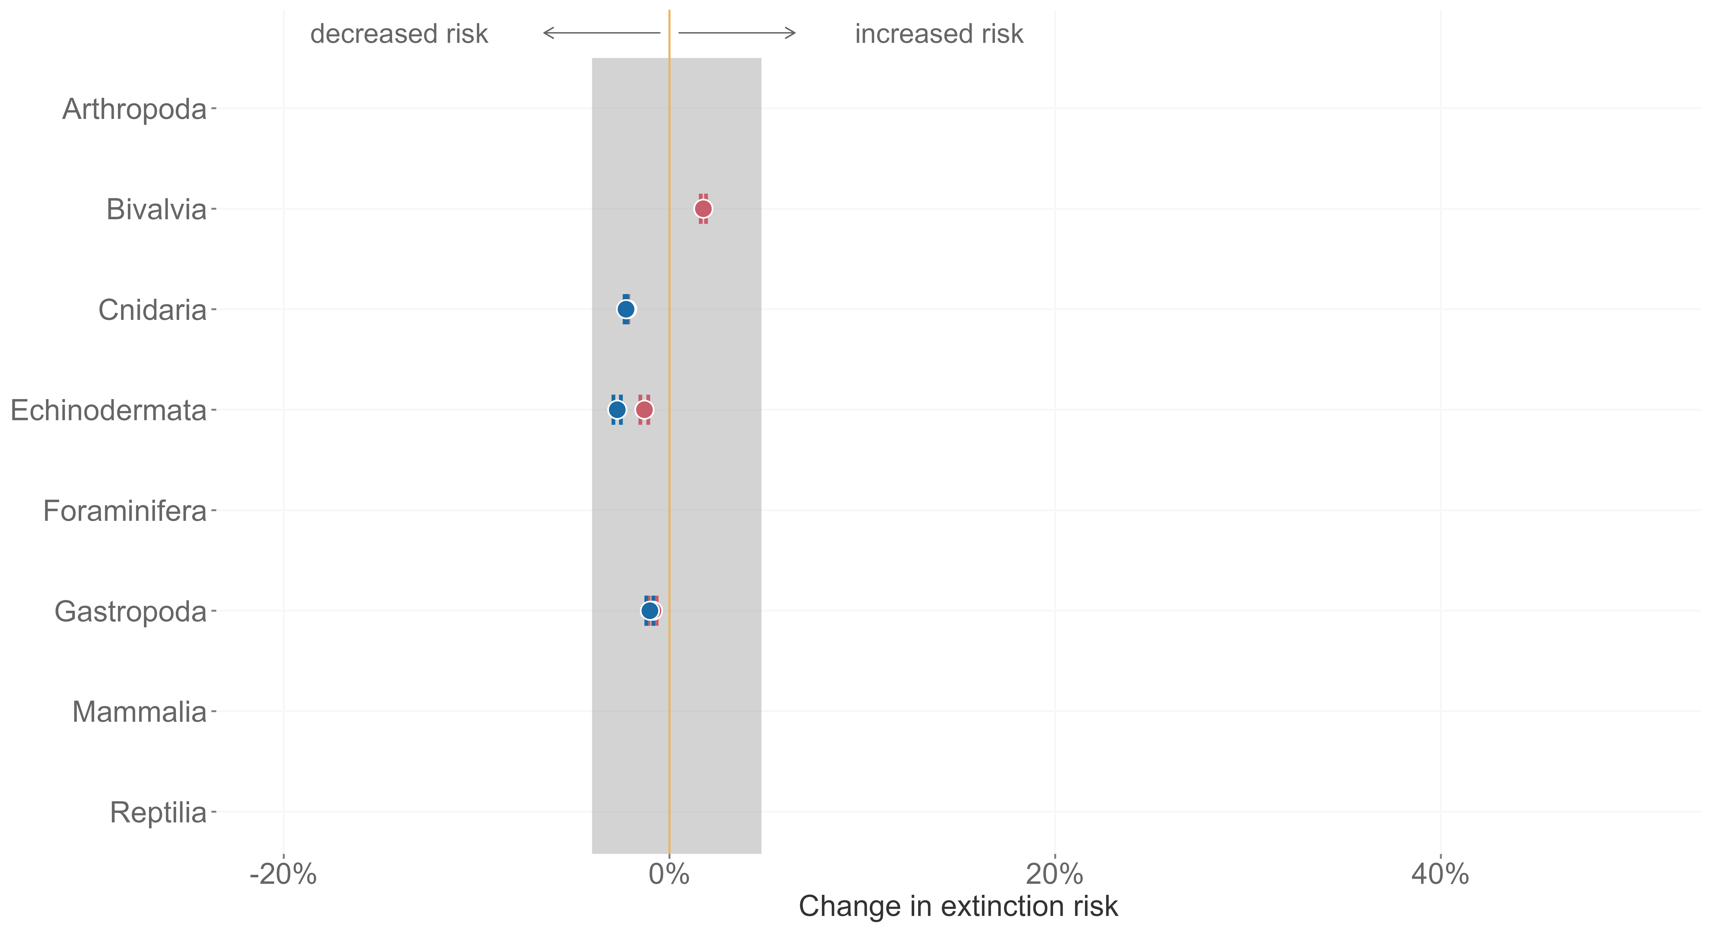
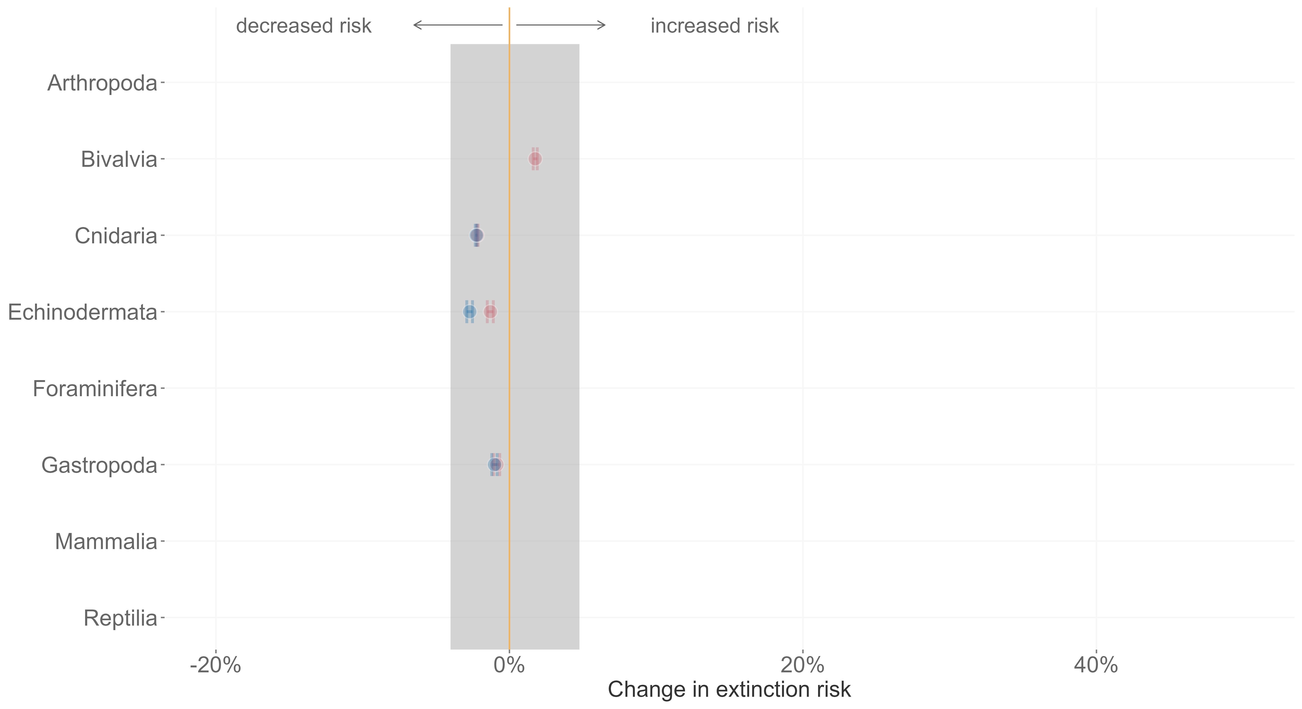
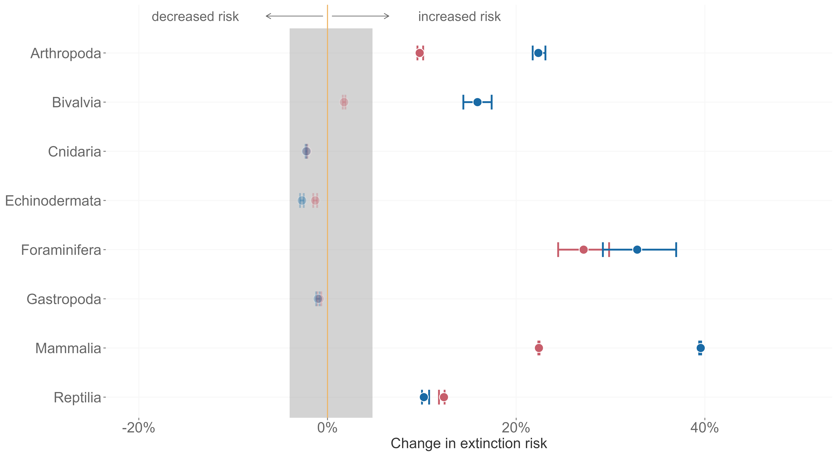
Mathes et al. 2021, Nature Ecology and Evolution

Slide 12

Origination probability
δ¹⁸O
Genera
PaleoBioDB
Marine only
Speciation events
6 million years / 6 to 24 million years

Slide 13
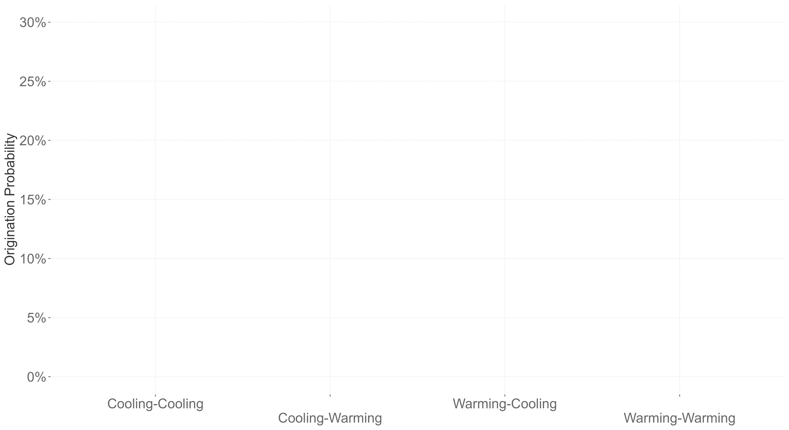
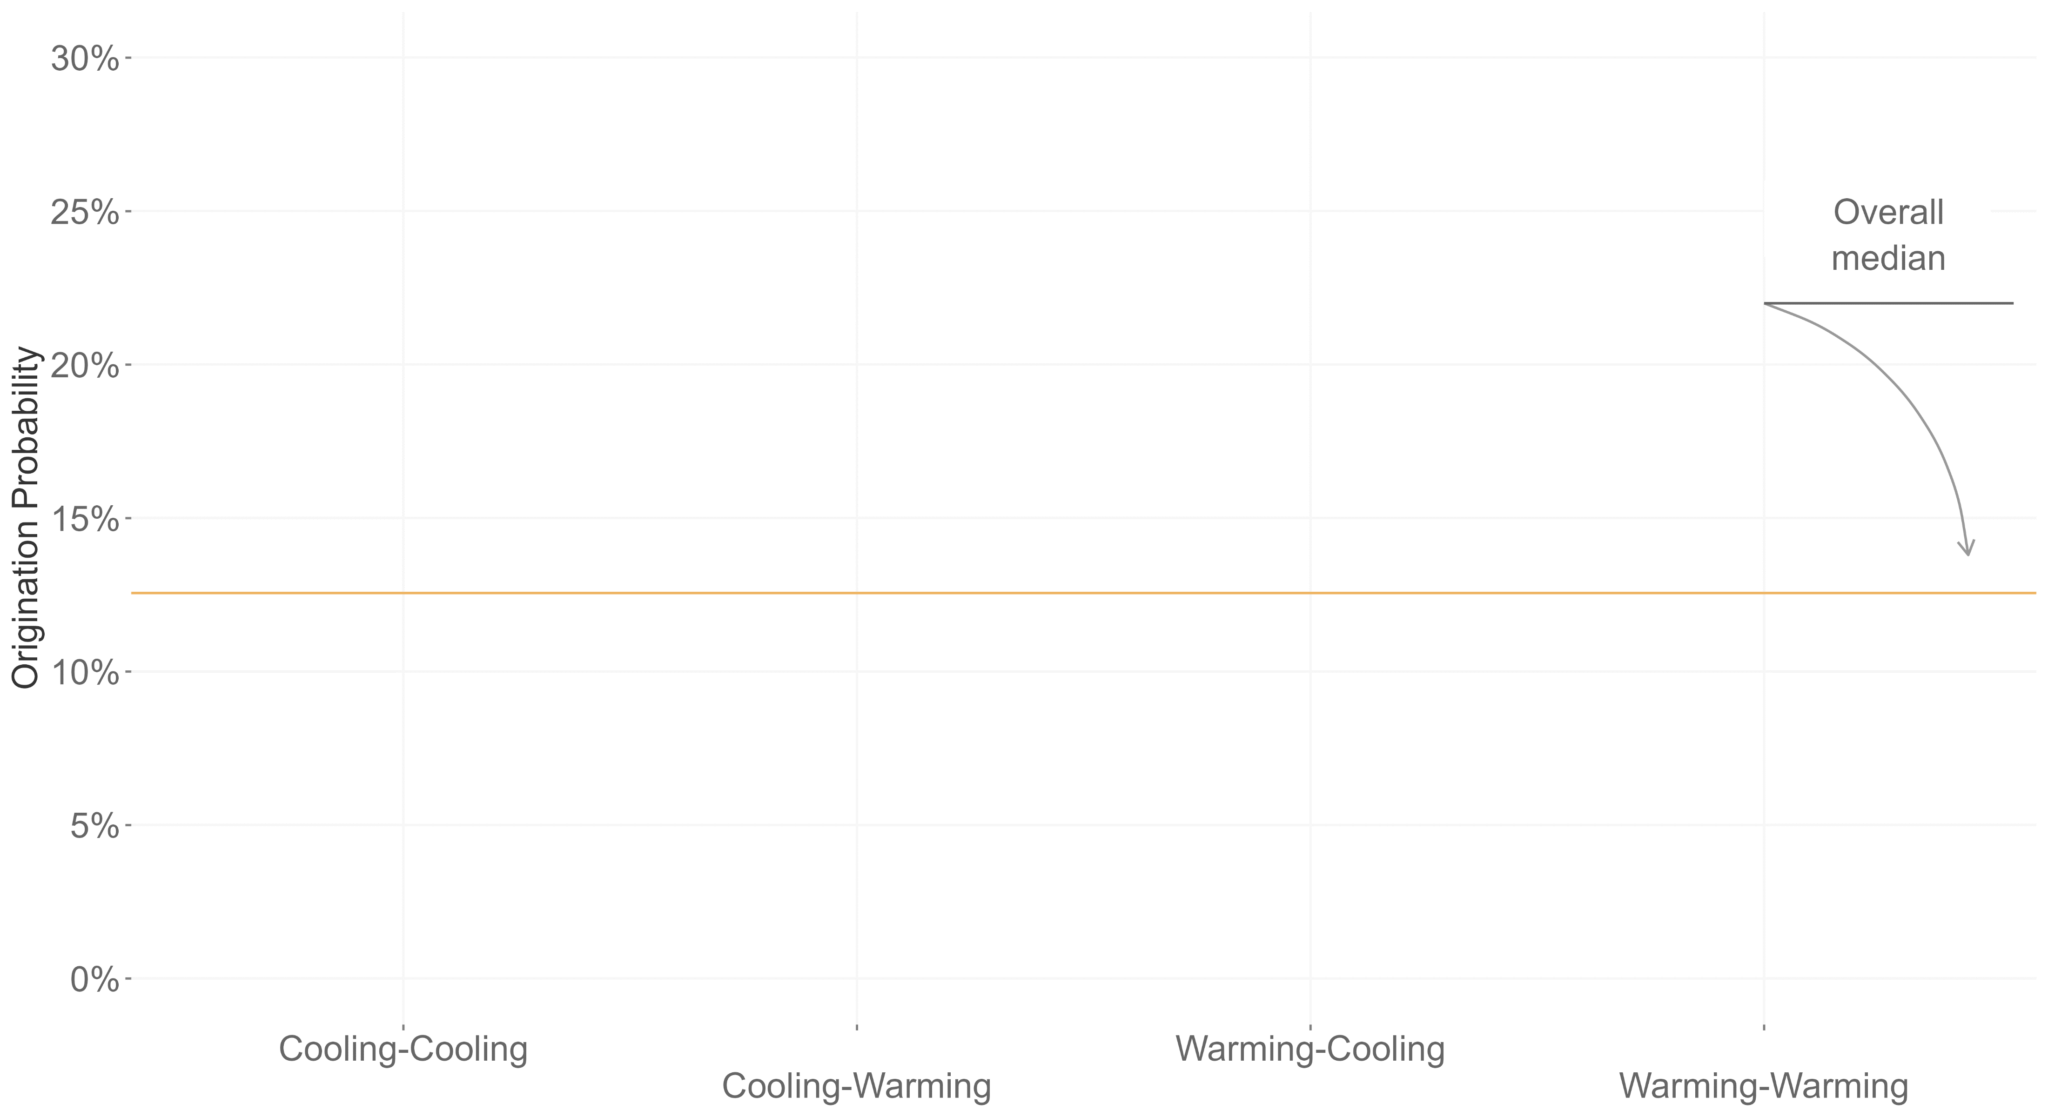
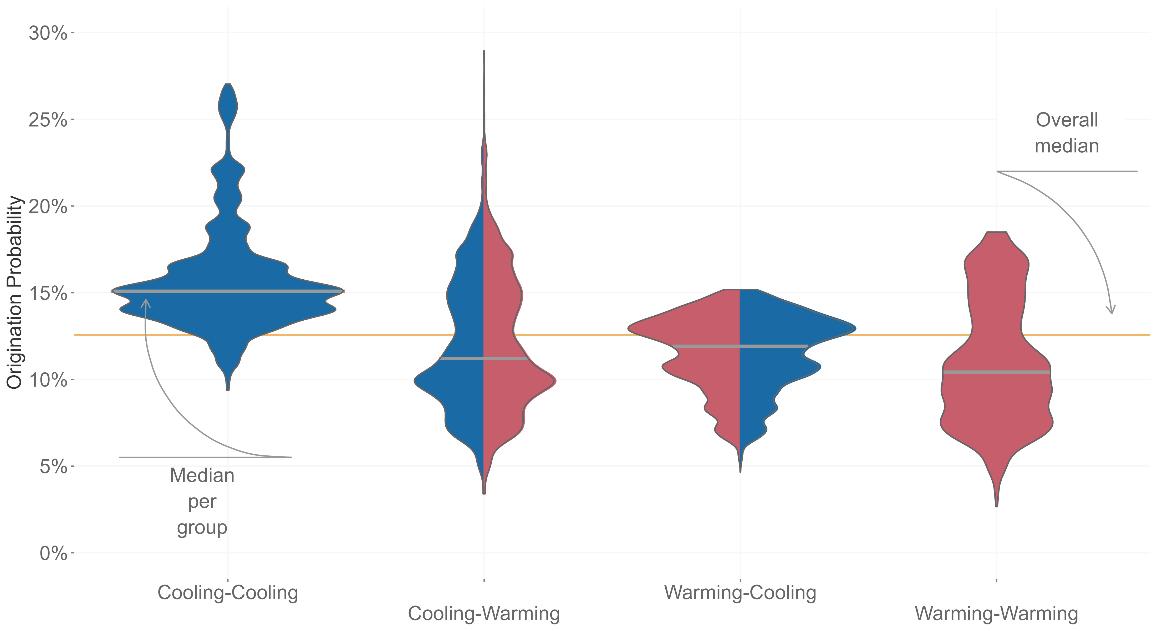
Mathes et al. 2021, PNAS

Slide 14

Rate of change
AOGCM
Pollen taxa
NeotomaDB
Terrestrial only
Vegetation turnover
100 years/ 100 to 1.000 years

Slide 15
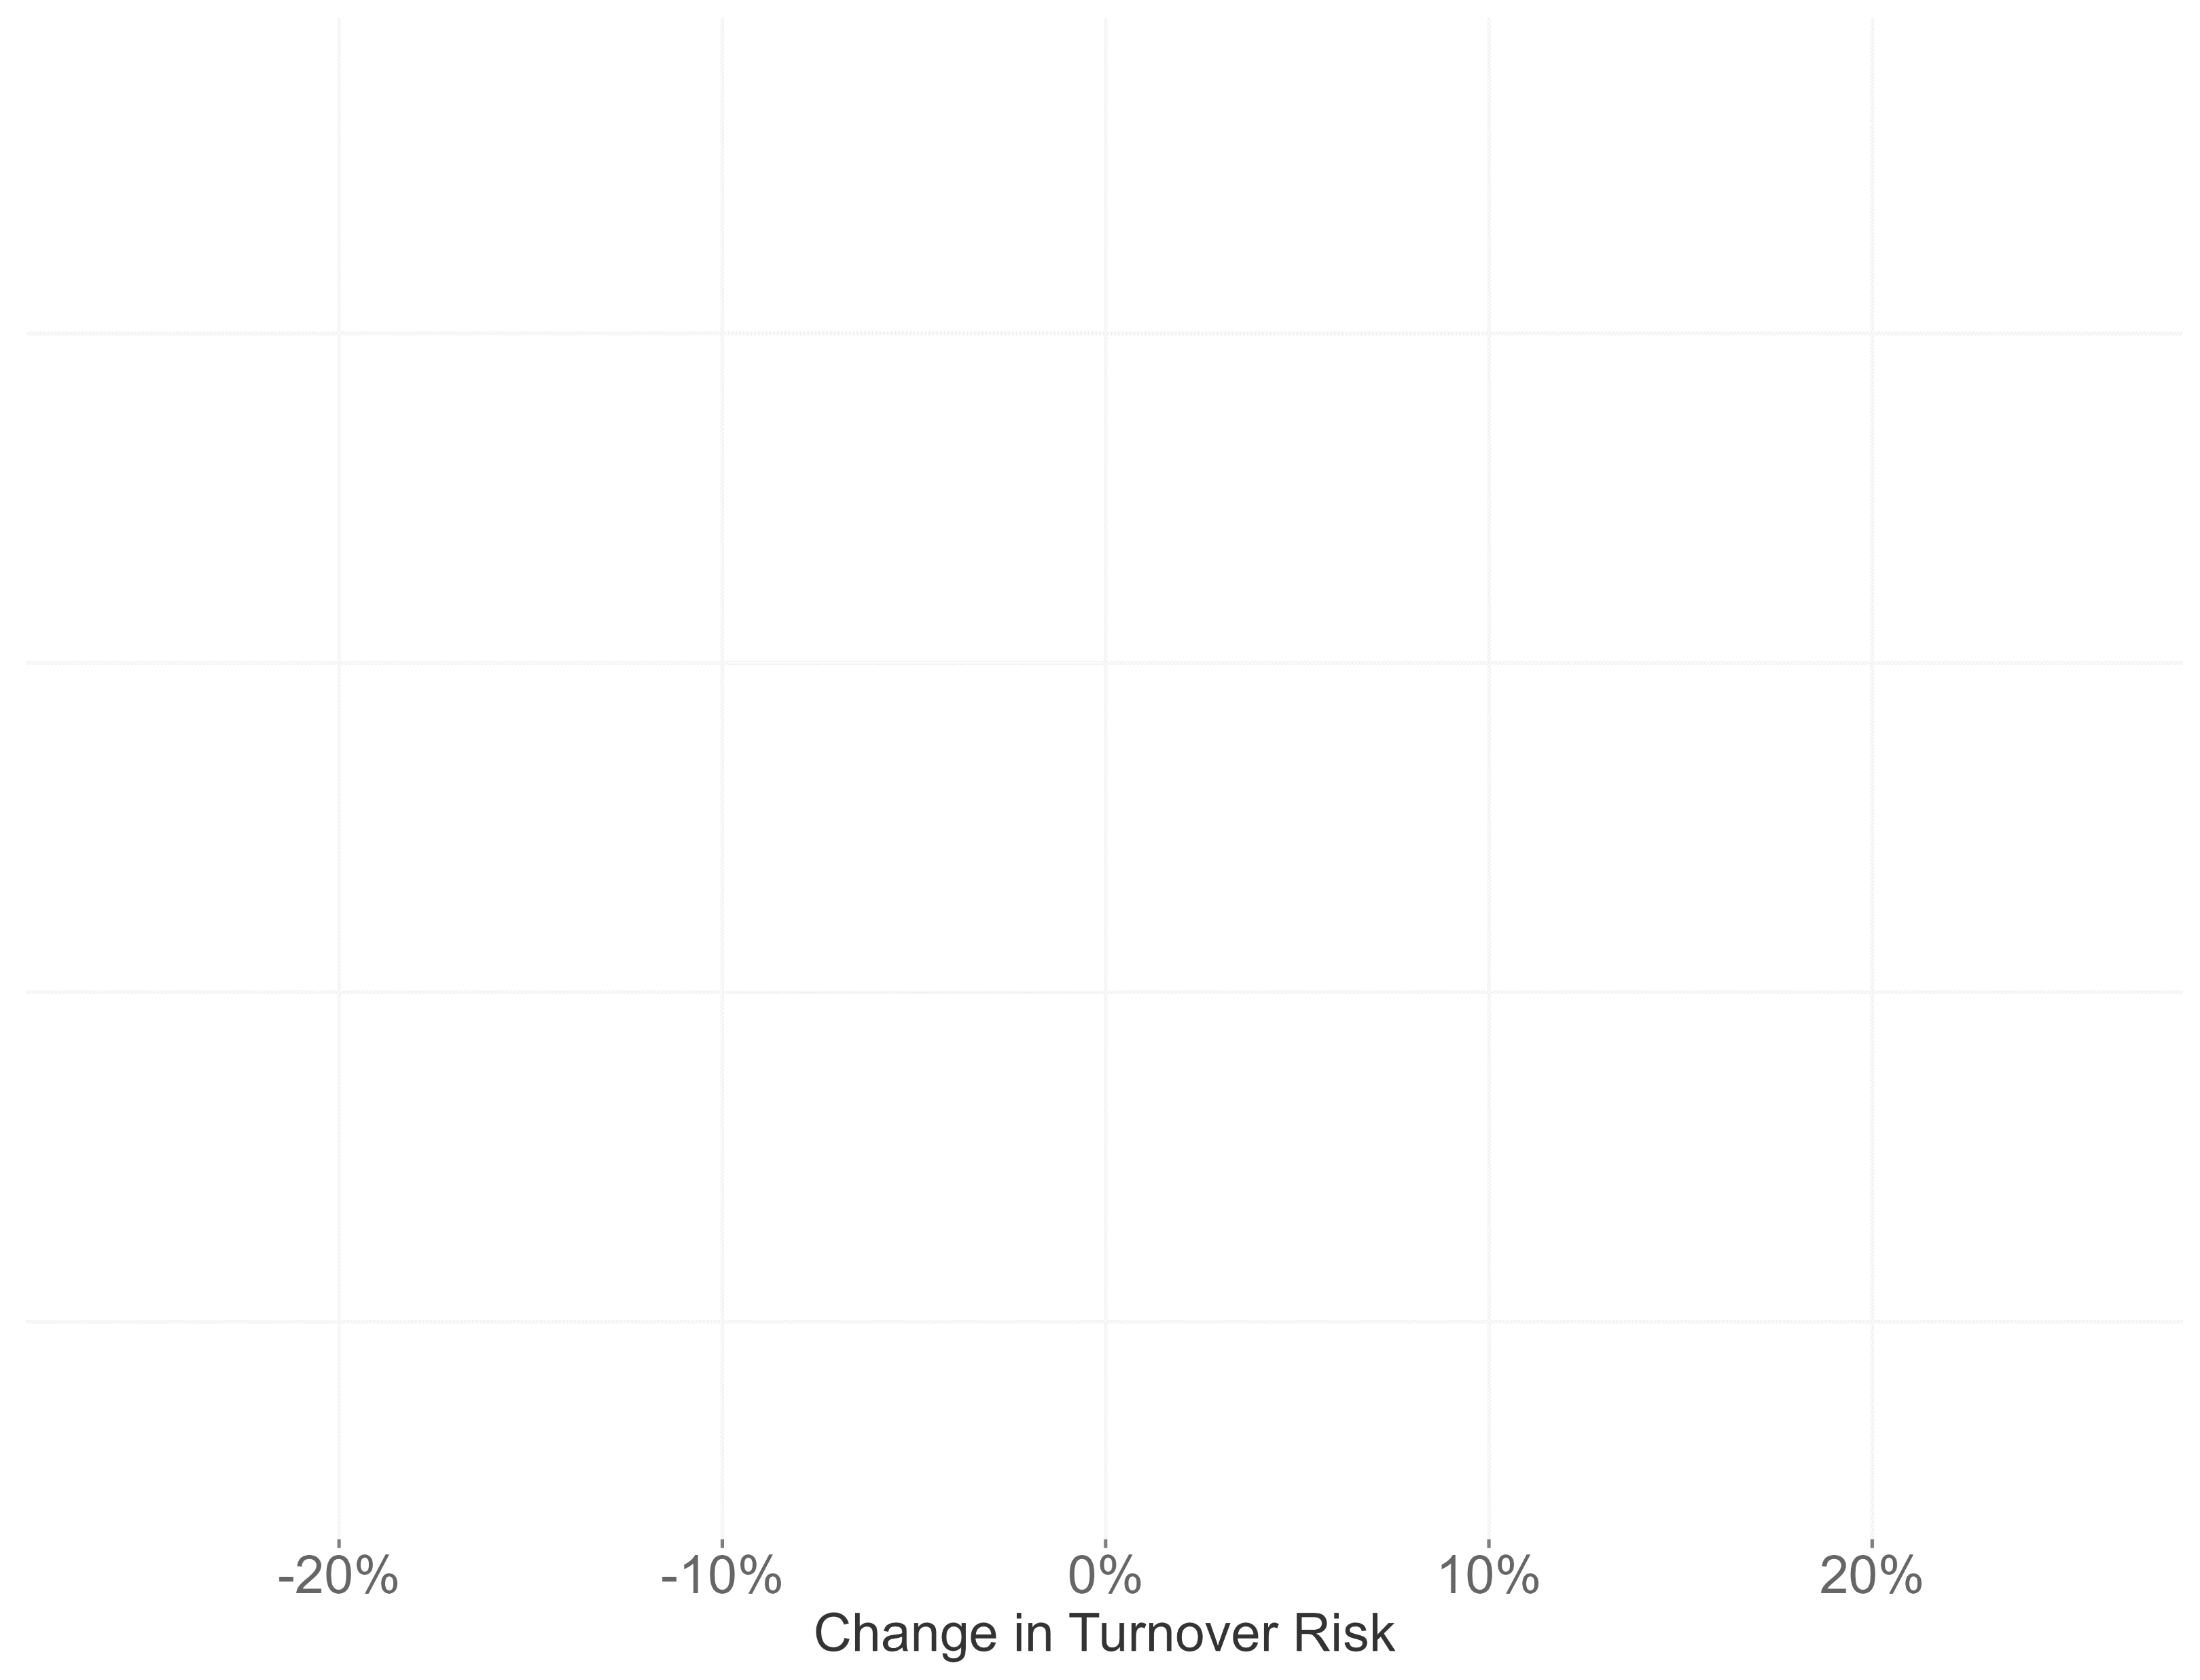
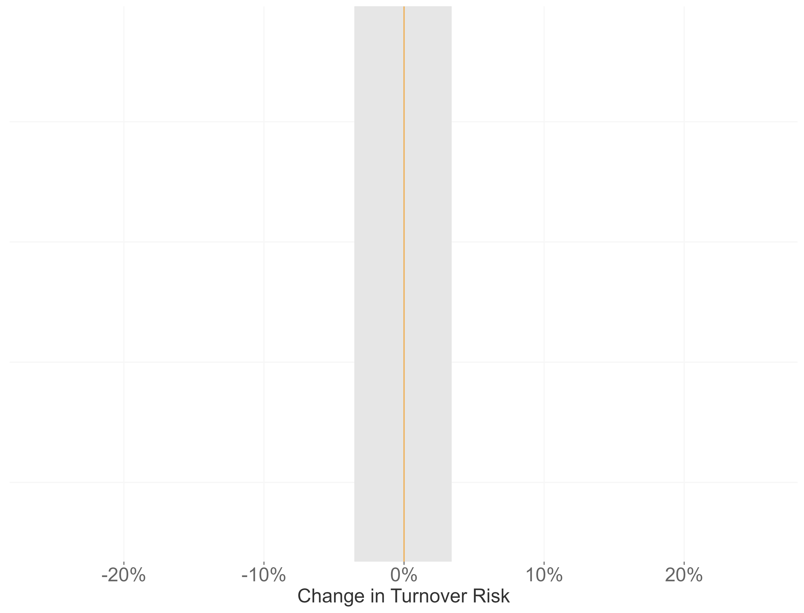
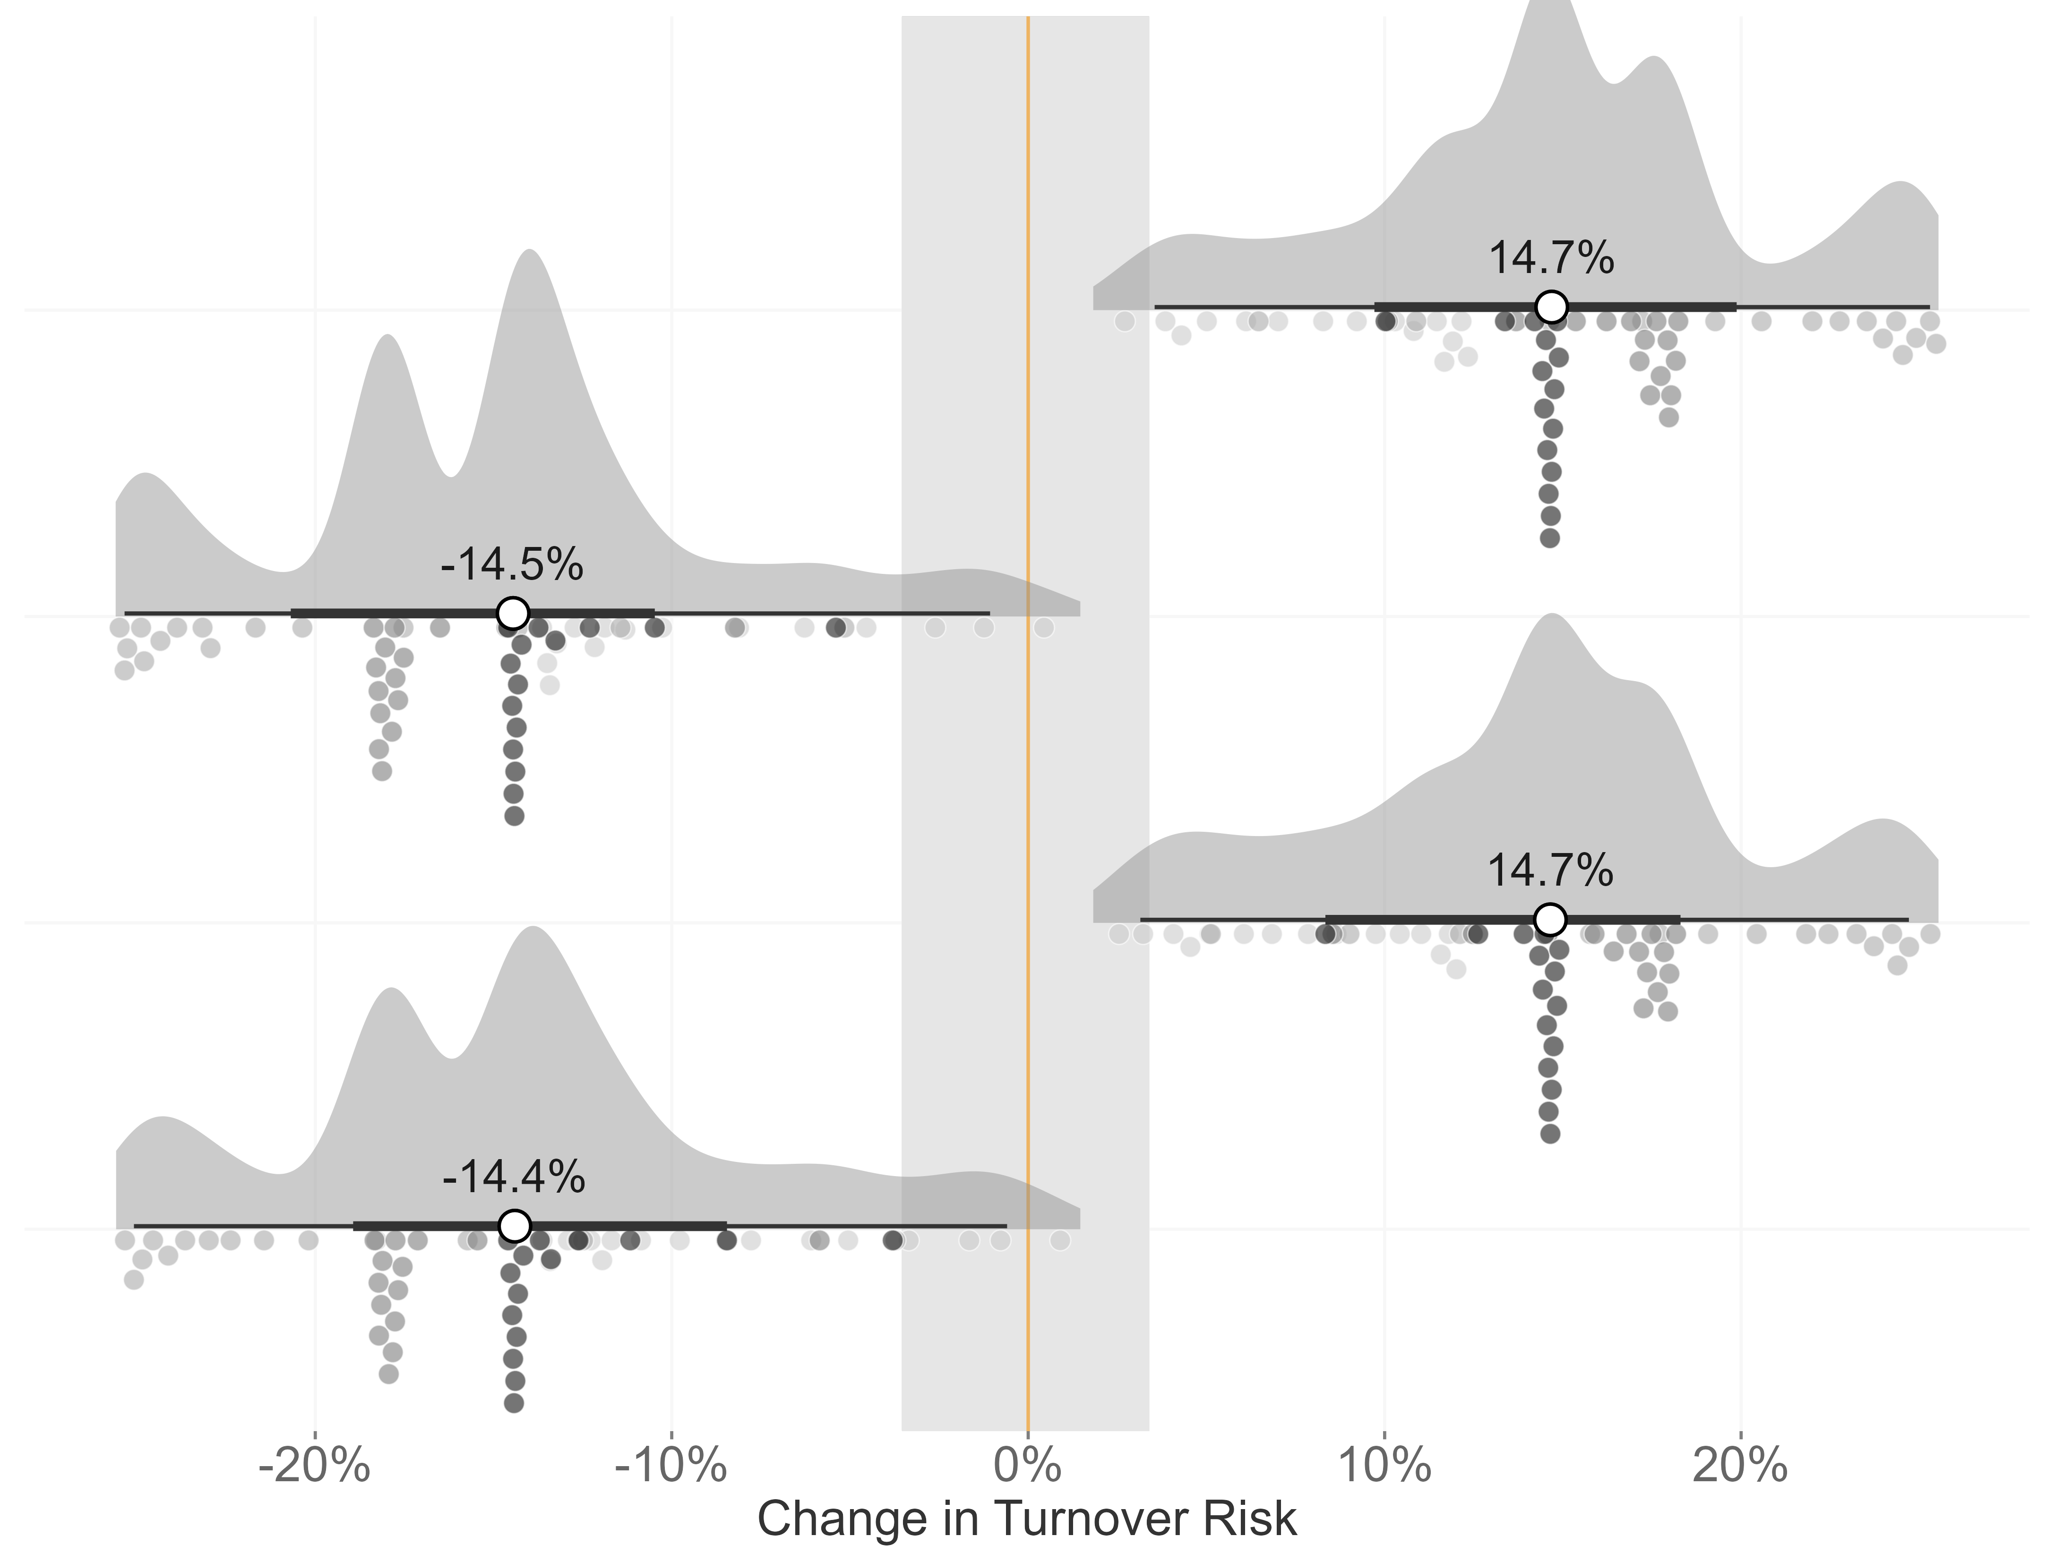
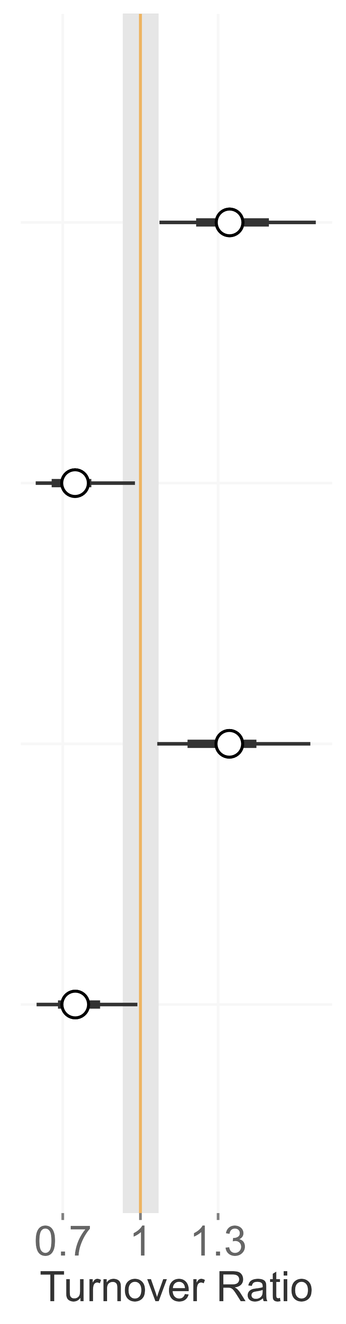
Climate Interaction
long-term
short-term
Mathes et al. 2023, in prep for resubmission

Slide 16
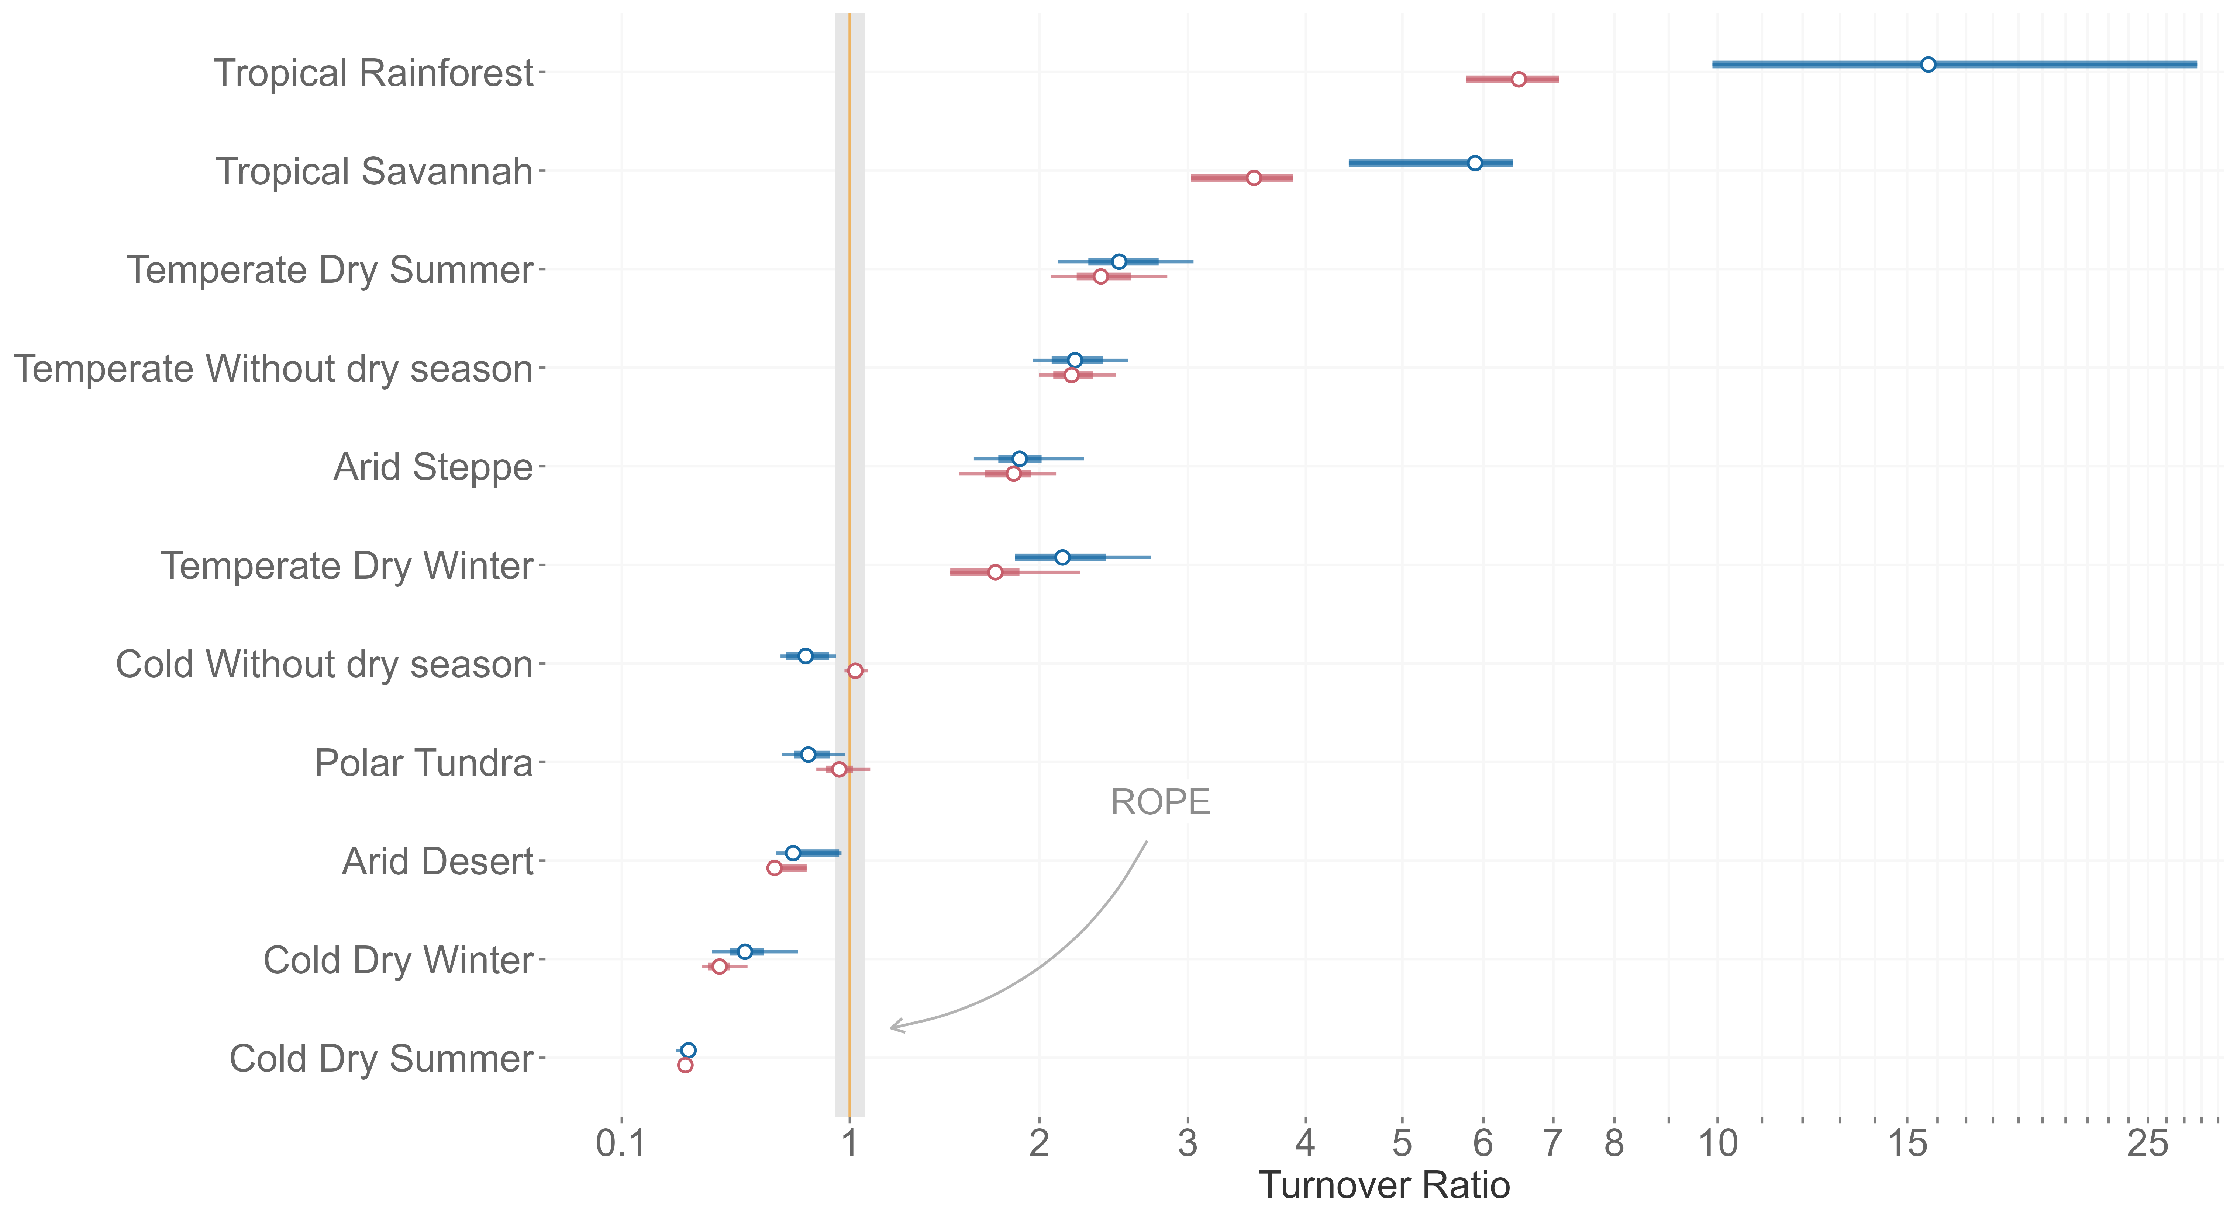
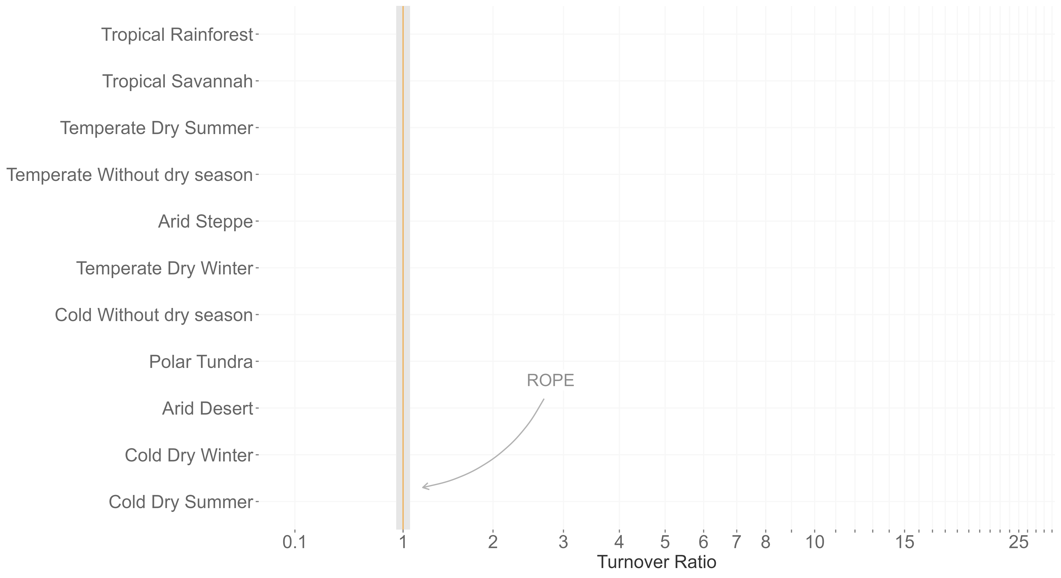
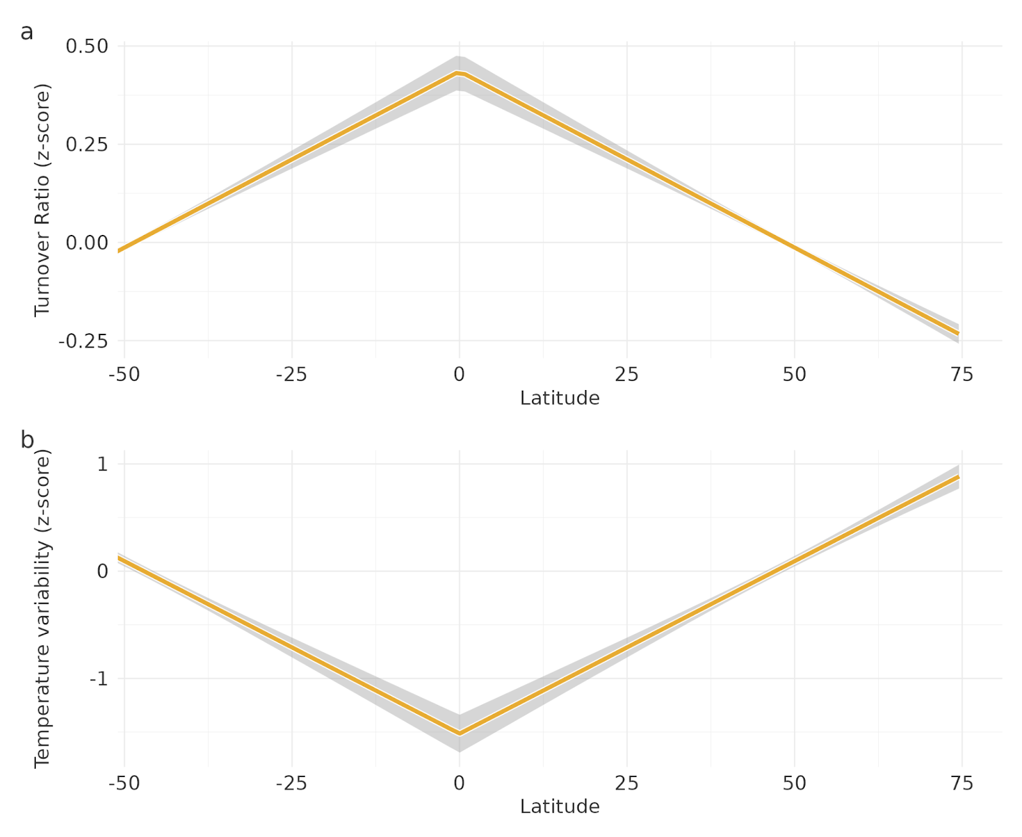
1
0
Temp. variability
-1
-50
-25
0
25
50
Latitude

Slide 17
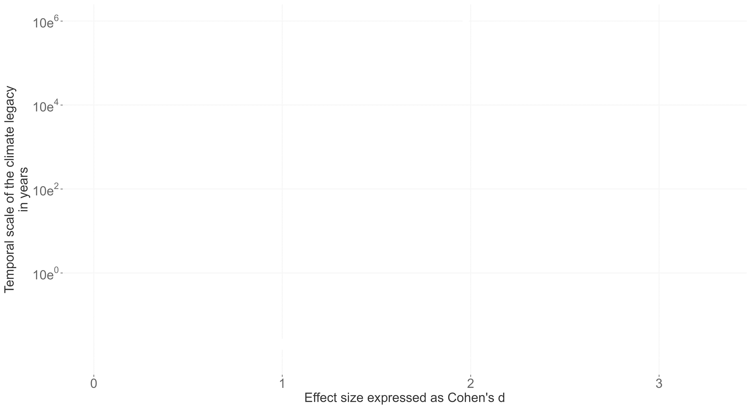
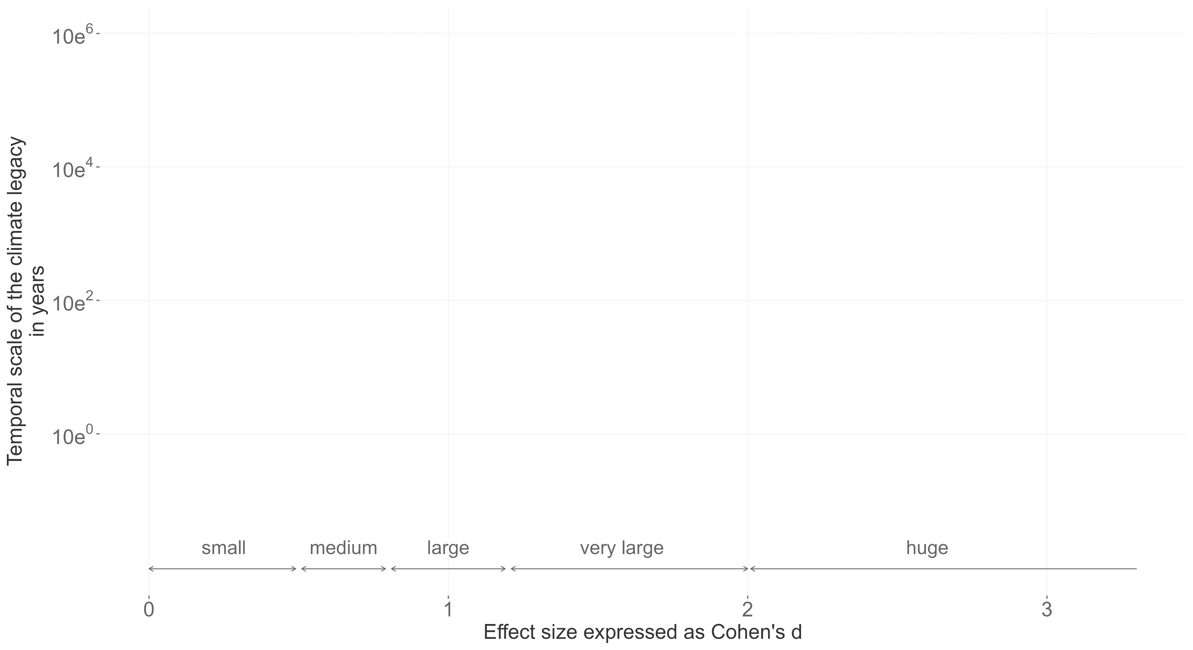
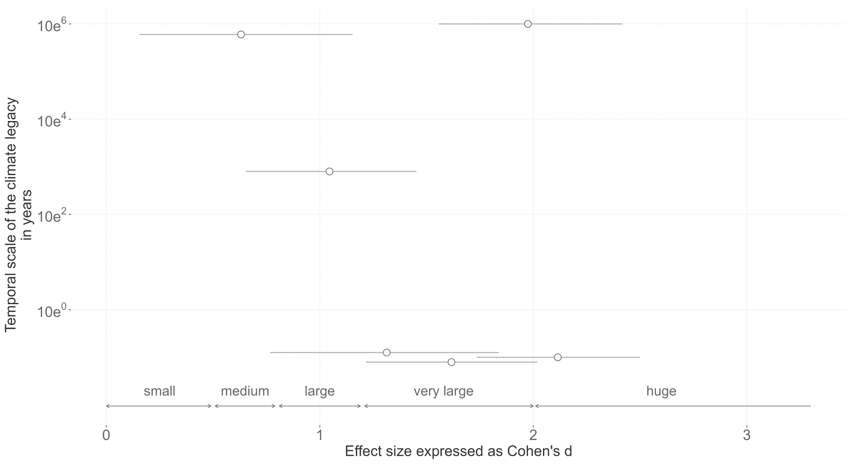
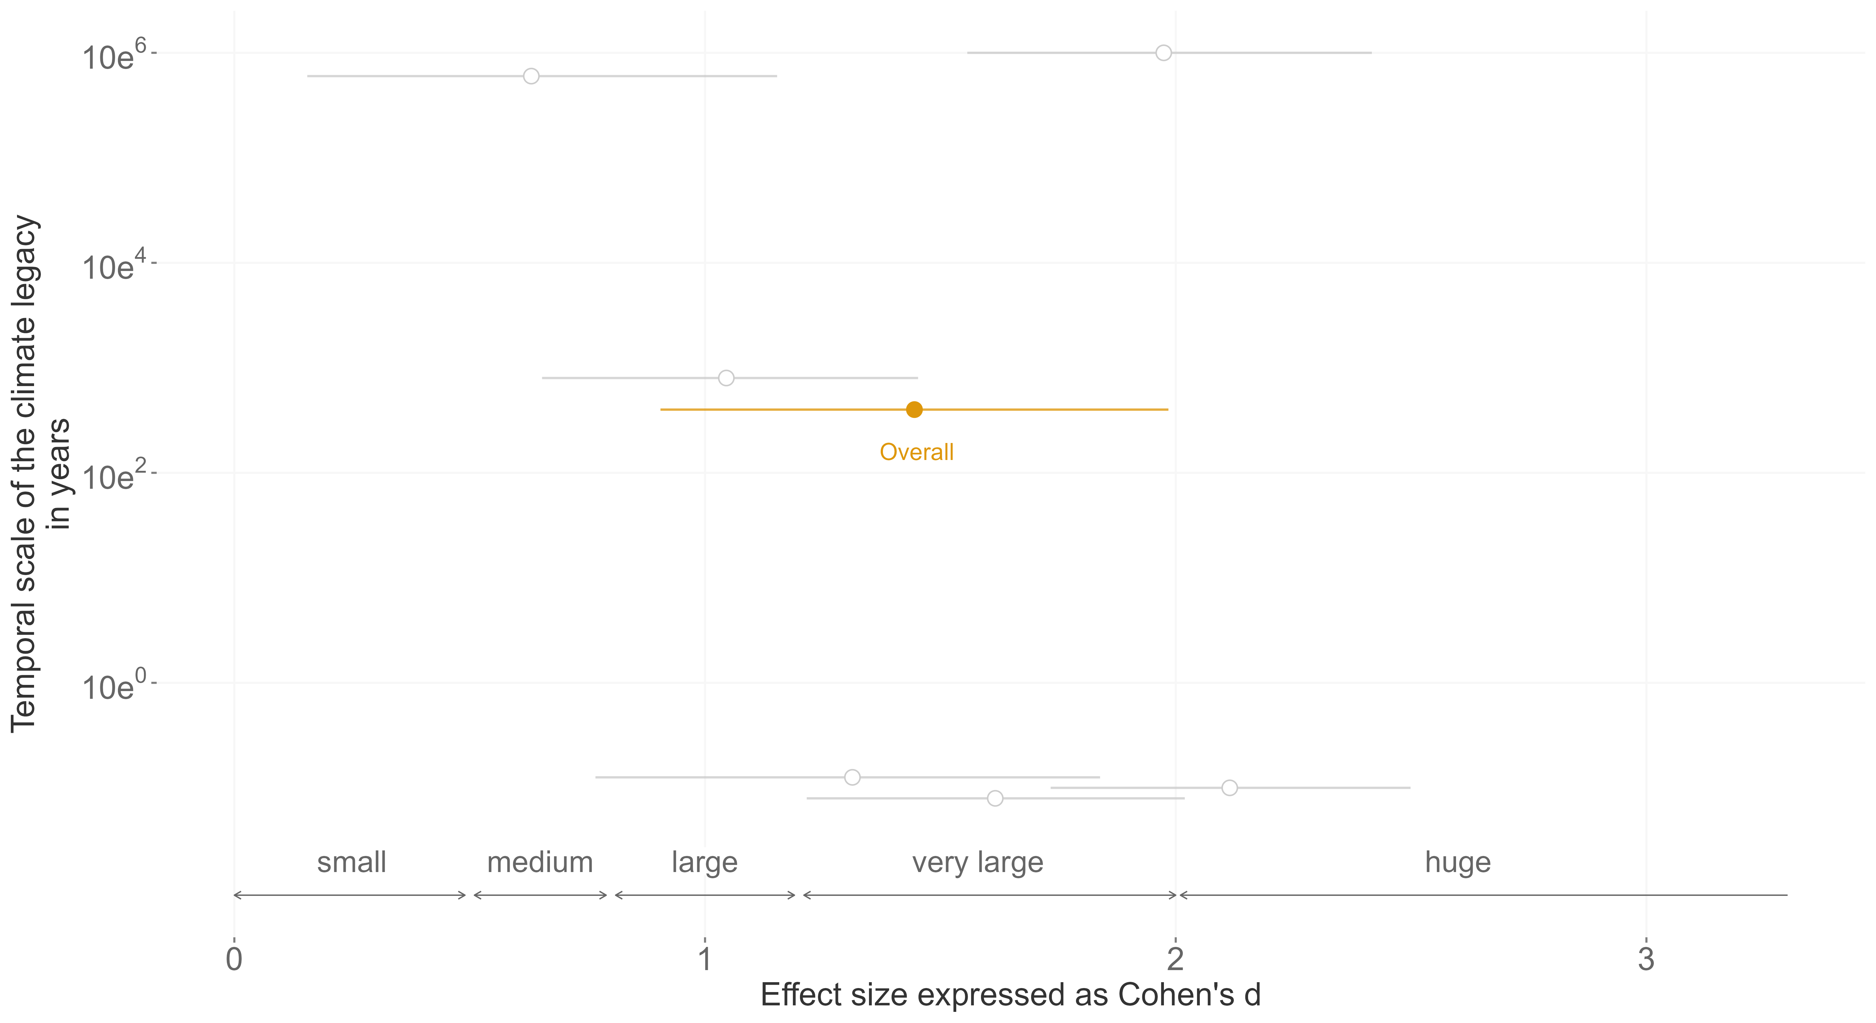

Slide 18
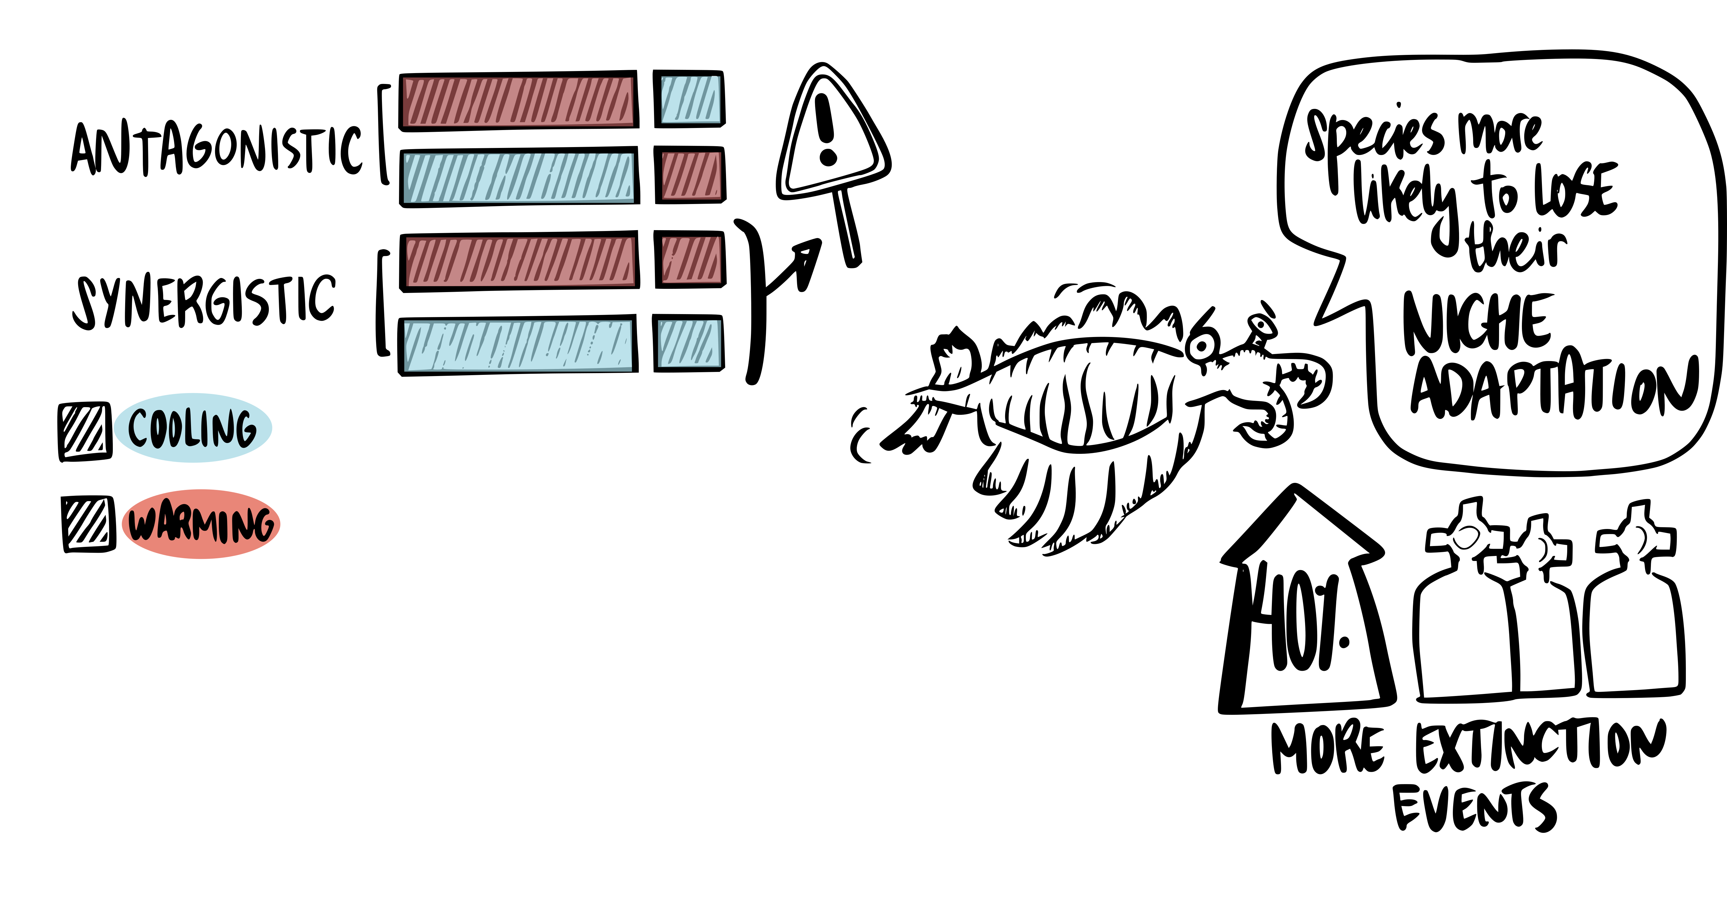
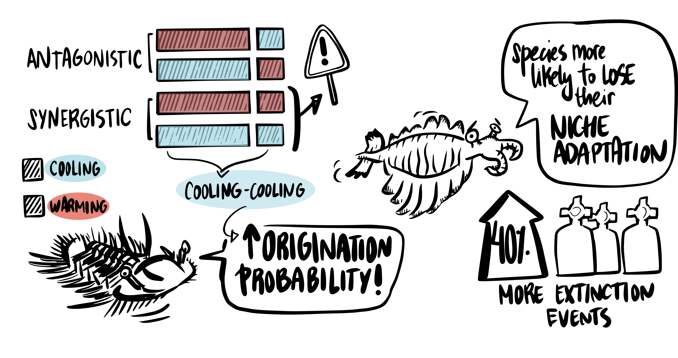

Slide 20
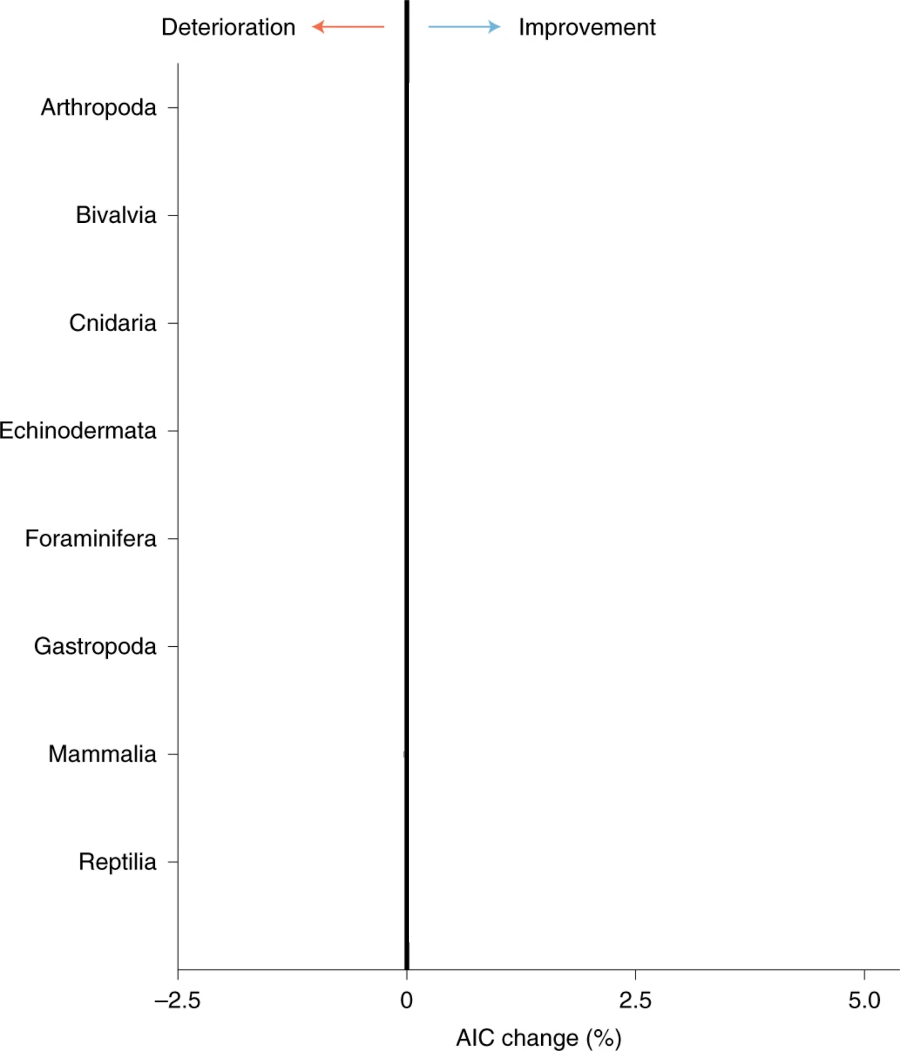
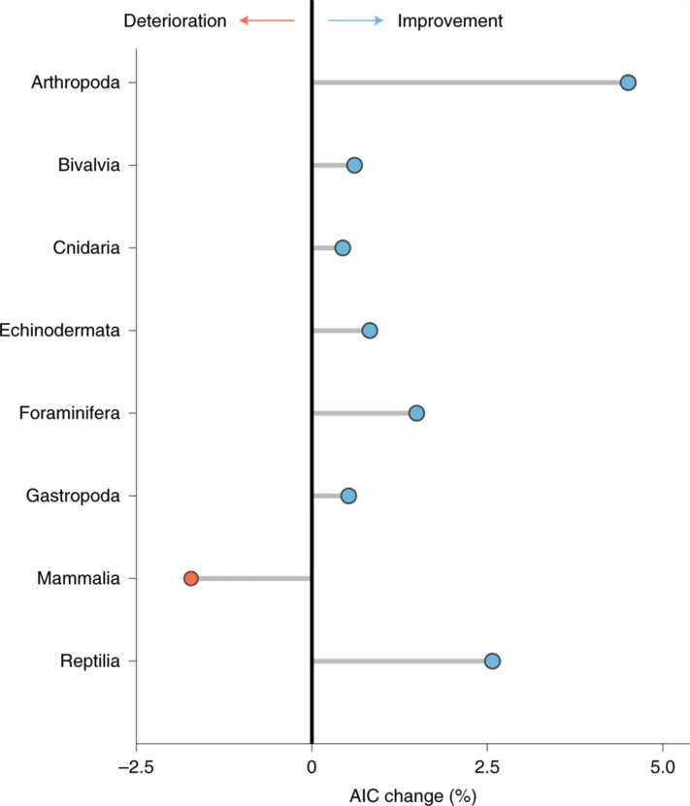
Short-term Change
Long-term Trend
Mathes et al. 2021, Nature Ecology and Evolution

Slide 21
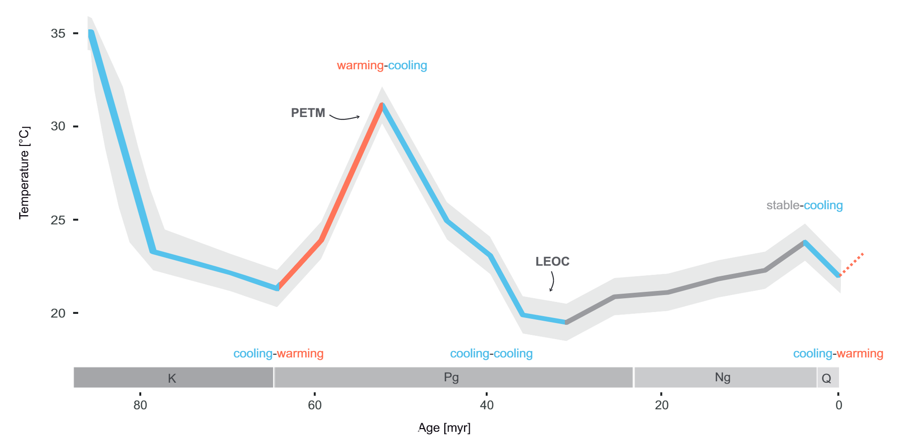

Slide 22
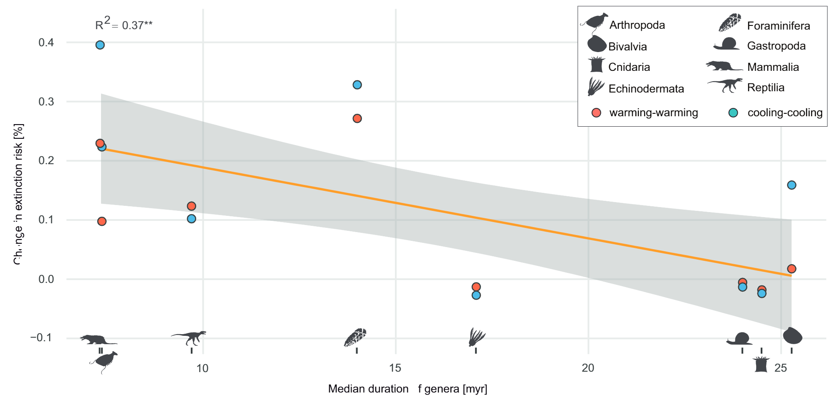

Slide 23
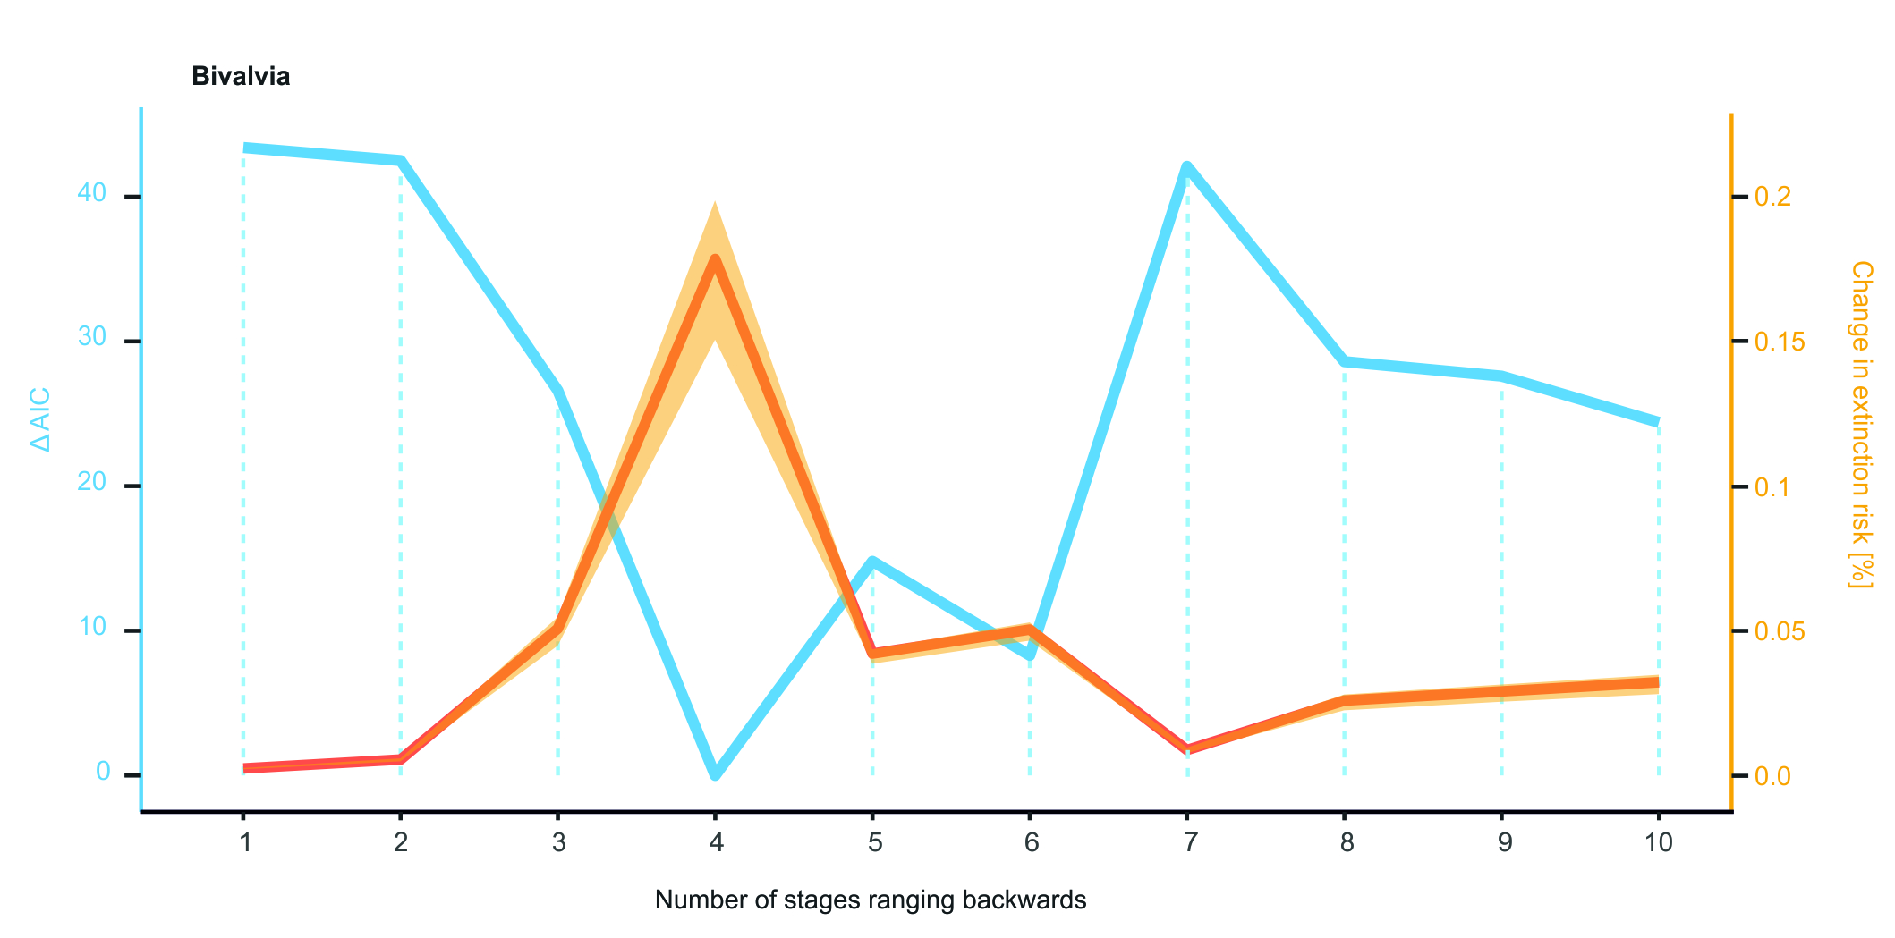

Slide 24
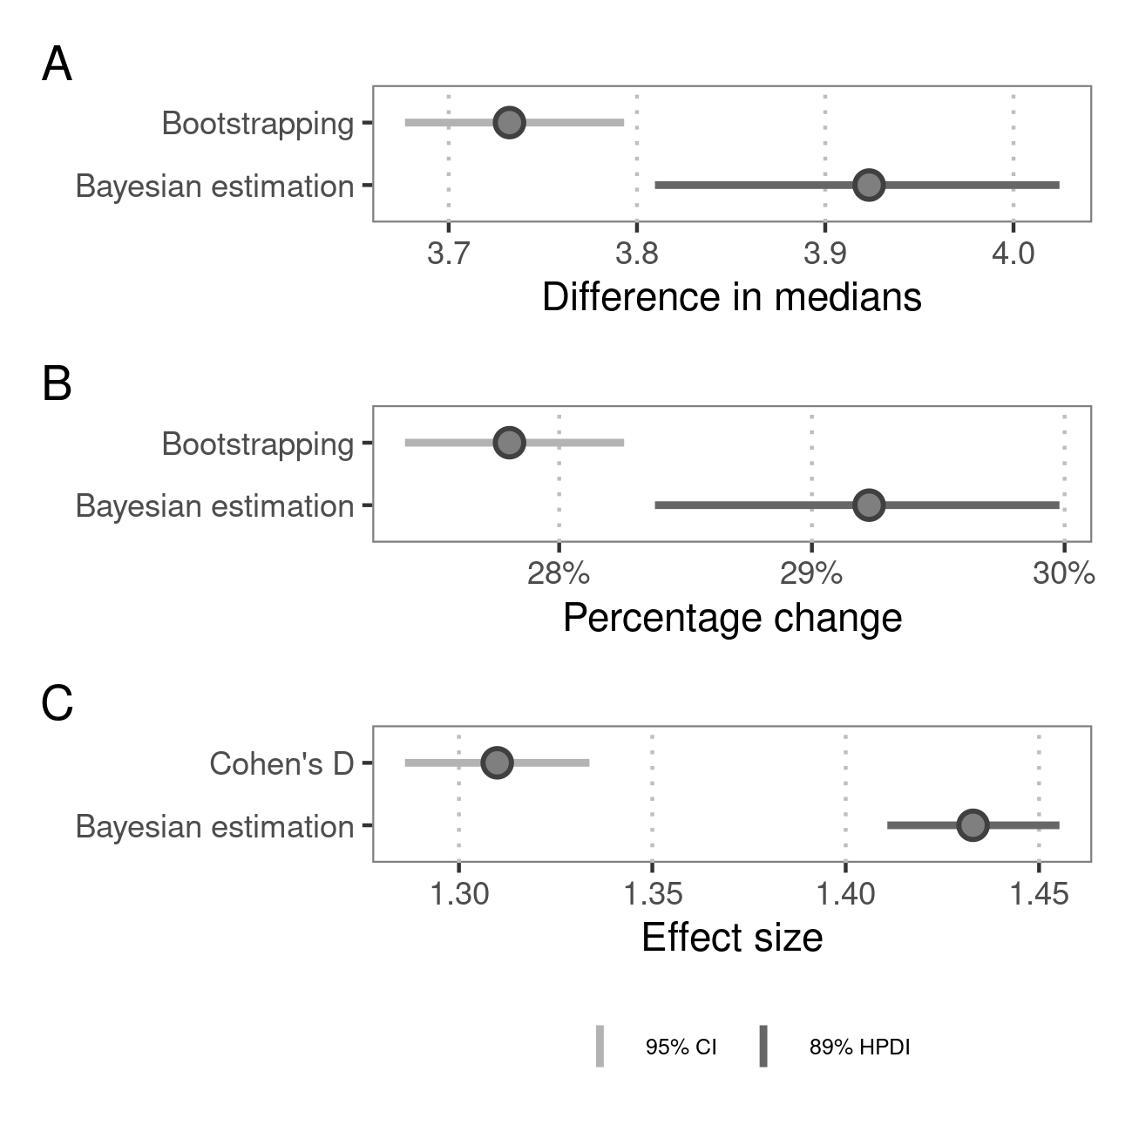

Slide 25
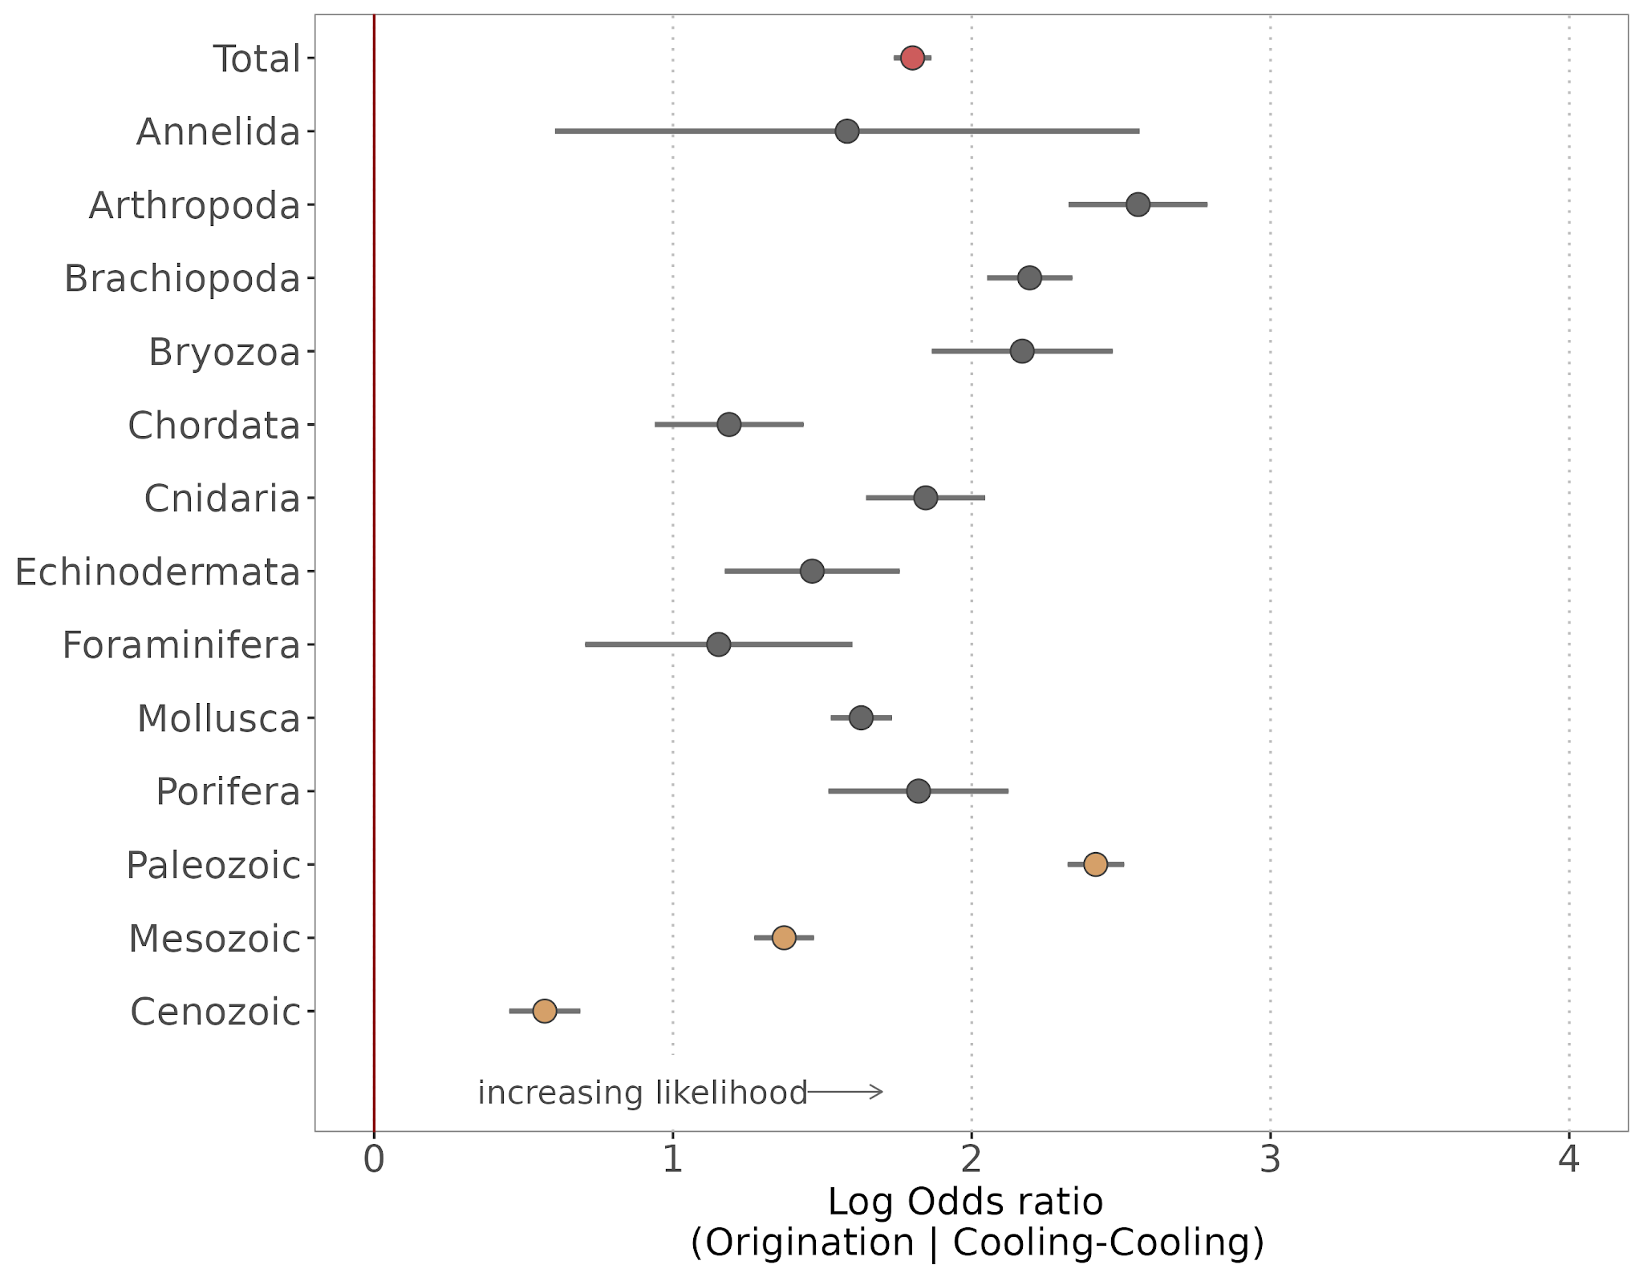

Slide 26
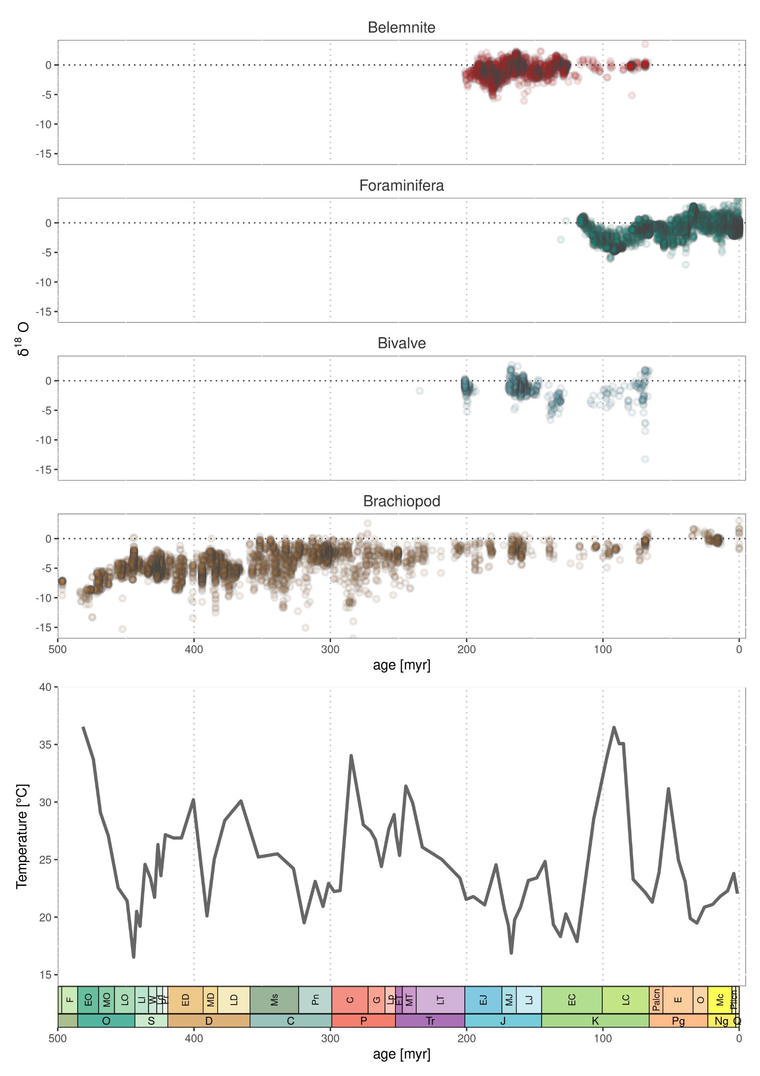

Slide 27
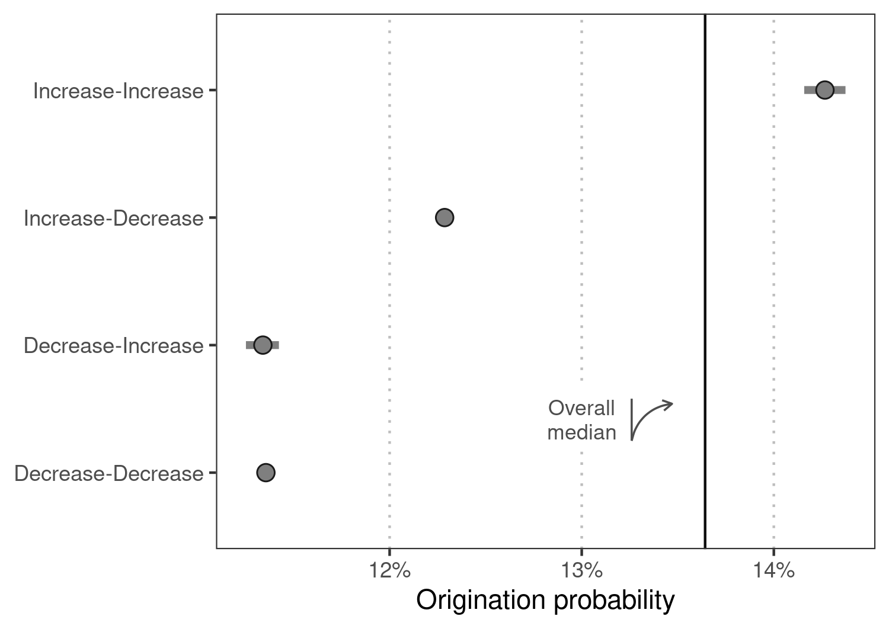

Slide 28
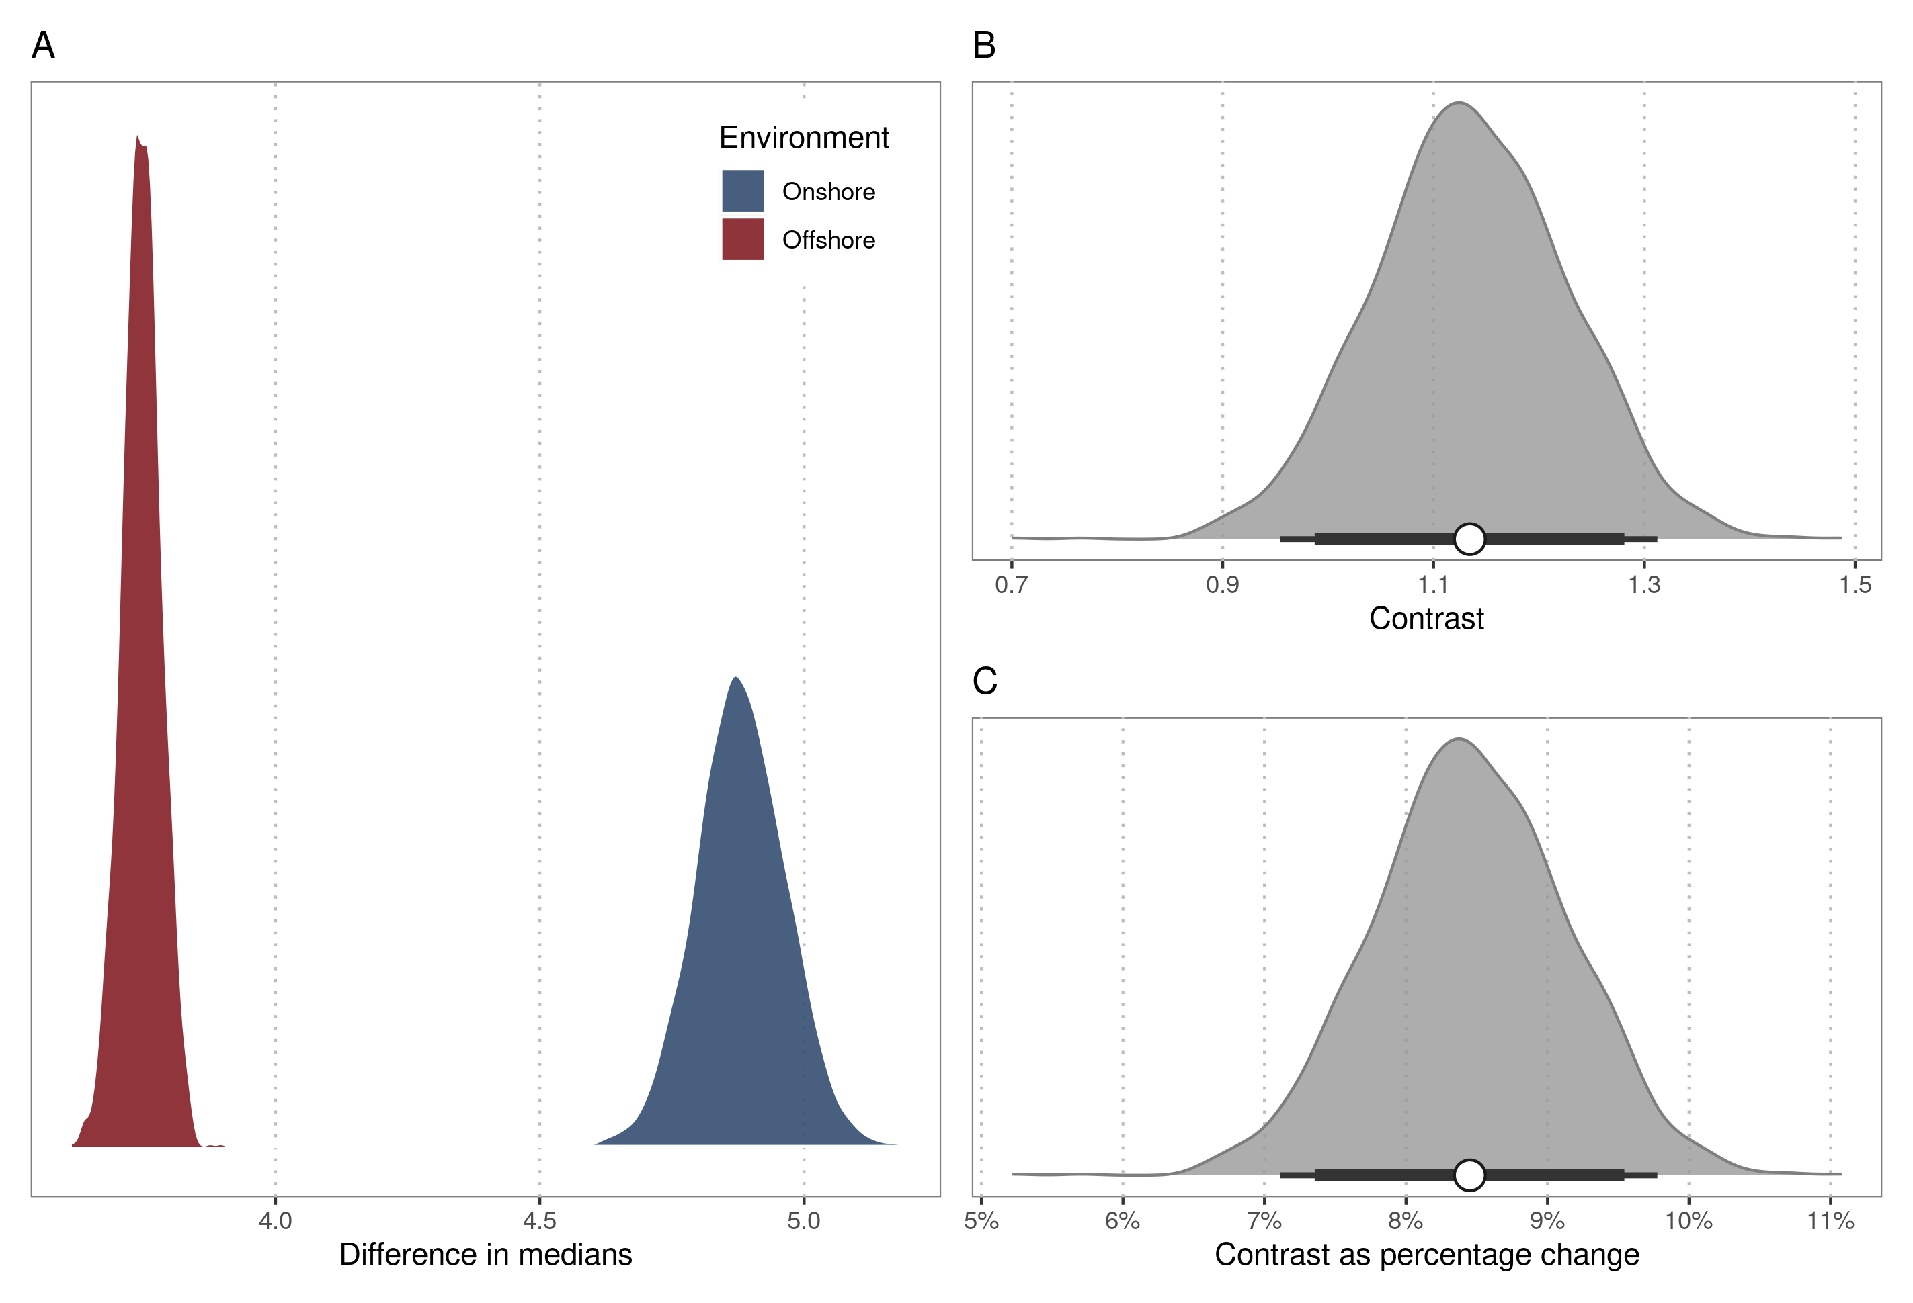

Slide 29
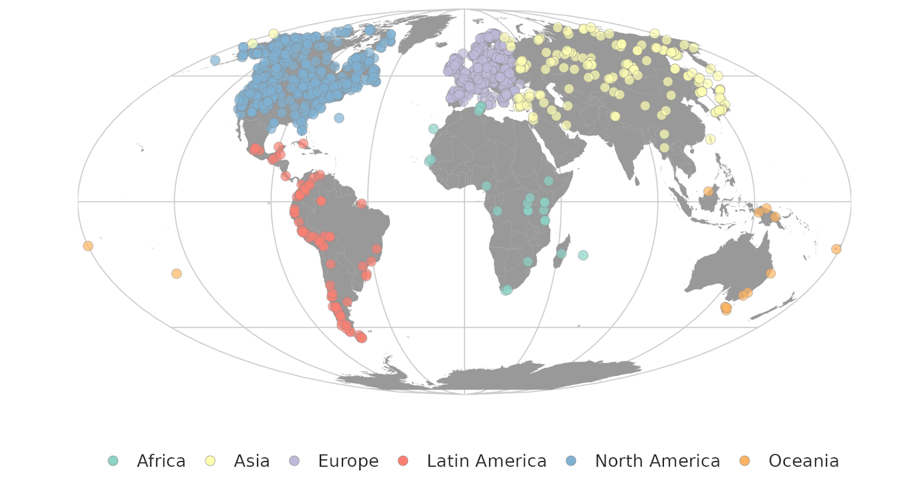

Slide 30








Initial
Geographic
Occupation
Long-term
Short-term

Slide 31
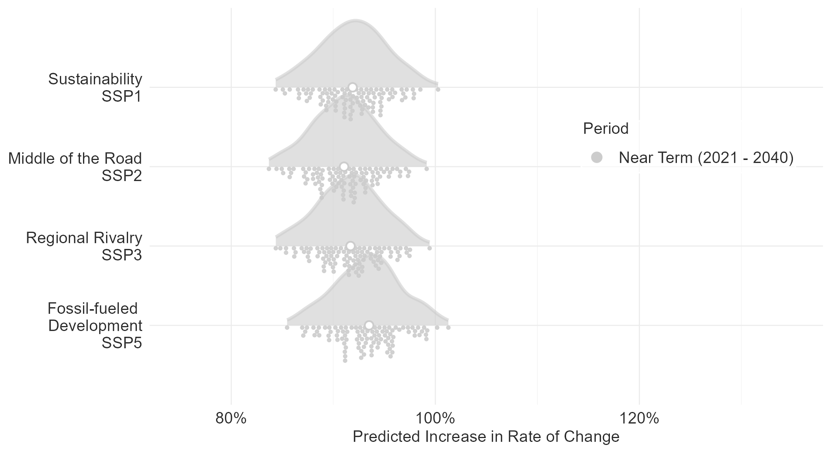
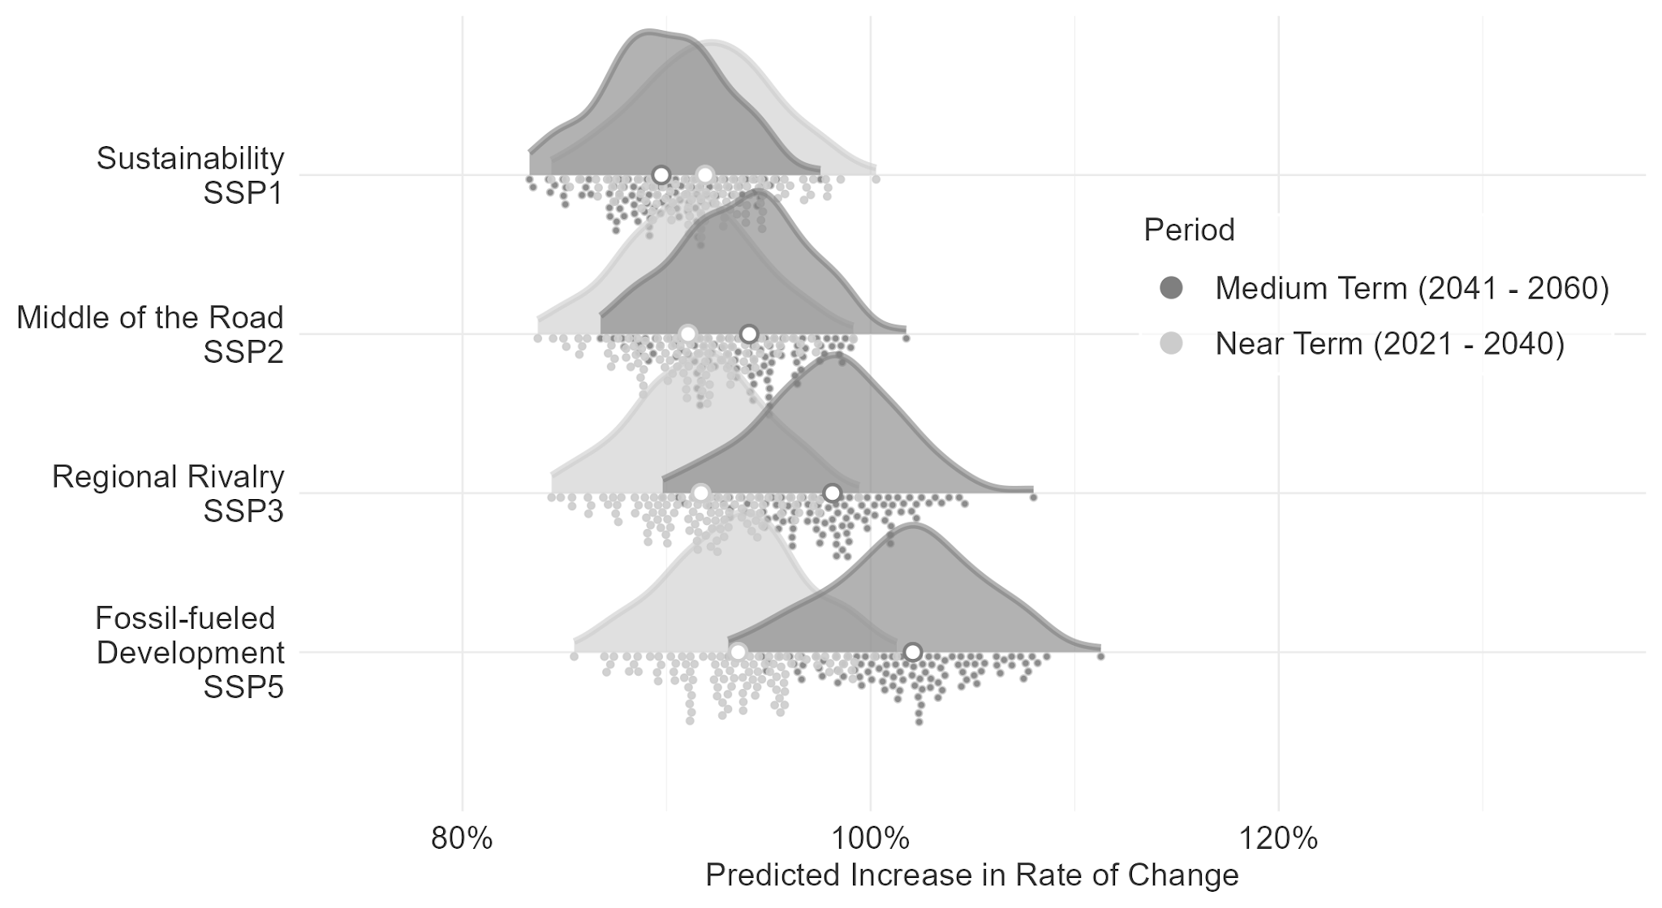
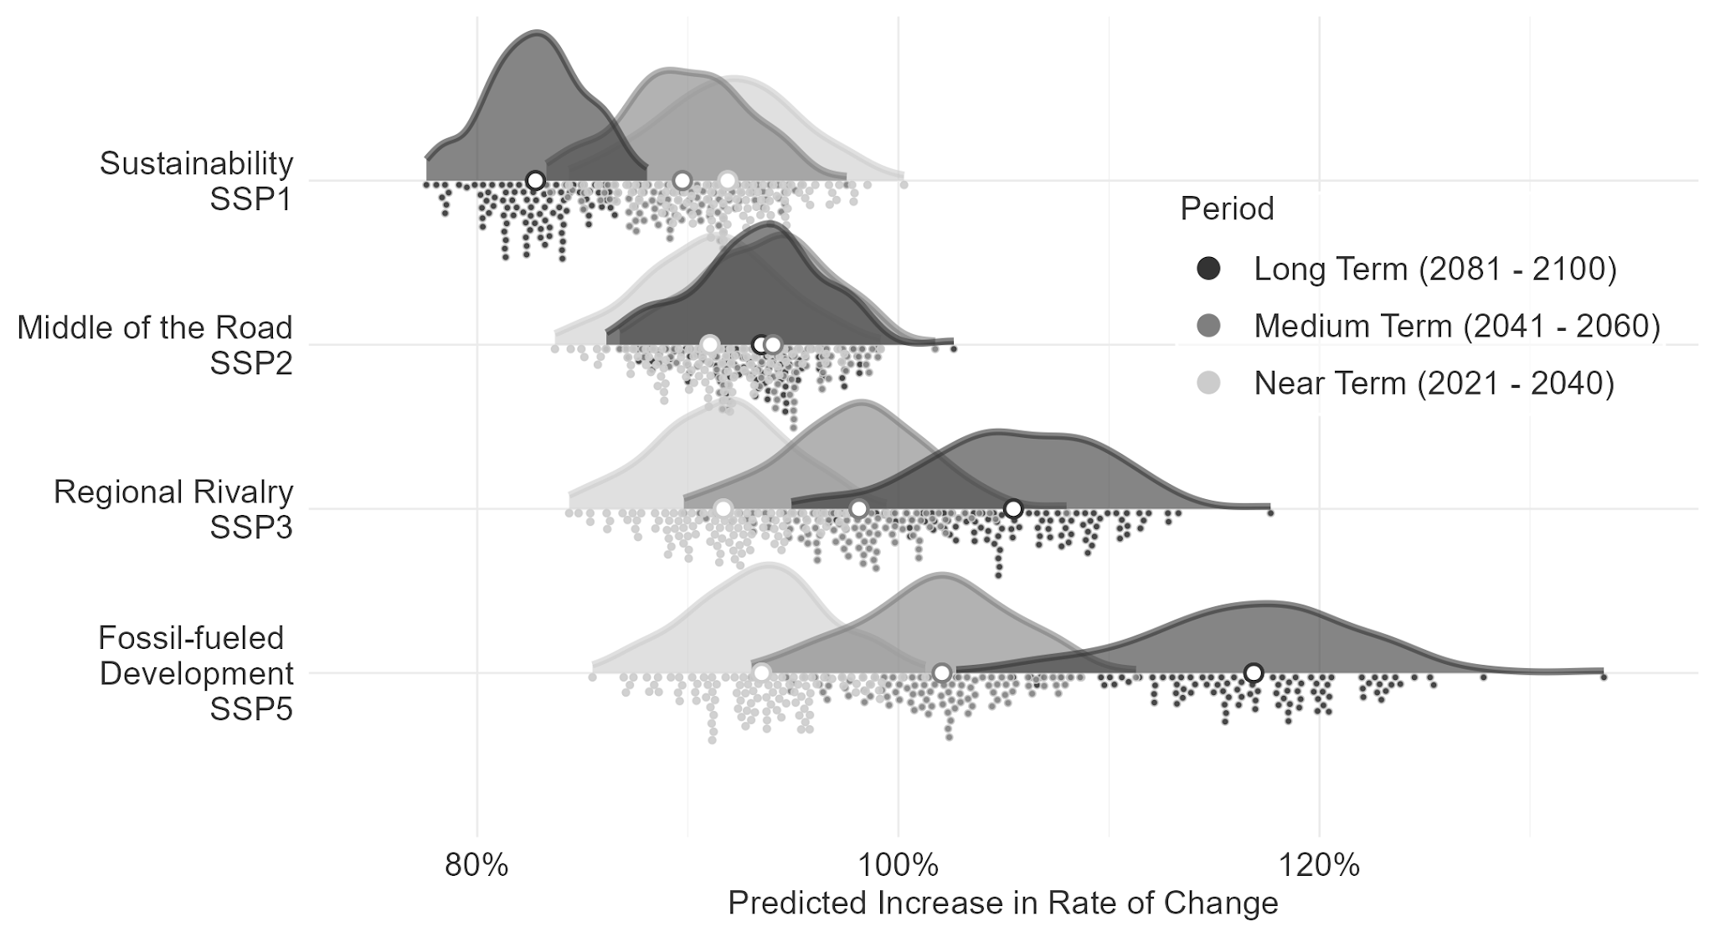

Slide 32
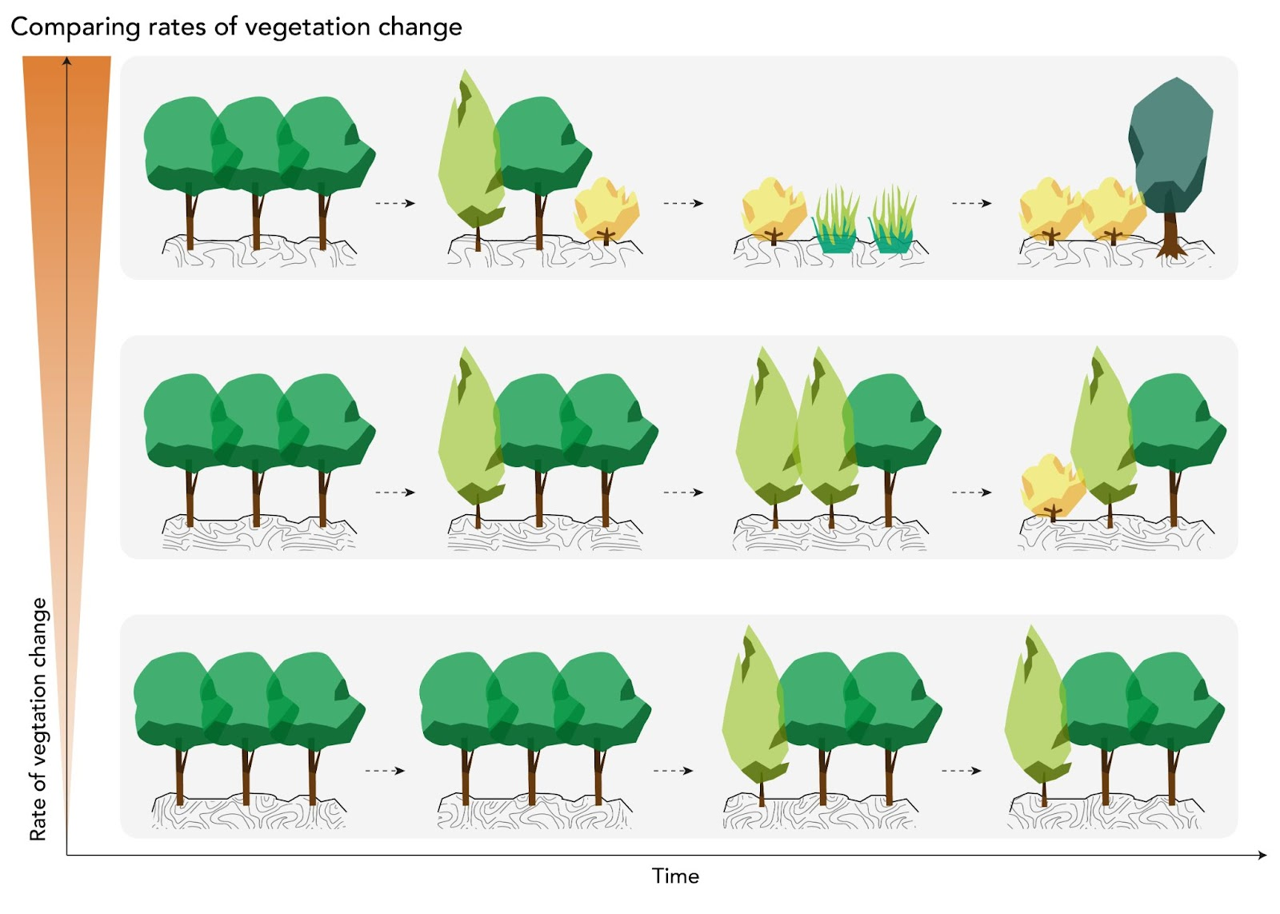

Slide 33
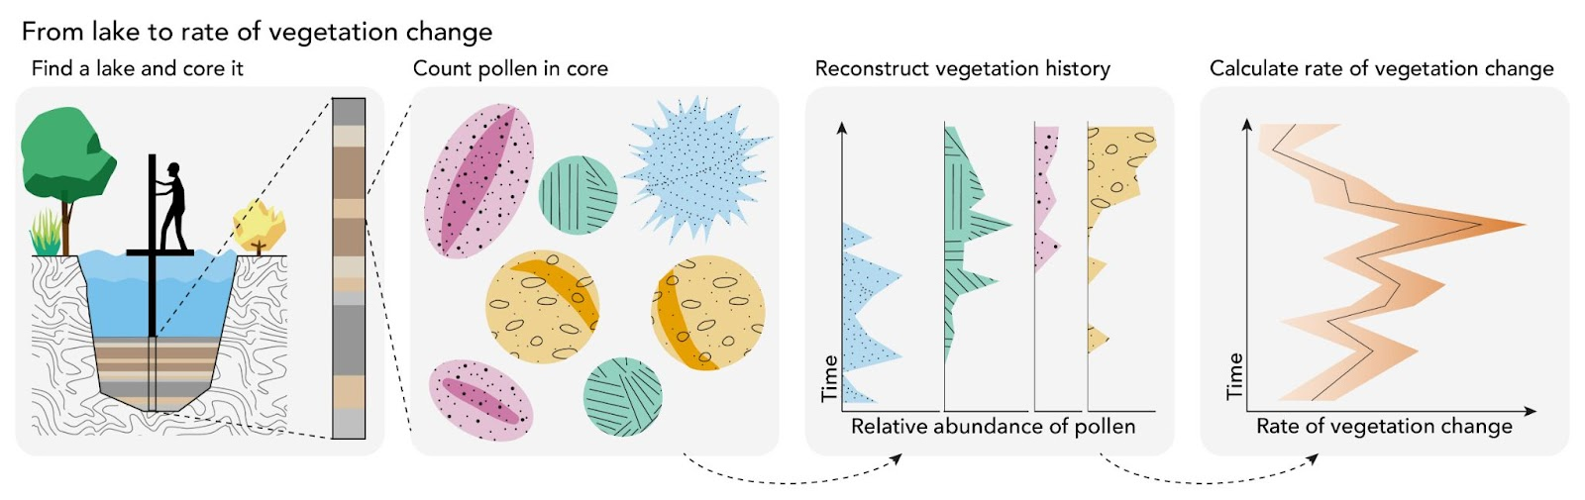

Slide 34
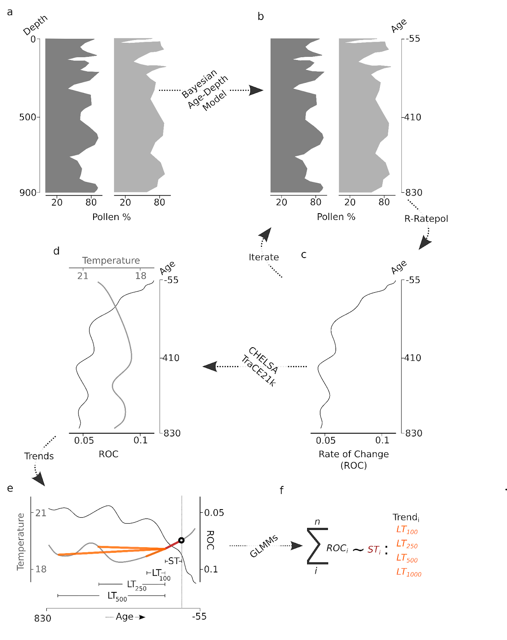

Slide 35
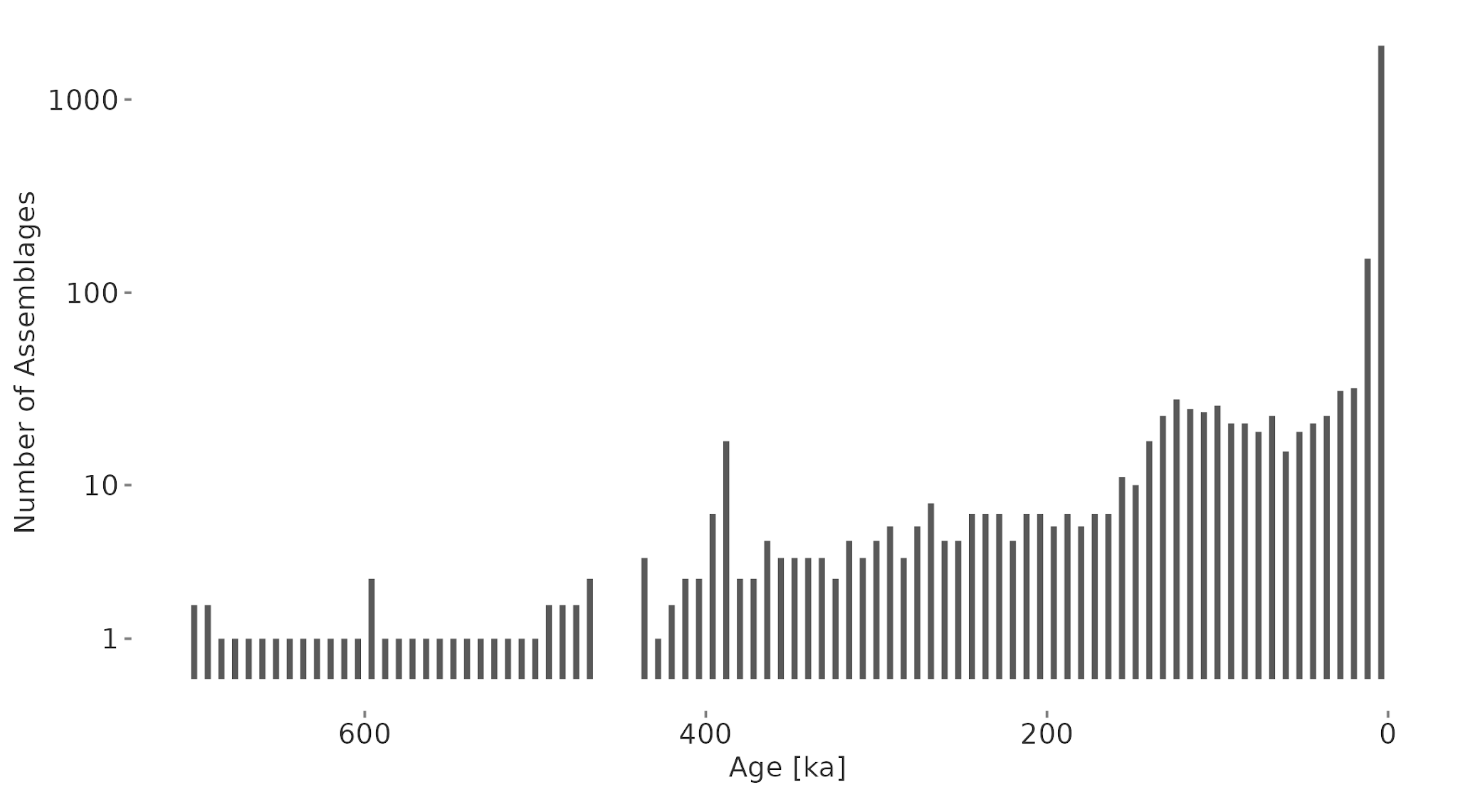
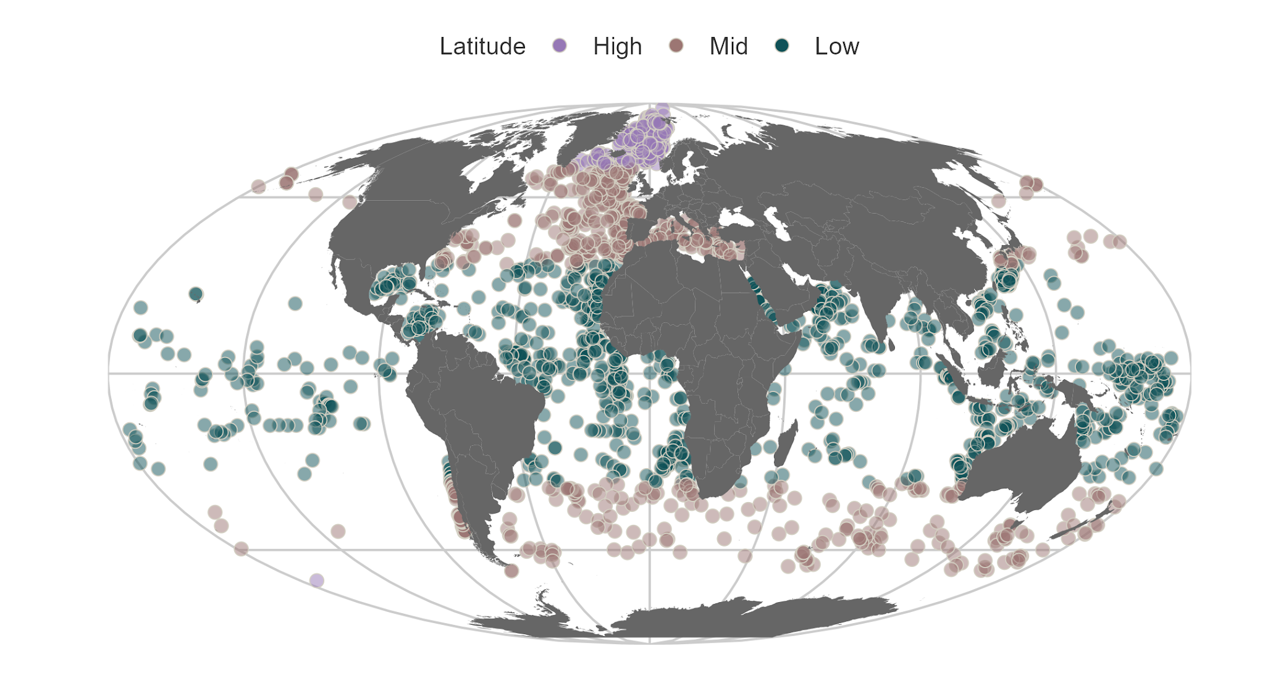

Slide 36




Climatic Mismatch = Actual Temperature - Assemblage Temperature
Assemblage Temperature ~ ∫ Species Temperature Niches

Slide 37



Slide 38





Slide 39


